Slide 1
Those That Came Before – Ancestry and the Stories That Shape Us

Slide 2
Does knowing where we came from change who we become? Reflect upon these three questions and jot down some thoughts.
Which matters more in shaping us: the ancestors we know, the family stories we were told, or the people who actually raised us? Why?
Have you ever learned something about an ancestor that caused you to see your own life differently?
If you could ask one ancestor a question that had nothing to do with names, dates, or places, what would you ask?

Slide 3

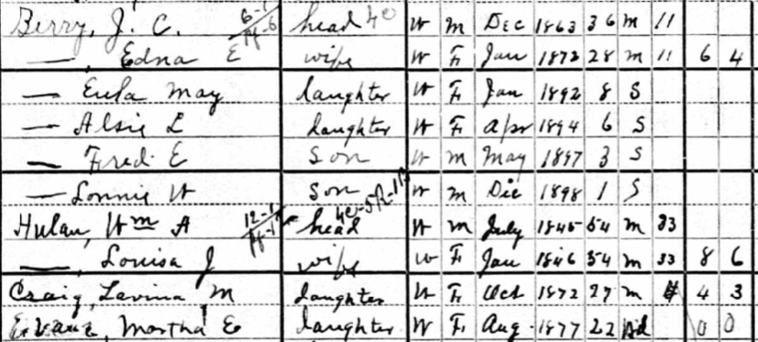
Notes:
What do we inherit besides DNA?
Pride in our ancestors accomplishments – Helen Fuller Officer (Leadville) was the first female graduate of the Colorado Seminary, precursor to the University of Denver
1-or it could be the collective trauma or sorrow of the women whose children didn’t survive
2-3-4
https://www.genealogybank.com/doc/newspapers/image/v2%3A12C601A5C4B97518%40GB3NEWS-138578651A7BC900%402410074-13856DFEB526B850%402-13856DFEB526B850%40?h=3&fname=Helen&lname=Officer&fullname=&kwinc=&kwexc=&rgfromDate=1886&rgtoDate=1886&formDate=&formDateFlex=exact&dateType=range&processingtime=&addedFrom=&addedTo=&sid=wqiauyolxscnvjnaoedqypjrdtfpxyii_ip-10-166-46-89_1790211637038

Slide 4
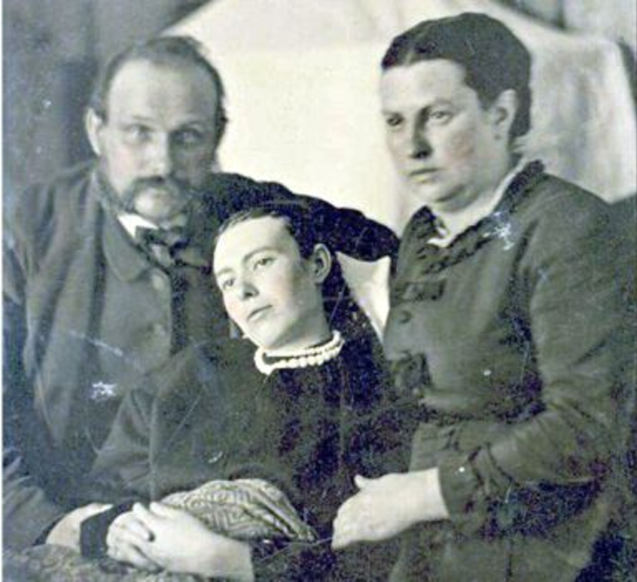
Post-mortem pictures – Most common from the mid-19th to early 20th century.
Notes:
How does knowing what our ancestors lived through affect the way we view the choices they made?

Slide 5
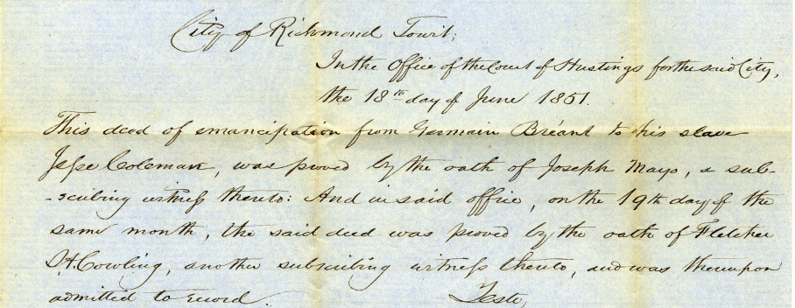
Coleman, Jesse : Deed of Emancipation
Library of Virginia, VirginiaMemory.com
Notes:
Whose stories tend to disappear from families, and what do we lose when they do?
https://rosetta.virginiamemory.com/delivery/DeliveryManagerServlet?dps_pid=IE3666757

Slide 6
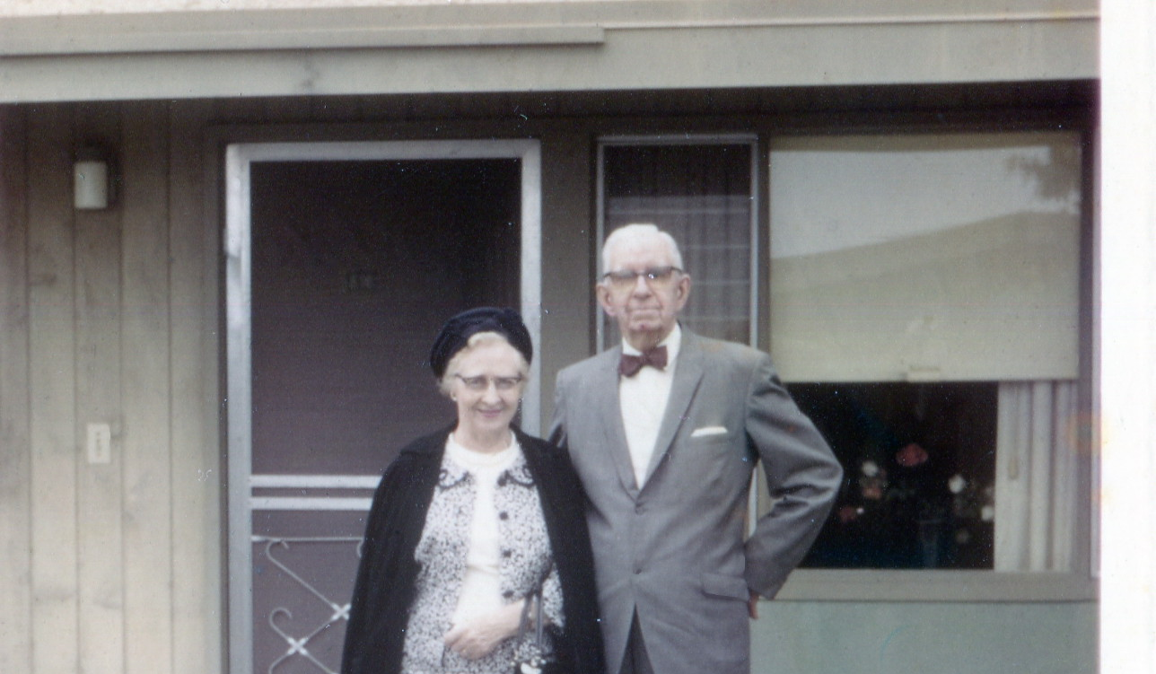
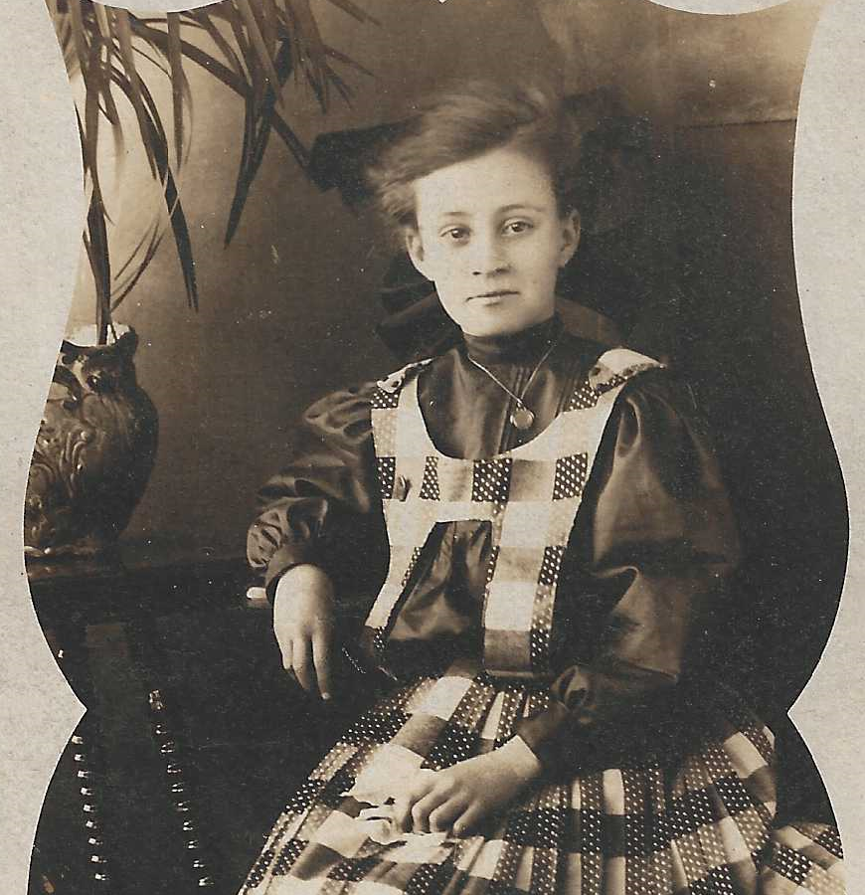
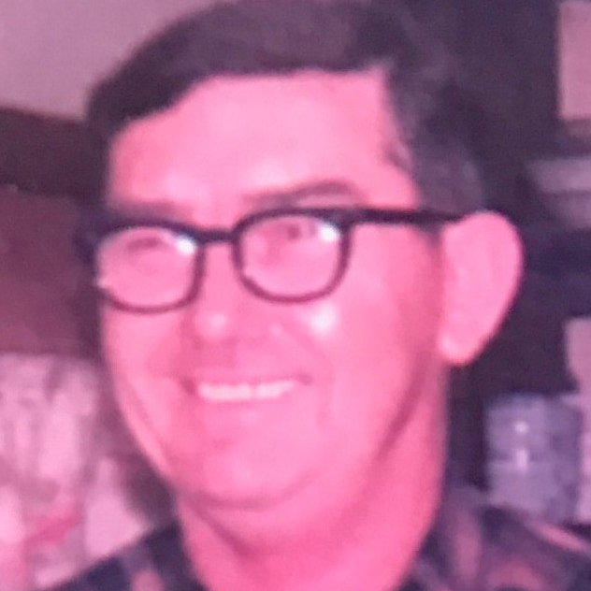
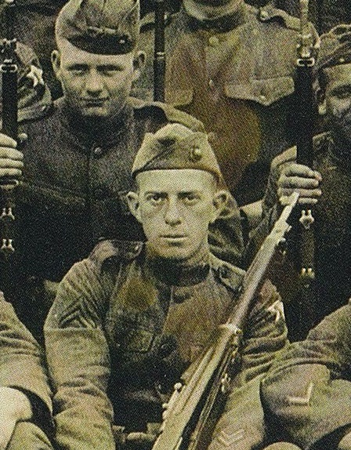
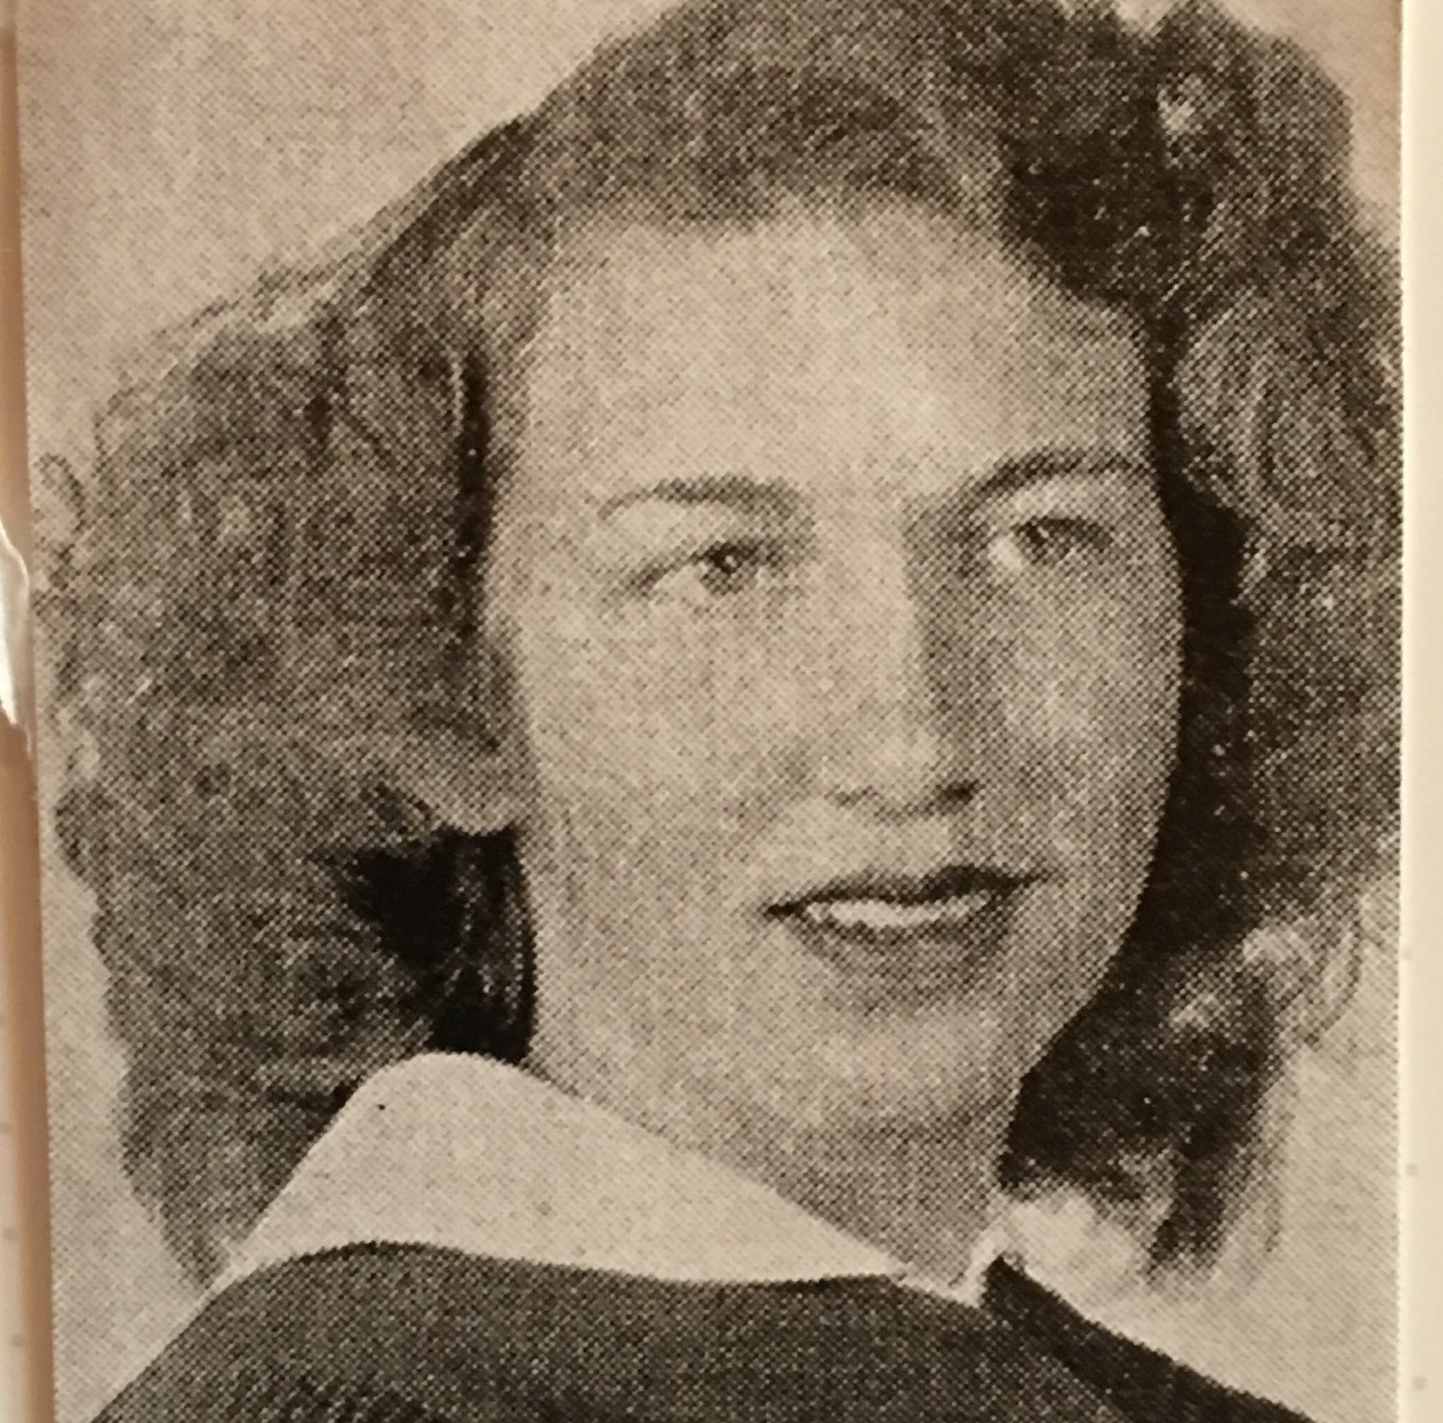
Does knowing where we came from change who we become?
Genealogy finds the people.
History helps us understand them.

