Slide 1

Aging & Medical Care
Advocating for your Health
August 21, 2025
Kerry Hildreth, MD
Assistant Professor
University of Colorado School of Medicine

Slide 2
Objectives
Review recommended screening and preventive services for older women
Learn ways to help you get the most out of your medical visits
Learn ways to advocate for your health and healthcare as you age

Slide 3

Prevention and screening
Improve overall health and lessen future health decline
Screening test vs diagnostic test
Individualize screening and prevention interventions to maximize value
  Age
  Sex
  Personal and family medical history
  Lifestyle or other risk factors
Incorporate patient preferences
Acknowledge tradeoffs between benefits, harms, and costs
Notes:
Life span vs health span
Everyone doesn’t need everything

Slide 4

Potential harms from screening
Anxiety from false positive tests
Harms/complications from the test or additional diagnostic procedures
Overdiagnosis
  Finding and treating a condition that would not have caused symptoms or death within the person’s remaining lifetime

Slide 5

Balancing future potential benefits and immediate potential harms
Balance shifts more toward harm with:
More underlying medical conditions
Poor health and functional status
Shorter life expectancy
Notes:
In other words, older age

Slide 6
Time to Benefit

Slide 7

When to stop screening?
Am I more likely to benefit or experience harm from screening?
  Life expectancy and time to benefit
  https://eprognosis.ucsf.edu/index.php
Personal preferences and shared decision making
  Ability and desire to undergo treatment
Notes:
Avg life expectancy for women in the U.S. is 81 years
But if you live to age 75, the average life expectancy after age 75 is about 12.5 years

Slide 8

Screening and Preventive Care
The USPSTF
A scientifically independent, volunteer panel of national experts in disease prevention and evidence-based medicine that makes evidence-based recommendations about clinical preventive services
Other professional organizations also issue guidelines on screening and prevention
https://www.uspreventiveservicestaskforce.org/uspstf/recommendation-topics/uspstf-a-and-b-recommendations
Notes:
Uncertain future of this panel

Slide 9

Grade | Definition | Suggestions for Practice
A | The USPSTF recommends the service. There is high certainty that the net benefit is substantial. | Offer or provide this service.
B | The USPSTF recommends the service. There is high certainty that the net benefit is moderate or there is moderate certainty that the net benefit is moderate to substantial. | Offer or provide this service.
C | The USPSTF recommends selectively offering or providing this service to individual patients based on professional judgment and patient preferences. There is at least moderate certainty that the net benefit is small. | Offer or provide this service for selected patients depending on individual circumstances.
D | The USPSTF recommends against the service. There is moderate or high certainty that the service has no net benefit or that the harms outweigh the benefits. | Discourage the use of this service.
I Statement | The USPSTF concludes that the current evidence is insufficient to assess the balance of benefits and harms of the service. Evidence is lacking, of poor quality, or conflicting, and the balance of benefits and harms cannot be determined. | Read the clinical considerations section of USPSTF Recommendation Statement. If the service is offered, patients should understand the uncertainty about the balance of benefits and harms.
Notes:
Insurers must cover evidence-based services for adults that have a rating of A or B

Slide 10
USPSTF Examples
Grade | Recommendation
A | The USPSTF recommends screening for colorectal cancer in all adults aged 50 to 75 years.
B | The USPSTF recommends screening for osteoporosis to prevent osteoporotic fractures in women 65 years or older.
C | The USPSTF recommends that clinicians selectively offer a statin for the primary prevention of CVD for adults aged 40 to 75 years who have 1 or more CVD risk factors (i.e. dyslipidemia, diabetes, hypertension, or smoking) and an estimated 10-year risk of a cardiovascular event of 7.5% to less than 10%.
D | The USPSTF recommends against screening for ovarian cancer in asymptomatic women.
I | The USPSTF concludes that the current evidence is insufficient to assess the balance of benefits and harms of screening mammography in women 75 years or older.
Notes:
Guidelines – e.g. Medicare covers a mammogram every year with no age limit

Slide 11
USPSTF A and B screening/prevention recommendations for older women
Diseases
Cancer screening
Other
Hypertension
Depression and suicide risk
Anxiety: adults age ≤64
Diabetes: ages 35-70 years with overweight or obesity
Osteoporosis screening: age ≥65
Hepatitis C screening: ages 18-79
HIV screening: ages 15-65
Breast cancer: mammogram every 1-2 years ages 40-74
Colorectal cancer screening: ages 45-75
Cervical cancer: every 3-5 ages 30-65
Falls: exercise interventions to prevent falls in at-risk adults age ≥65
Tobacco use
Unhealthy alcohol use
Unhealthy drug use
*20 pack-year smoking history and currently smoking or quit within the past 15 years
Notes:
For average-risk women.
Importance of individualizing recommendations based on your personal and family history, and risk factors

Slide 12
Additional screening and preventive recommendations
Not routinely recommended:
Cholesterol screening
General counseling for cancer and chronic disease prevention
  Avoid tobacco
  Engage in regular physical activity
  Maintain a healthy weight
  Eat a diet rich in fruits, vegetables, and whole grains and low in saturated/trans fat
  Limit alcohol consumption
  Protect against sexually transmitted infections
  Avoid excess sun exposure
Thyroid disease
Vitamin D deficiency
Iron deficiency
Electrocardiogram (ECG)
Coronary artery calcium testing
Screening for peripheral vascular disease
Screening for atrial fibrillation
Screening for carotid artery stenosis
Screening for ovarian cancer
Aspirin for primary prevention

Slide 13

Vaccinations
Advisory Committee on Immunization Practices
A committee within the U.S. Centers for Disease Control and Prevention (CDC) that develops written recommendations for routine administration of vaccines, along with schedules regarding appropriate timing, dosage, and contraindications.
ACIP statements are official federal recommendations for using vaccines and are published by the CDC.
Health plans must provide coverage without cost-sharing for immunizations that are recommended and determined to be for routine use by the ACIP.
https://www.cdc.gov/vaccines/hcp/imz-schedules/adult.html
Notes:
Future of this panel is uncertain – may affect recommendations as well as coverage

Slide 14

Vaccines for older adults
Influenza: one dose annually
Pneumonia: one dose for ages ≥50 years*
COVID 2024-25: two doses, six months apart
Respiratory syncytial virus (RSV)
  one dose (age ≥75)
  Consider in high-risk adults age 60-74
Tetanus, diptheria, pertussis (Tdap): one dose every 10 years
Shingles – two doses ages ≥50 years
Other vaccines may be recommended depending on your personal medical conditions or risk factors
Keep a record!
*no previous vaccine or unknown vaccine history
Notes:
Adults over 65 make up the vast majority of hospitalizations and deaths from flu, pneumonia, COVID

Slide 15


Do I need a measles vaccine?
Highest number of measles cases in the U.S. since 1992
People born before 1957 are presumed to be immune
Consider vaccinating
  Immunized between 1963-1968 and known to have received the inactivated measles vaccine (Pfizer), or are unsure
  Unknown if/when previously vaccinated and concerned about risk

Slide 16
I. Prevention and screening: summary
Goal is to improve health and reduce risks of future decline
Recommended preventive services have traditionally followed guidelines published by independent panels such as USPSTF and ACIP
Recommendations are individualized
Screening tests require balancing future potential benefits with immediate potential harms
Screening should be discontinued if it is unlikely to benefit the person in their expected remaining lifetime

Slide 17

II. Getting the most out of your medical visit
What are you there for?
  Specific problem
  Follow up on chronic conditions
  General “annual” visit
How long do you have?

Slide 18
Medicare Wellness Visits
Initial Preventive Physical Exam (“Welcome to Medicare”)
  Review of medical and social health history and preventive services education
  New Medicare patients within 12 months of starting part B coverage
Annual Wellness Visit
  Visit to develop or update a personalized prevention plan and perform a health risk assessment
  Covered once every 12 months
No cost!
Notes:
Focused on prevention and wellness!

Slide 19
Components of the Initial Annual Wellness Visit
Health risk assessment
Establish patient’s medical and family history
Establish current providers and suppliers
Measure: height, weight, BMI, blood pressure
Detect any cognitive impairment
Review risk factors for depression
Review functional ability and safety (e.g. falls, hearing, driving, ability to perform activities of daily living)
Establish an appropriate screening schedule
Establish risk factors and conditions
Provide personalized health advice and appropriate referrals for health education or preventive counseling services or programs
Provide advance care planning services
Review current opioid prescriptions (if applicable)
Screen for potential substance use disorders
Perform a social determinants of health risk assessment

Slide 20
Components of the Subsequent Annual Wellness Visit
Review/update health risk assessment
Update patient’s medical and family history
Update current providers and suppliers
Measure: weight, blood pressure
Detect any cognitive impairment
Update the screening schedule
Update risk factors and conditions
Provide and update personalized health advice and appropriate referrals for health education or preventive counseling services or programs
Provide advance care planning services
Review current opioid prescriptions (if applicable)
Screen for potential substance use disorders
Perform a social determinants of health risk assessment

Slide 21

What is missing?
Medicare does not cover a “routine” or “annual physical”
The Social Security Act explicitly prohibits Medicare coverage of routine physical exams.

Slide 22

Getting the most out of your doctor’s visit
Be prepared
Have a (short) agenda
Prioritize and negotiate
Consider more frequent visits
Notes:
Know why you are there – e.g. specific problem, follow up, annual?
Your and your doctor’s agenda may not overlap
Schedule a f/u visit to discuss other concerns

Slide 23

Getting the most out of your doctor’s visit
Keep records: medications, surgeries, vaccinations, allergies
Avoid the “hand on the door” question

Slide 24
II. Getting the most out of your medical visit
Know why you are there and how long you have
Be prepared
Prioritize your issues

Slide 25
III. Advocating for your health
Advocate (v): to support or argue for; to plead in favor of
Patient-centered care: care that is respectful of and responsive to individual patient preferences, needs, and values, and that ensures that patient values guide all clinical decisions
Most healthcare providers are not aware of what matters most to an individual patient
Shared decision-making
  Patients are invited to participate in decisions about their care
  Given information about options in ways they can understand
  Invited to ask questions

Slide 26

Advocating for your health
Are you being heard?
Ask for clarification if you are not sure
Share what is important to you, what matters
Review your after-visit summary or notes
It’s okay to ask for a second opinion or request another doctor if the fit isn’t good
Consider bringing someone with you
Be informed, but consider the source

Slide 27
Reliable sources of health information
The National Institutes on Aging (https://www.nia.nih.gov/)
American Geriatrics Society (healthinaging.org)
The Alzheimer’s Association (alz.org)
The North American Menopause Society (menopause.org)
MedlinePlus, part of the U.S. Library of Medicine (medlineplus.gov)
The websites of other established academic medical centers, e.g. (mayoclinic.org)

Slide 28

Planning ahead
How to advocate for yourself if you can’t?

Slide 29
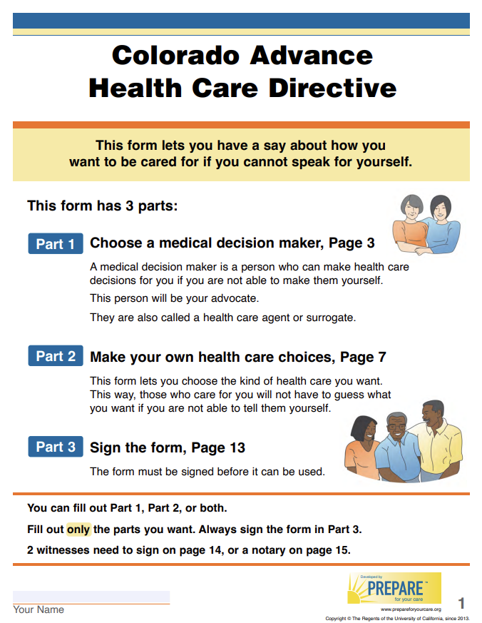
Advance care planning
Medical durable power of attorney
  Who would make medical decisions on your behalf if you could not?
Living Will
  Make your own healthcare choices
https://prepareforyourcare.org/

Slide 30
III. Advocating for your health - summary
Think about what is important to you and share that with your doctor
Know where to go for reliable health information
Identify trusted loved ones who know and will carry out your wishes if they need to

Slide 31
Take home points
Goal of prevention and screening is to improve overall health and lessen future decline
Recommended screening and prevention services are individualized and need to balance benefits, harms, and costs
Being prepared and prioritizing your concerns can help you get the most out of your medical visits
You can advocate for your health by communicating what matters most to you
Choose a medical decision maker and share your healthcare wishes with them

Slide 32

Thank you for your attention!

