Slide 1
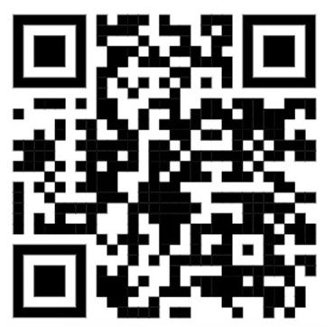
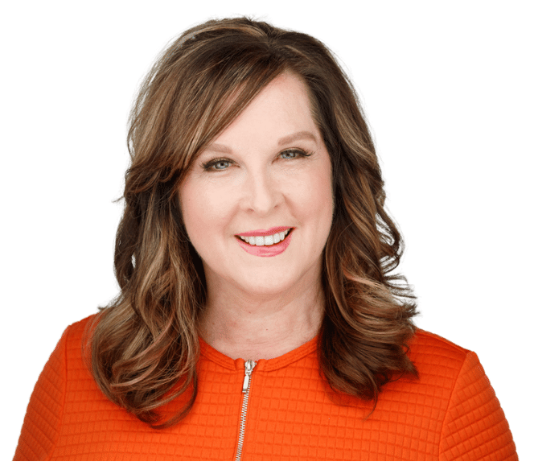
Psycho-Oncology:
The Intersection of Mental Health and Cancer
DianeMSimard.com
Diane M. Simard
Author | Storyteller
Mental Wellness Advocate

Slide 2


Slide 3


Slide 4
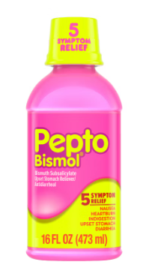

Slide 5

My Most Significant
Emotional Trauma (so far)

Slide 6
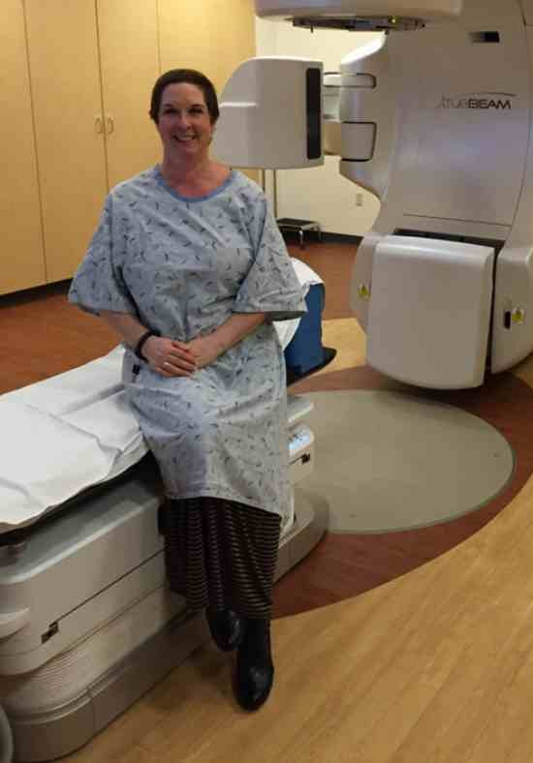
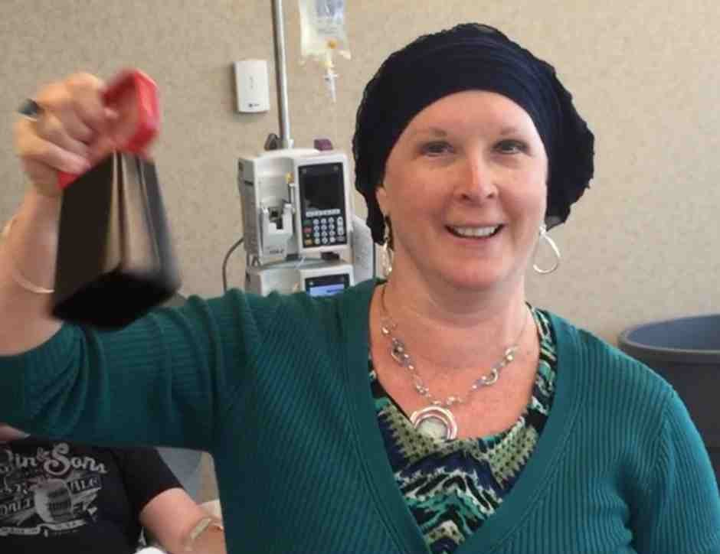
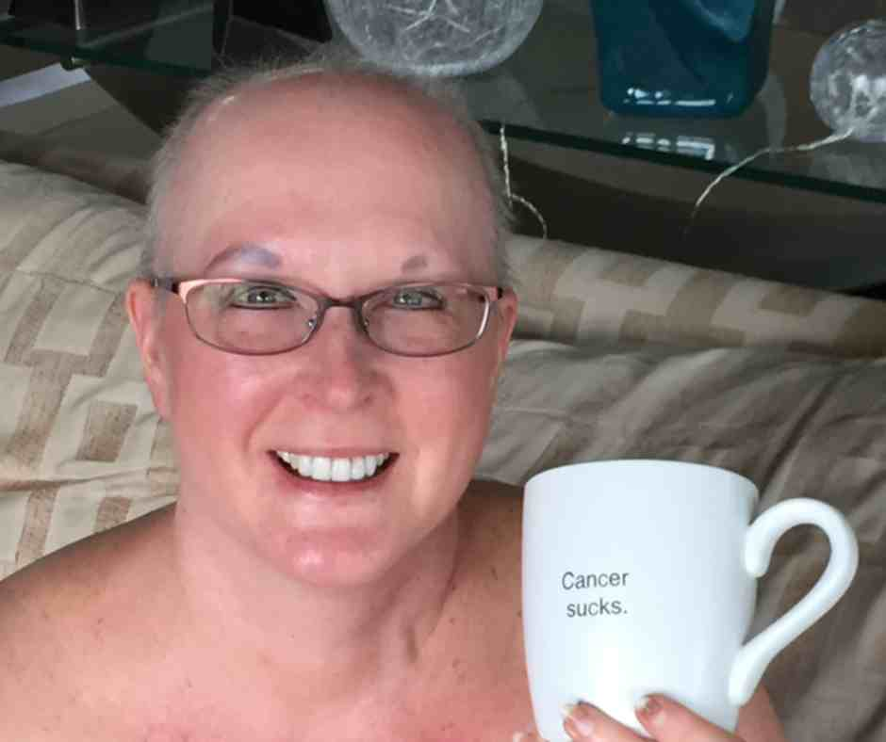
Stage 3c Breast Cancer - 2015
16 chemo infusions
Lumpectomy surgery (2X)
33 radiation treatments

Slide 7
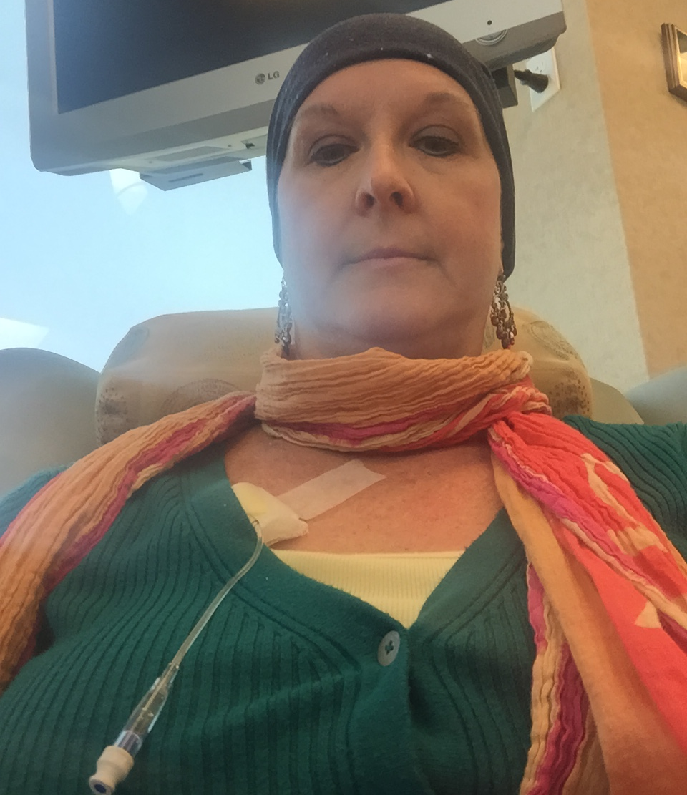

Chemo Anxiety & Depression

Slide 8
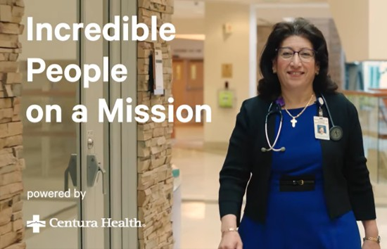
Impact of Psychological
Cancer Trauma
My Anxiety Peaked before 15th
of 16 chemo infusions

Slide 9

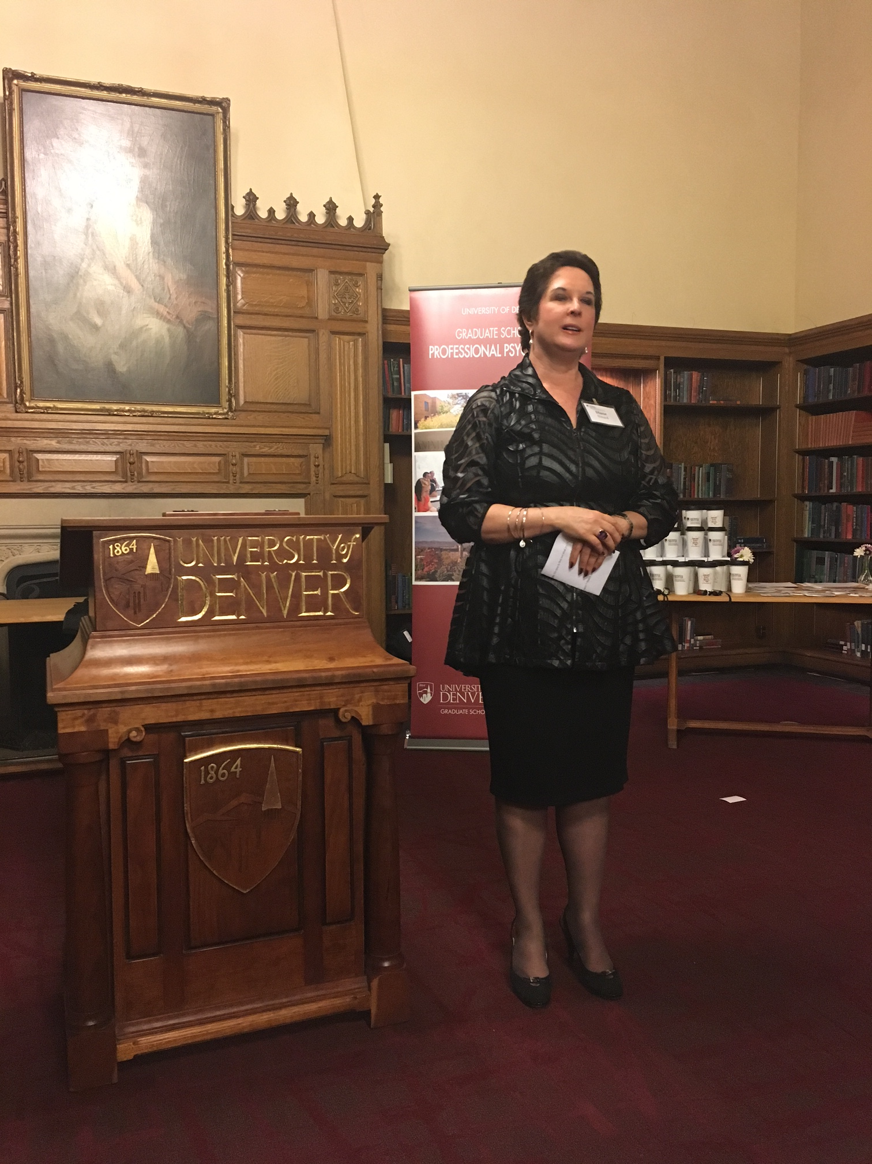
Launched 45 days
after finishing treatment

Slide 10

Academic sequence
has reached ~ 600 students

Slide 11

Psycho-oncology
A cancer specialty that addresses
the emotional, psychological, behavioral,
& social issues
that can
accompany cancer.

Slide 12
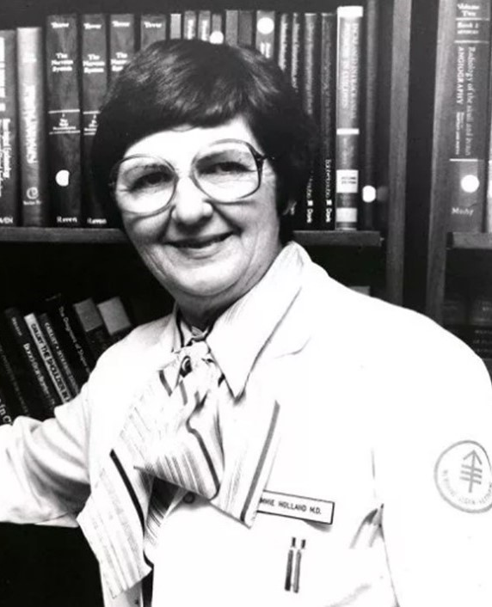
Dr. Jimmie Holland
Pioneer of
psycho-oncology
Introduced the specialty at Memorial Sloan Kettering Cancer Center in the late 1970s

Slide 13

Impact of Psychological
Cancer Trauma
Can change an individual’s capacity to reason, sometimes savagely erasing the ability to cope and heal.

Slide 14

Impact of Psychological
Cancer Trauma
Most Common Symptoms
  Distress
  Depression
  Anxiety

Slide 15

Psycho-oncology
Benefits & Outcomes
  Improved survival rates
  Better treatment adherence
  Reduced physical pain
  Boosted immune system
  Strengthened resilience
  Navigation from fight mode back to daily life (first 3 years critical)

Slide 16
Recent Research Findings*
Among adult cancer patients, 10.6% developed
a new-onset mental health disorder—primarily depression or anxiety—within the first year after diagnosis. They faced a 51% higher risk of death during the first 1-3 years compared to those without a new mental health diagnosis. This elevated risk diminished over subsequent years.
*Data analysis on 371,189 adult cancer patients at Univ of California-affiliated hospitals diagnosed with cancer in 2013–2023 but had no prior documented mental health disorders.

Slide 17




My Primary
Psycho-oncology Impact Focus
COPE-care pilot project
Long-term goal: To help ensure psychosocial support becomes an integrated and expected component of cancer care rather than an optional add-on

Slide 18

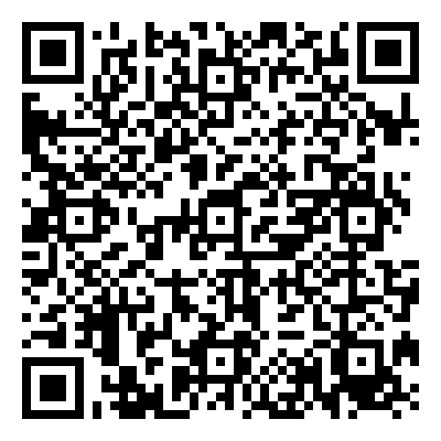
Psychosocial Support Should be a Standard Part of Cancer Care
COPE-Care pilot project
Giving Link

Slide 19

Current Psycho-oncology Impact Focus #2
Video chats about life after breast cancer
Watch my website and newsletter for details!

Slide 20
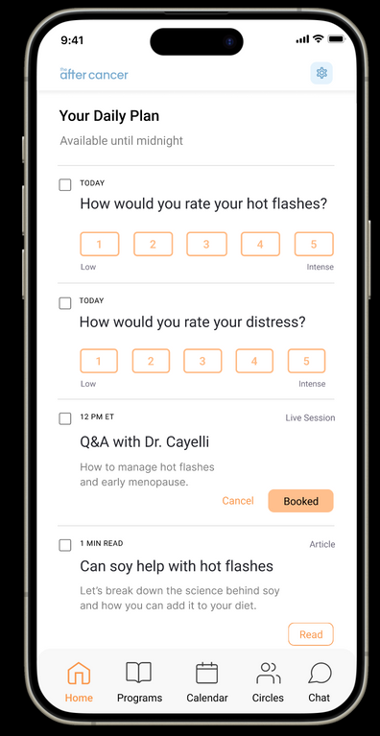

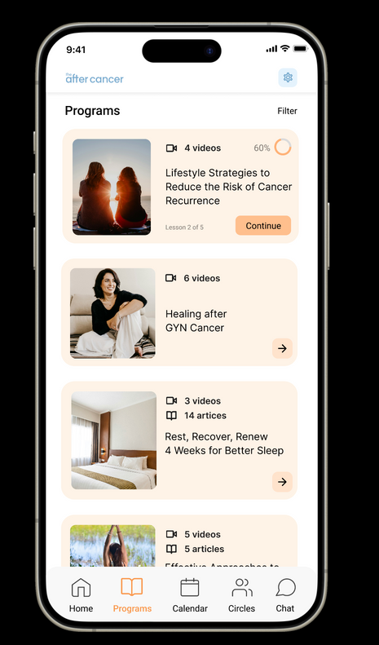
Current Psycho-oncology Impact Focus #3
Digital health tool
that enables health systems, employers, and nonprofits
to deliver clinical-grade
survivorship care.
www.theaftercancer.com

Slide 21

I apply the lessons of psycho-oncology to transform my life experiences into UNLIKELY GIFTS of illumination, helping others understand themselves with deeper clarity.
Which All Means . . .

Slide 22
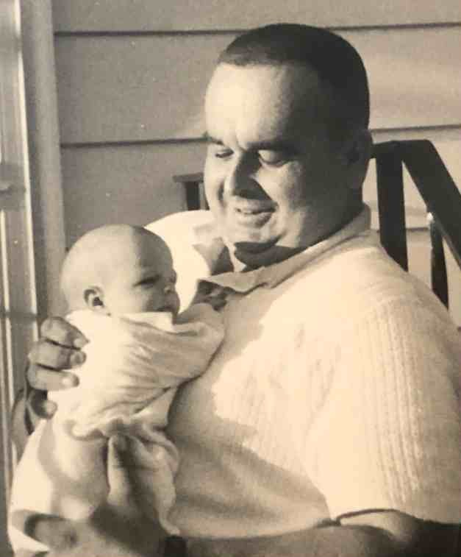
Unlikely Gifts from Breast Cancer
Daddy/daughter
pain resolved

Slide 23


Unlikely Gifts from Breast Cancer
The essence of living
is not about the magnitude of traumas we face, but how we deal with them and ultimately persevere.

Slide 24

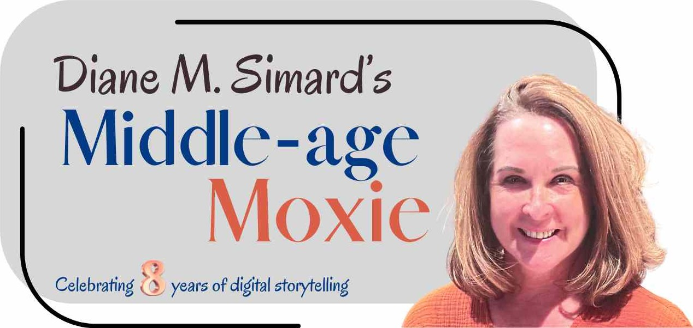
Please Keep in Touch!
Sign up for my monthly newsletter and blog
at DianeMSimard.com
Notes:
Let’s break these down.

Slide 25
Quick Review of My Books
(A.K.A. Shameless
Promo Plug)
Notes:
Let’s break these down.

Slide 26
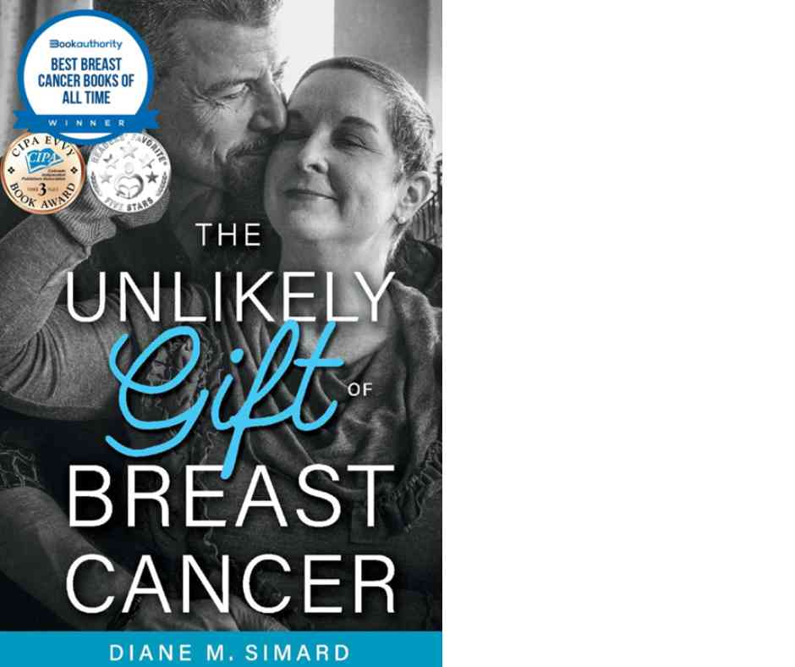
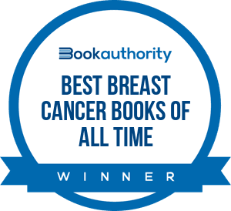
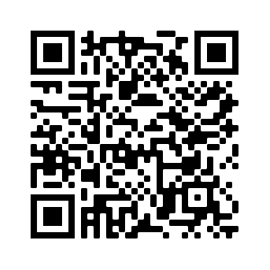
Released 2019
My year with BC in 2015
Authentic, raw, humorous
Appeals to newly diagnosed

Slide 27


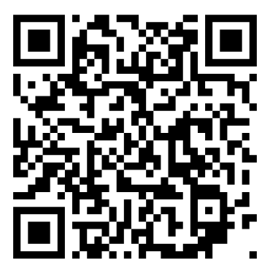
Released 2025
Covers 10 years after treatment ended
Inspiring, self-discovery
Appeals to those struggling to find themselves after BC
Notes:
Let’s break these down.

Slide 28


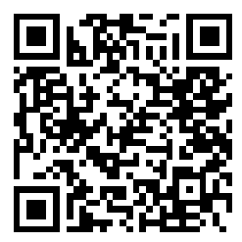
Released 2023
Hard cover (gift book)
Inspirational stories of those who overcame trauma by focusing on impact projects

Slide 29
Thank You!

