Slide 1

Talking About Death Won’t Kill You!
Inspired by Dr. Alan Wolfelt https://www.centerforloss.com/

Slide 2
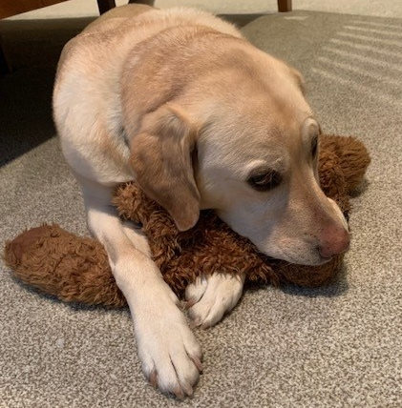
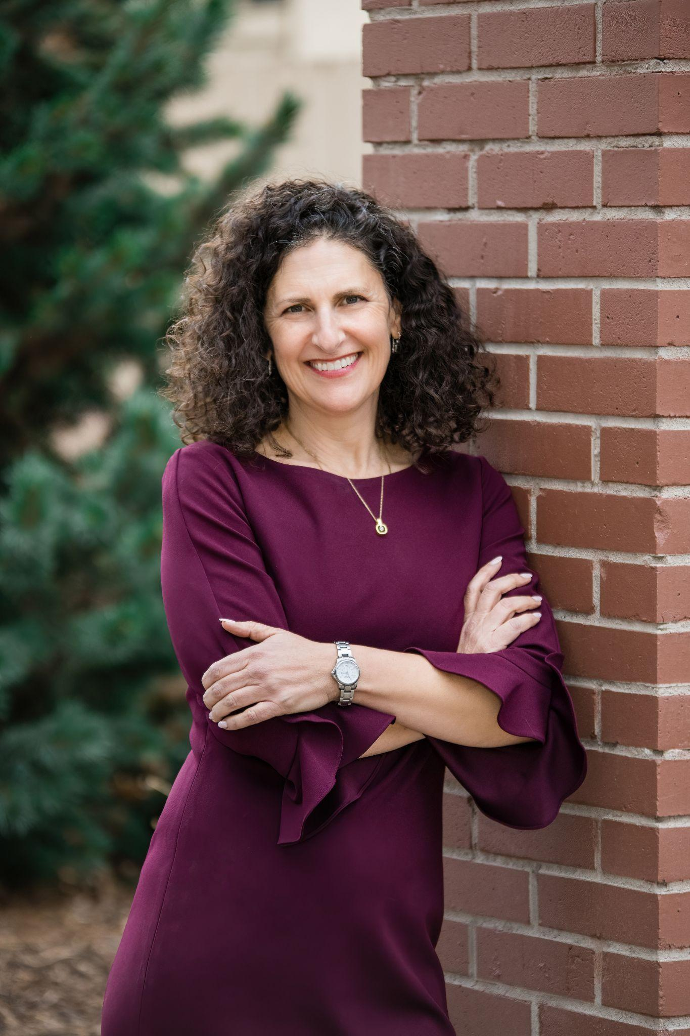
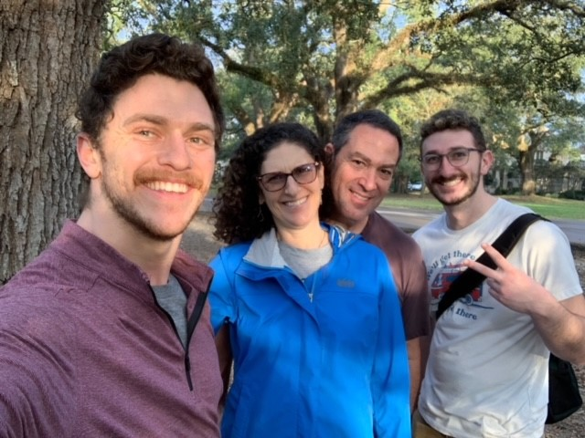
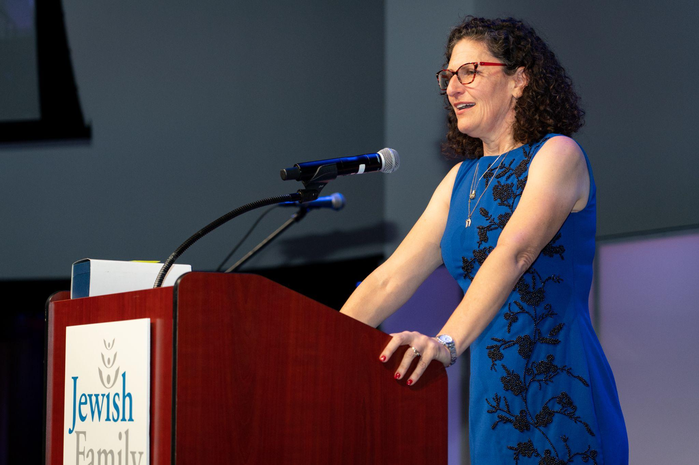
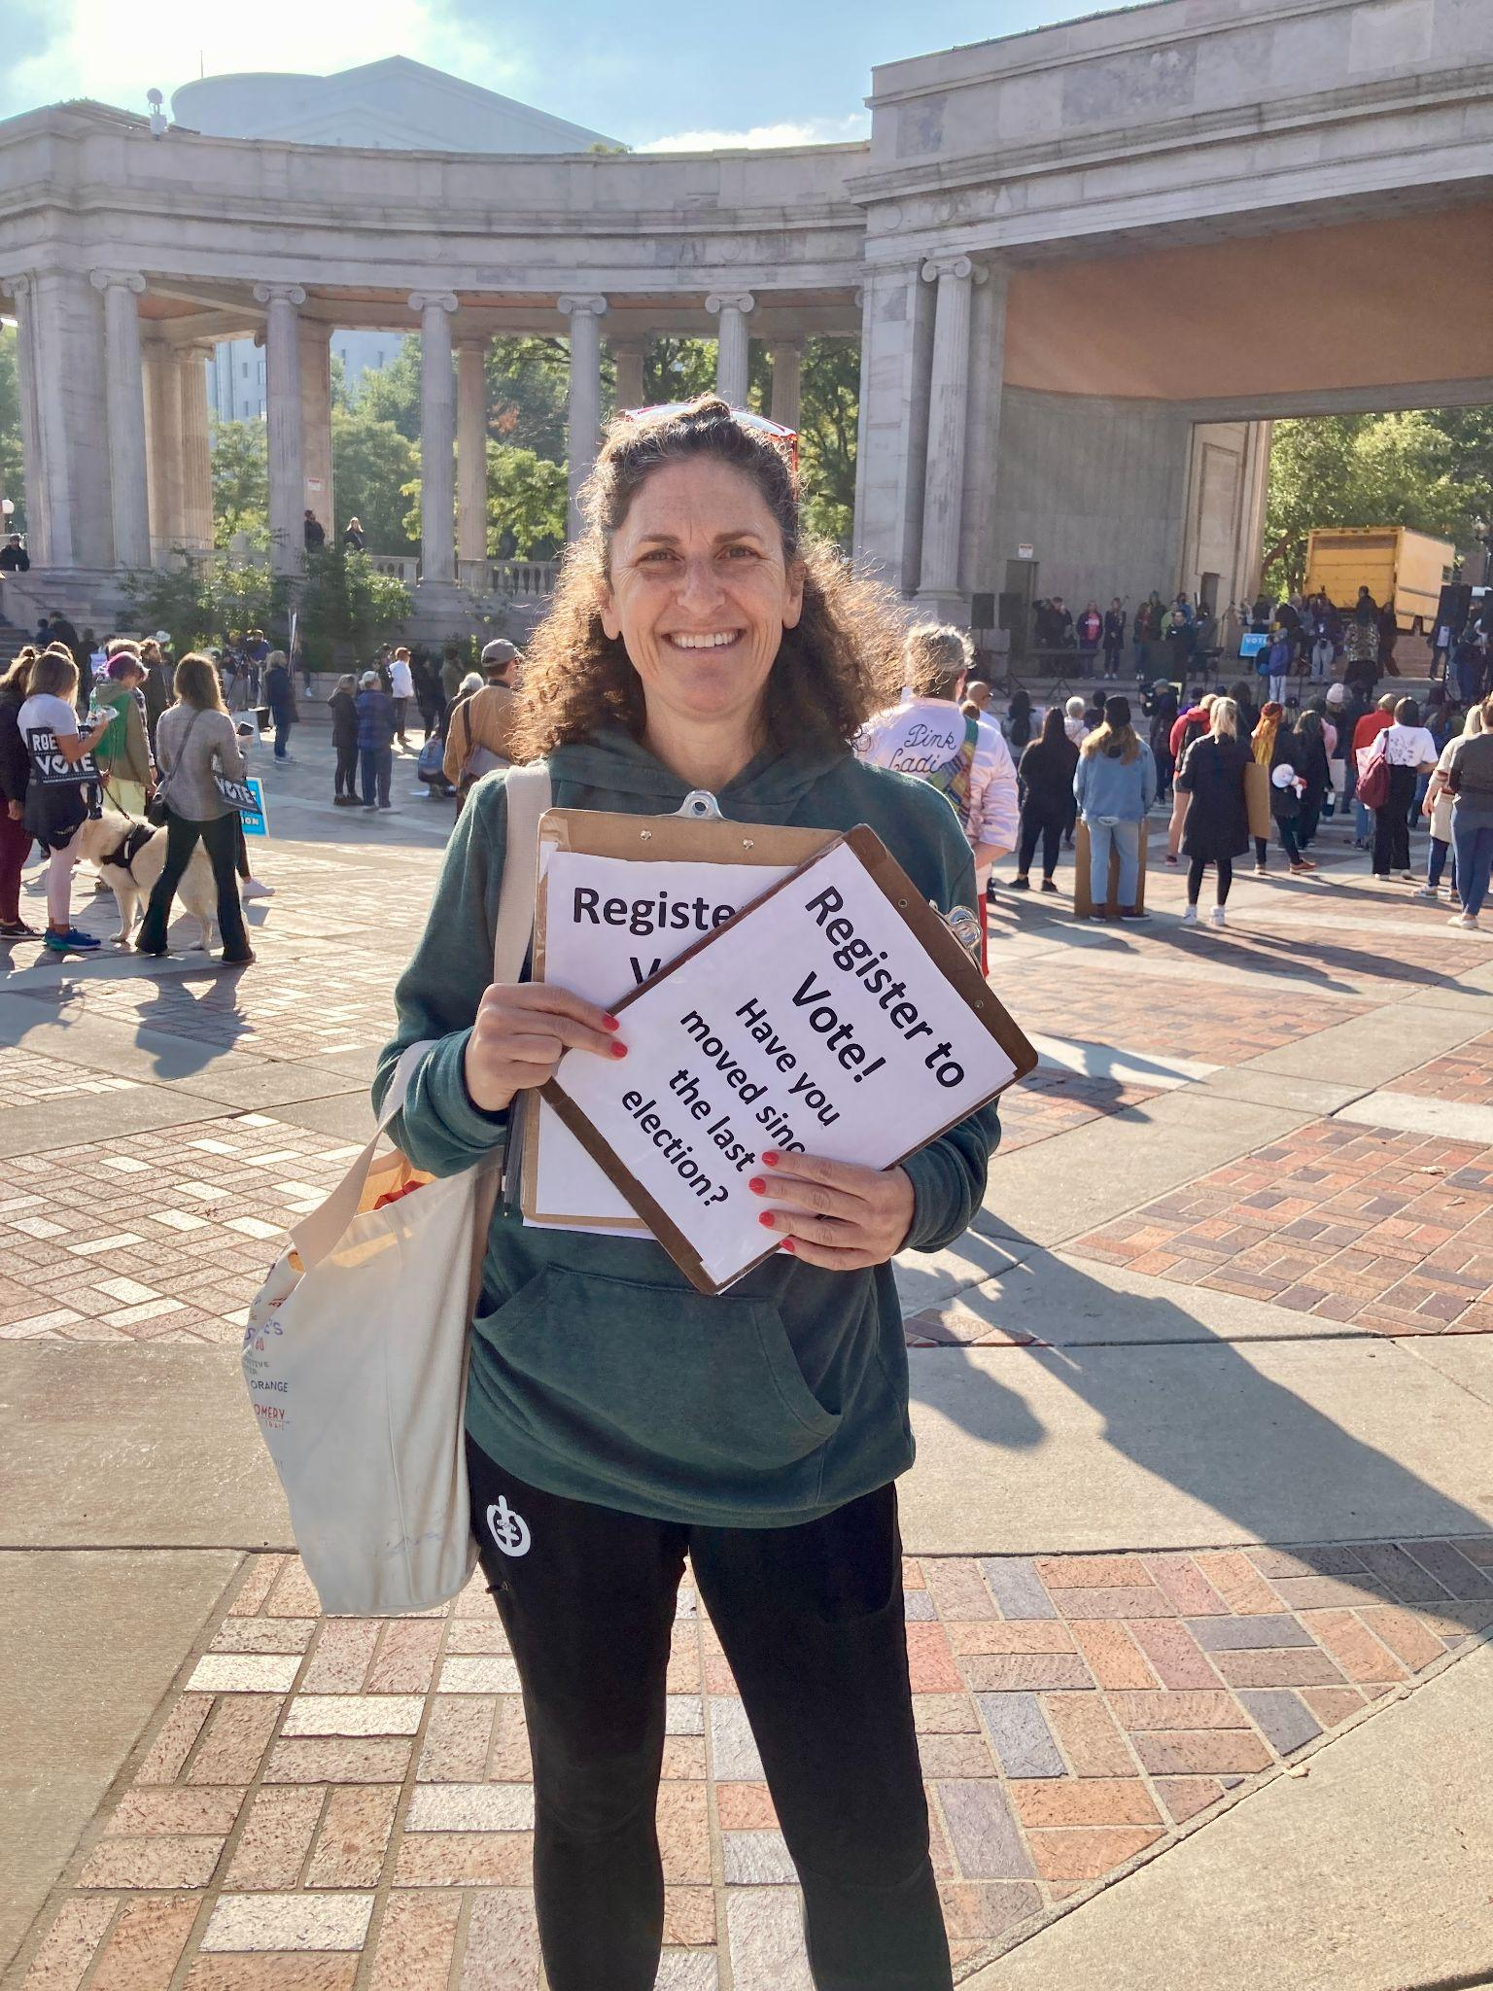
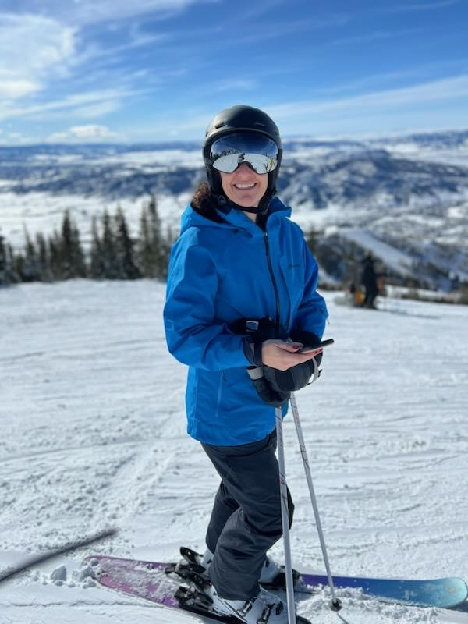
A little about me!

Slide 3
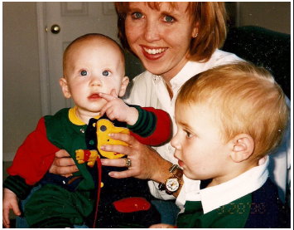
How’d I get into this?

Slide 4
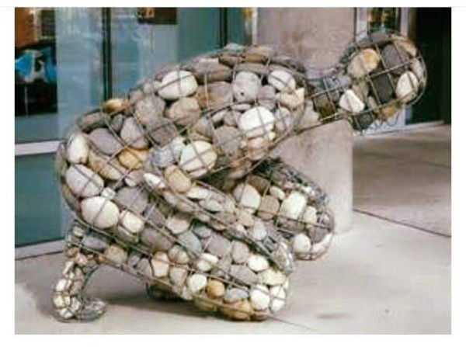
When someone dies…
Notes:
Be fully present!
Difficult in busy, distracted world
Give your complete attention
Put away your phone

Slide 5
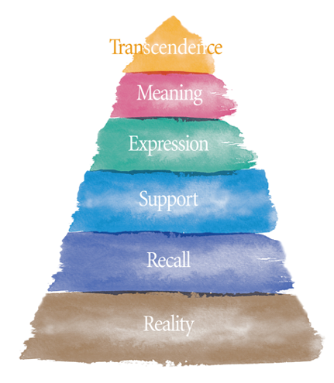

Slide 6

Embrace the pain

Slide 7
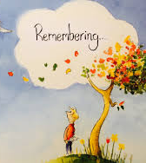
Tell the stories

Slide 8

Create a new self identity

Slide 9

Search for meaning

Slide 10

Receive ongoing support from others

Slide 11

Why plan now?
Notes:
Be fully present!
Difficult in busy, distracted world
Give your complete attention
Put away your phone

Slide 12
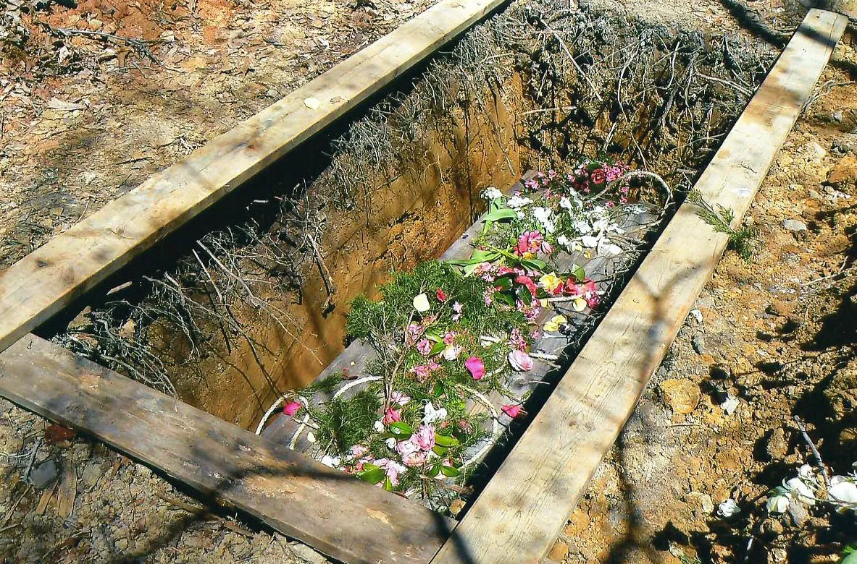
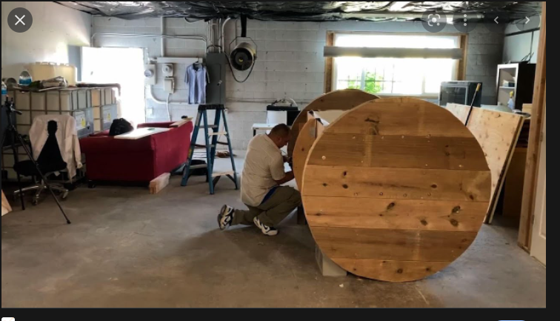
Choices!
Notes:
Allow the person you’re you’re holding space for to have THEIR experience. Do not try to fix the situation. Do not rescue

Slide 13
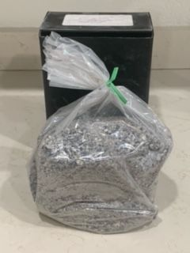
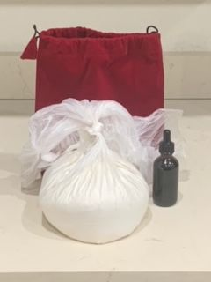
Choices!
Notes:
Allow the situation to unfold. Get comfortable with silence. Avoid saying something dumb. No magic words except maybe “tell me more.”

Slide 14
Inflation 7-10%/year!
All include a ceremony with officiant | Natural Burial (not including cemetery) | Composting | Cremation by Water | Cremation by Fire
2023 | ~10,000 | ~10,000 | ~6,500 | ~5,000
2033 | ~20,000 | ~20,000 | ~13,000 | ~10,000
2043 | ~40,000 | ~40,000 | ~26,000 | ~20,000
2053 | ~80,000 | ~80,000 | ~52,000 | ~40,000
Notes:
You cannot fix the problem. Don’t take on more than you are willing and able to handle. Be empathic, but do not become enmeshed.

Slide 15
Protecting Assets!
What? | For Whom?
Burial Space Items Merchandise and items associated with the burial of the deceased such as caskets, urns, vaults, burial plots, crypt, mausoleum, cremation niches, headstones, opening & closing of gravesite, perpetual care | You and immediate family members including your spouse, your children (natural, adoptive and stepchildren) and their spouses, your siblings and their spouses, your parents
Burial Funds These are funds set aside to cover the services provided by a funeral home, such as the services of the funeral director and staff, use of the funeral home facilities, transportation of the body, preparation of the deceased, embalming, cremation fees, opening & closing of the gravesite, flowers, burial clothing, death certificates, obituaries, etc. | You and your spouse ONLY To be considered exempt, burial funds can only be purchased in an irrevocable prepaid funeral contract (maximum value determined by the State) or a revocable account of less than $1,500.
Notes:
You cannot fix the problem. Don’t take on more than you are willing and able to handle. Be empathic, but do not become enmeshed.

Slide 16





Funding a plan
Notes:
You cannot fix the problem. Don’t take on more than you are willing and able to handle. Be empathic, but do not become enmeshed.

Slide 17

Keeping your money safe
Notes:
You cannot fix the problem. Don’t take on more than you are willing and able to handle. Be empathic, but do not become enmeshed.

Slide 18

Peace of mind and protection!
Notes:
grief is the internal meaning given to the experience of loss. Mourning is when you take the grief you have on the inside and express it outside yourself. Another way of defining mourning is “grief gone public” or “the outward expression of grief.

Slide 19

Thoughts? Questions?
Notes:
You cannot fix the problem. Don’t take on more than you are willing and able to handle. Be empathic, but do not become enmeshed.

Slide 20
Want to get in touch?
Jamie Sarche
jamie@feldmanmortuary.com
303-322-7764
Notes:
You cannot fix the problem. Don’t take on more than you are willing and able to handle. Be empathic, but do not become enmeshed.

