Slide 1
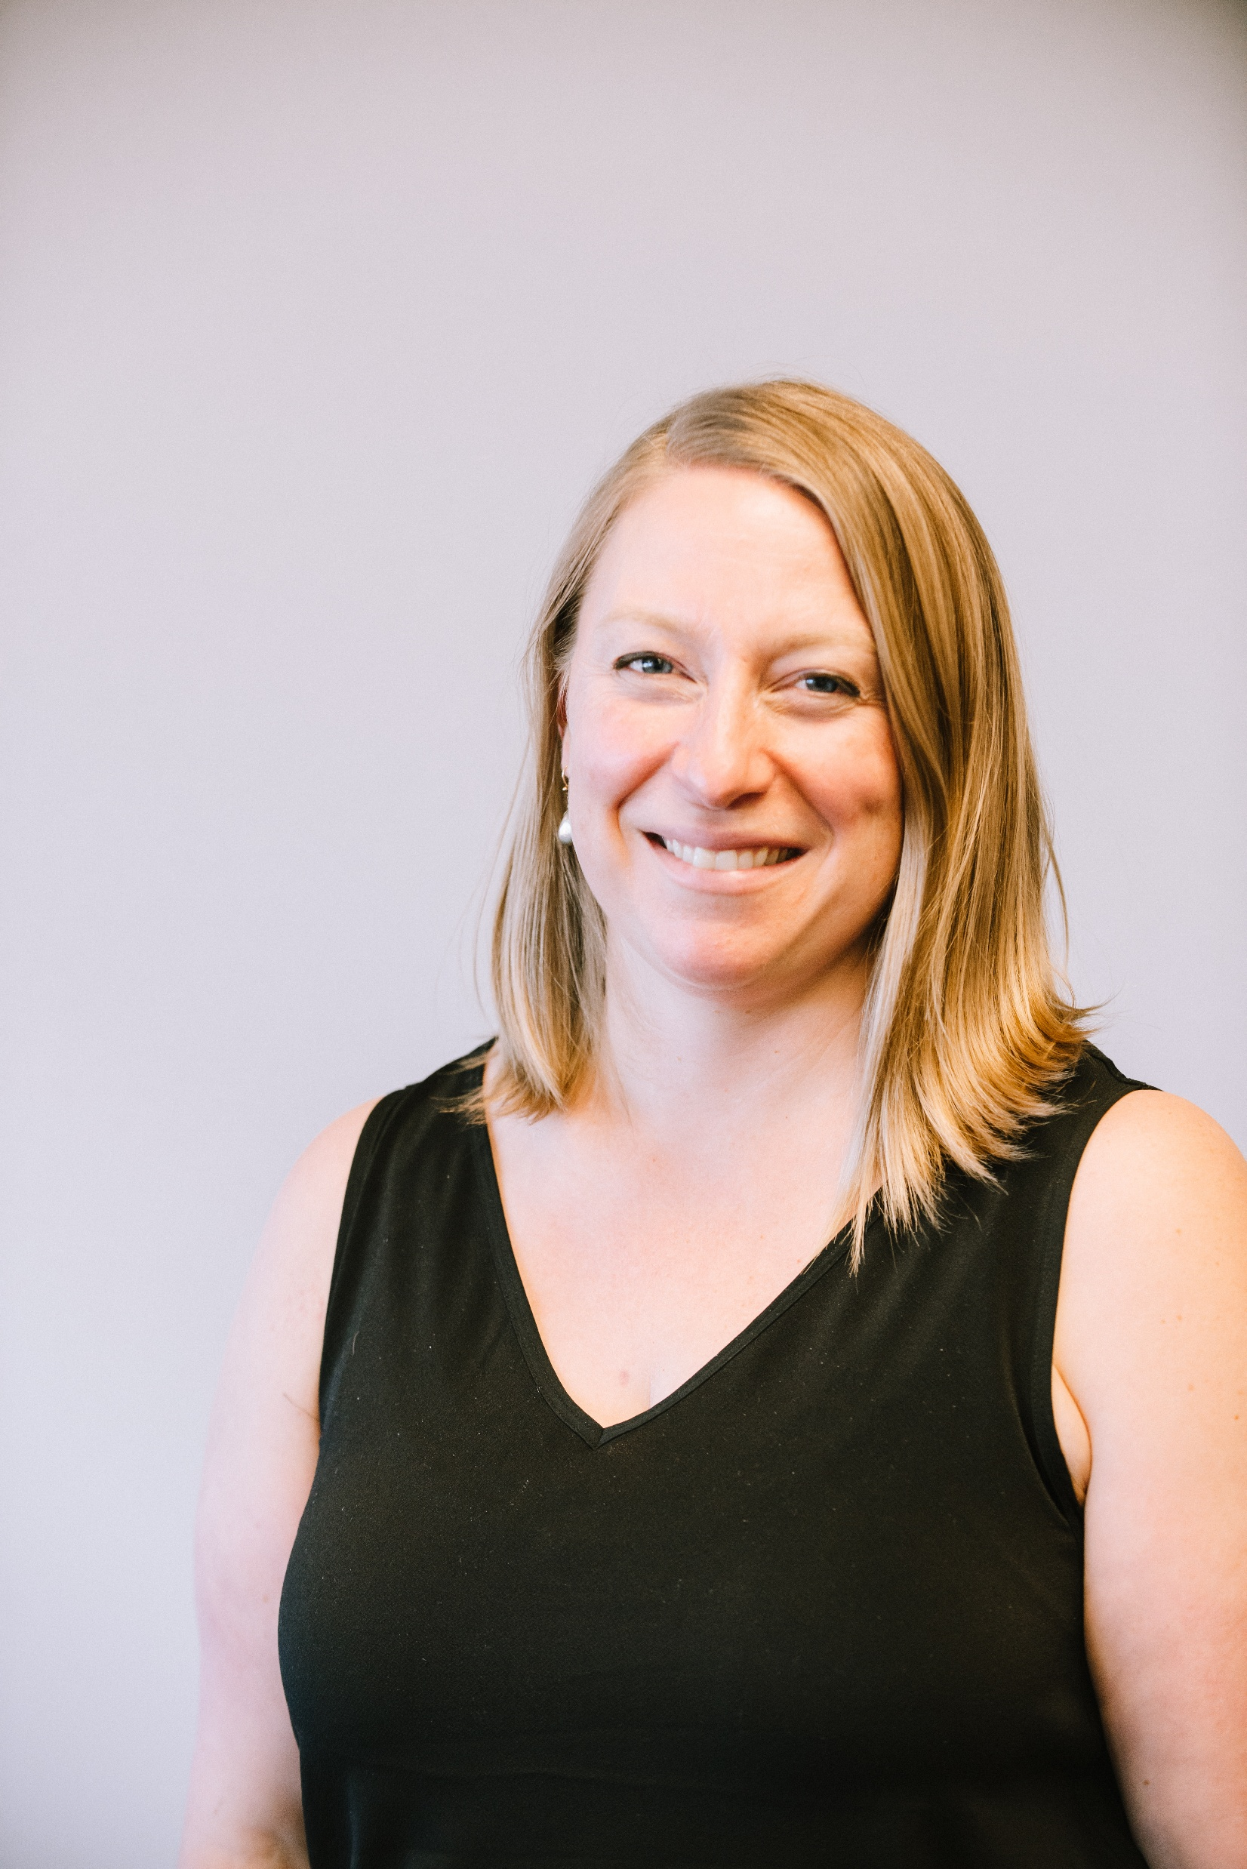
Workouts for the Young at Heart
Dr. Meredith Roberts Lo, DPT
Meredith@ParkinsonsPointe.org
www.ParkinsonsPointe.org
Phone: 720-468-4581

Slide 2
In our Time Today…
Understand the impact of exercise on aging
Explore the advancements to exercise research
Learn how to choose the exercise plan that is right for you
Discover how to help yourself stay motivated
Gather resources that will assist you in exercising
  What would you like answered today?

Slide 3
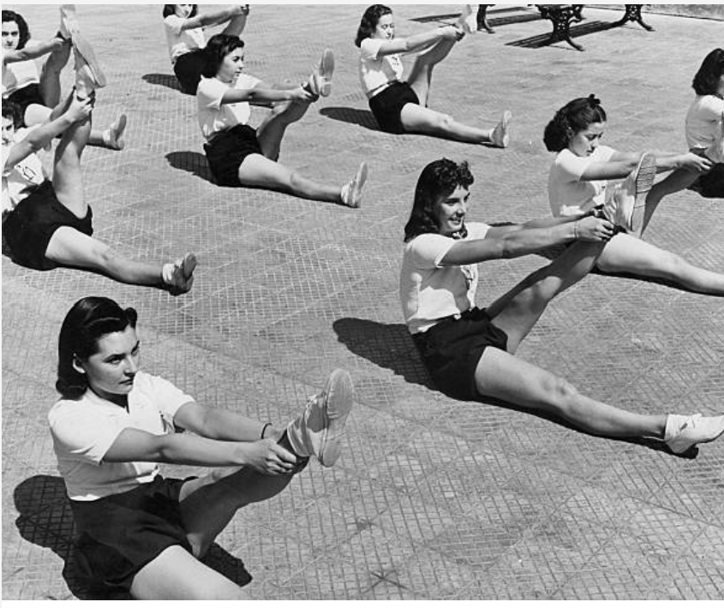
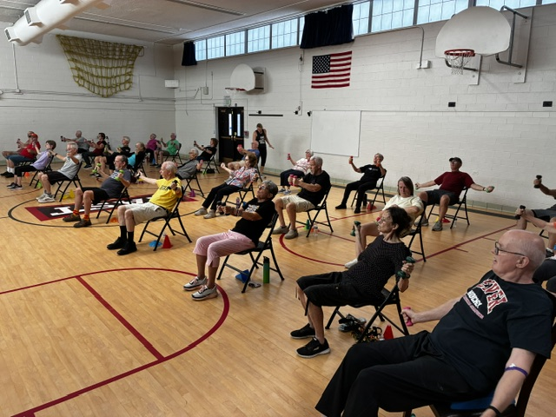
Exercise and Healthy Aging
Notes:
Much has changed in our lifetime about what we understand and believe is appropriate for seniors and exercise

Slide 4
The Well-Known Benefits to Exercise
Improves mood
Reduces stress and inflammation
Assists in improving quality of sleep
Enhances digestion and elimination
Improves strength, flexibility and cardiovascular function
Improves mobility and ability to remain independent with self care
Enhances cognition and learning skills

Slide 5
The Side Effects to Exercise
May create muscle soreness
There is a potential risk for a fall
May create some fatigue or general tiredness after
  Dependent upon the person and their health

Slide 6
Is Exercise Neuroprotective?
Exercise can be preventative for many diseases of old age…
  Dementias
  Parkinsons
  Heart disease, stroke, diabetes,
  Weight bearing exercise to prevent osteoporosis
When done correctly
Animal models demonstrate exercise releases
  BDNF, GDNF, IGF-1
PROTECT dopamine producing neurons and our cognition/thinking skill neurons to keep them alive longer
Notes:
Longetudinal studies ongoing

Slide 7
Exercise Research Progression
Exercise is safe
Exercise improves movement
Exercise changes the brain
  It is preventative and slows the progression of the disease
Exercise needs to be dosed appropriately to work
  Multi Modal, includes high intensity aerobic activity for neuroprotective effects
We need to continue to take it to have it work
  So how do we create sustainable programs?
Notes:
If we could put exercise in a pill then we would all be taking it

Slide 8
Current Research Demonstrates
Exercise can be preventative for many neurodegenerative diseases
If changes have been noted in cognition or you have been diagnosed with MCI, dementia, PD, etc. exercise is important in slowing disease progression
Data on octogenarians indicates exercise for 30 min a day is a key pillar in longevity

Slide 9
Current Research in Aging and Lifestyle
Li Y, Wang K, Jigeer G, Jensen G, Tucker KL, Lv Y, Shi X, Gao X. Healthy Lifestyle and the Likelihood of Becoming a Centenarian. JAMA Netw Open. 2024 Jun 3;7(6):e2417931. doi: 10.1001/jamanetworkopen.2024.17931. PMID: 38900423; PMCID: PMC11190803.
Is a healthy lifestyle associated with a higher likelihood of becoming a centenarian?
Findings:
In this nested case-control study,
Individuals aged 80 years or older were evaluated,
Including 1454 centenarians and 3768 individuals who died before reaching 100 years.
Individuals with the highest healthy lifestyle score (constructed from smoking, exercise, and dietary diversity) had a significantly higher likelihood of becoming a centenarian, compared with those with the least healthy lifestyle behaviors.

Slide 10
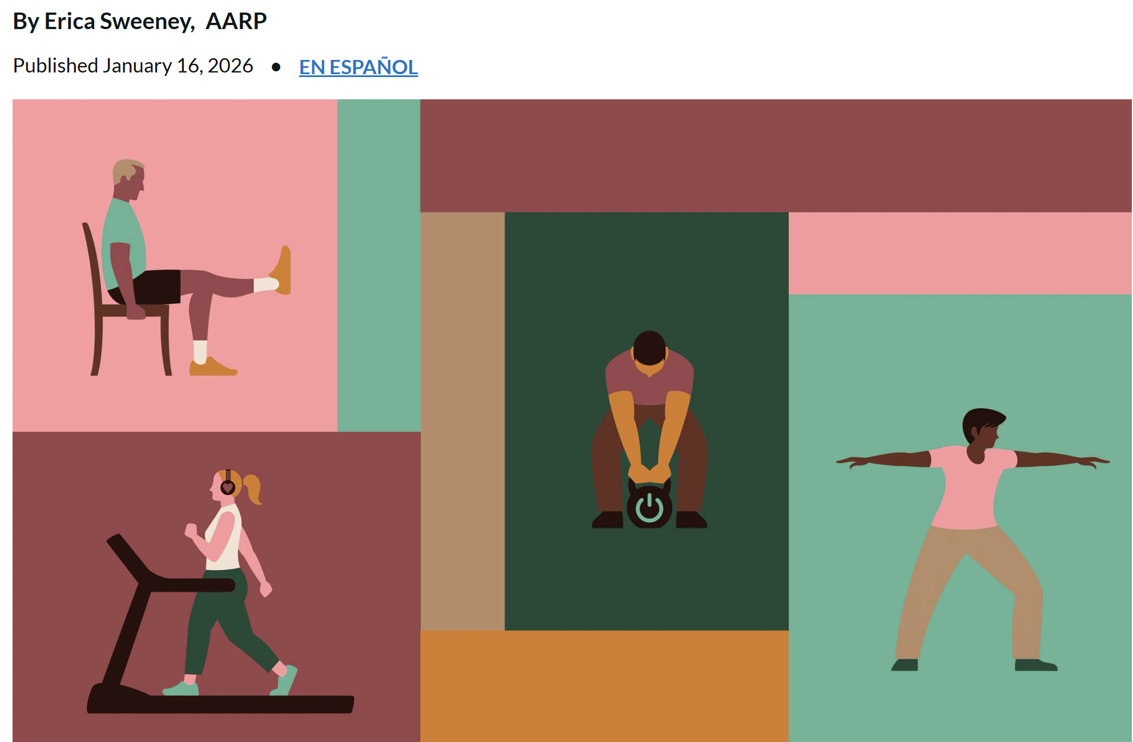
AARP Exercise Guidelines

Slide 11
Current Research in Parkinson’s
Oguh O et al. Parkinsonism and Related Disorders 2014 (1-5)
2252 people with PD one year later
Aerobic exercise of 150 min a week
Associated with higher:
  Quality of life
  Mobility
  Physical function
  Cognition
And LESS disease progression!

Slide 12
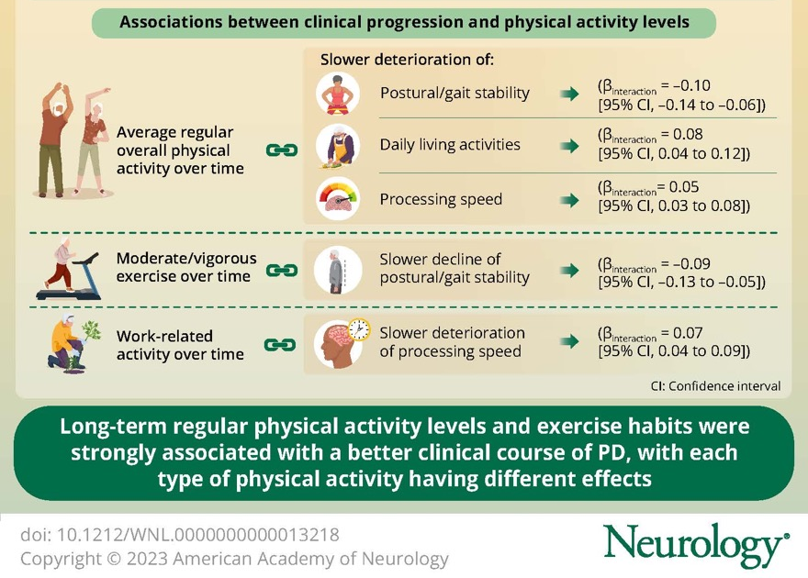
The Impact of Exercise

Slide 13
Current Research in Alzheimer’s
The EXERT Trial (2025):
  Tracked sedentary adults with MCI
  Participated in supervised training 3-4x/week for 12 months
  Cognition remained completely stable in both groups (high intensity and yoga/stretching)
  Typically, we see a sharp decline in this high-risk group over 12 months
The ACTIVE Study:
  Structure cognitive speed and multi modal exercise
  25% lower risk in developing dementia
Comprehensive RCT Meta-Analyses:
  Systematic review of 21 RCTs and older adults found BOTH aerobic and strength training
  Statistically significant improvements in global cognitive function testing

Slide 14

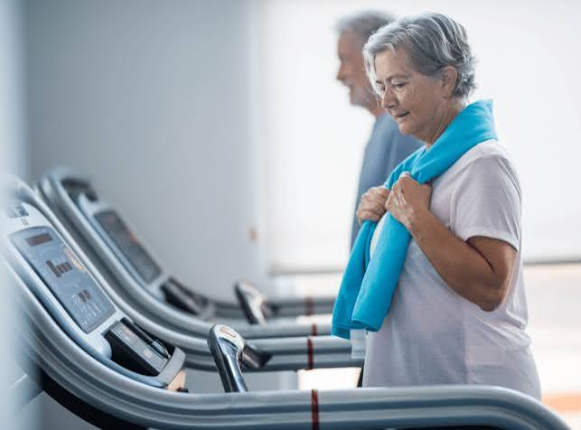
Activity vs Exercise
Activity
  Movement to accomplish a task - Functional
    Housework
    Yard work
    Parking further away from the entrance
Exercise
  Goal directed
  Elevate heart rate or increase your strength
  For set duration of time

Slide 15
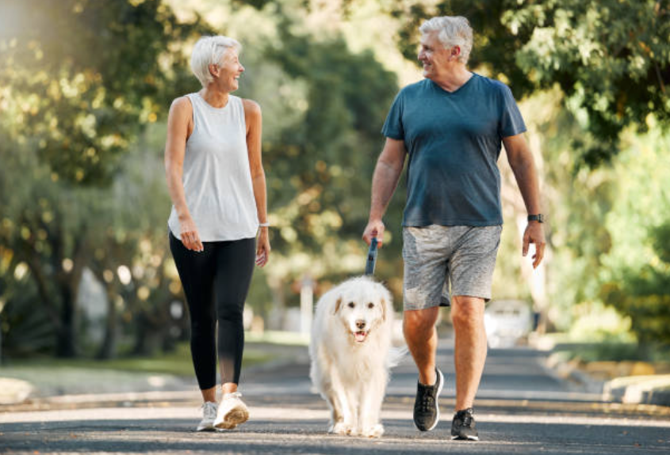
Activity is a good place to start
Activity is important as well
  Functional movement or those who take more than 7,000 steps a day
  Demonstrate reduced risk and improved overall health compared with sedentary individuals

Slide 16
4 Keys to Exercise as Medicine
Intensity
  75-80% of heart rate max
Complexity
  learning new things and challenging your brain – dual tasking
Timing
  the sooner I start the better and keep it going – benefit in starting at any age!
Saliency
  believe it has value and enjoy or have FUN

Slide 17
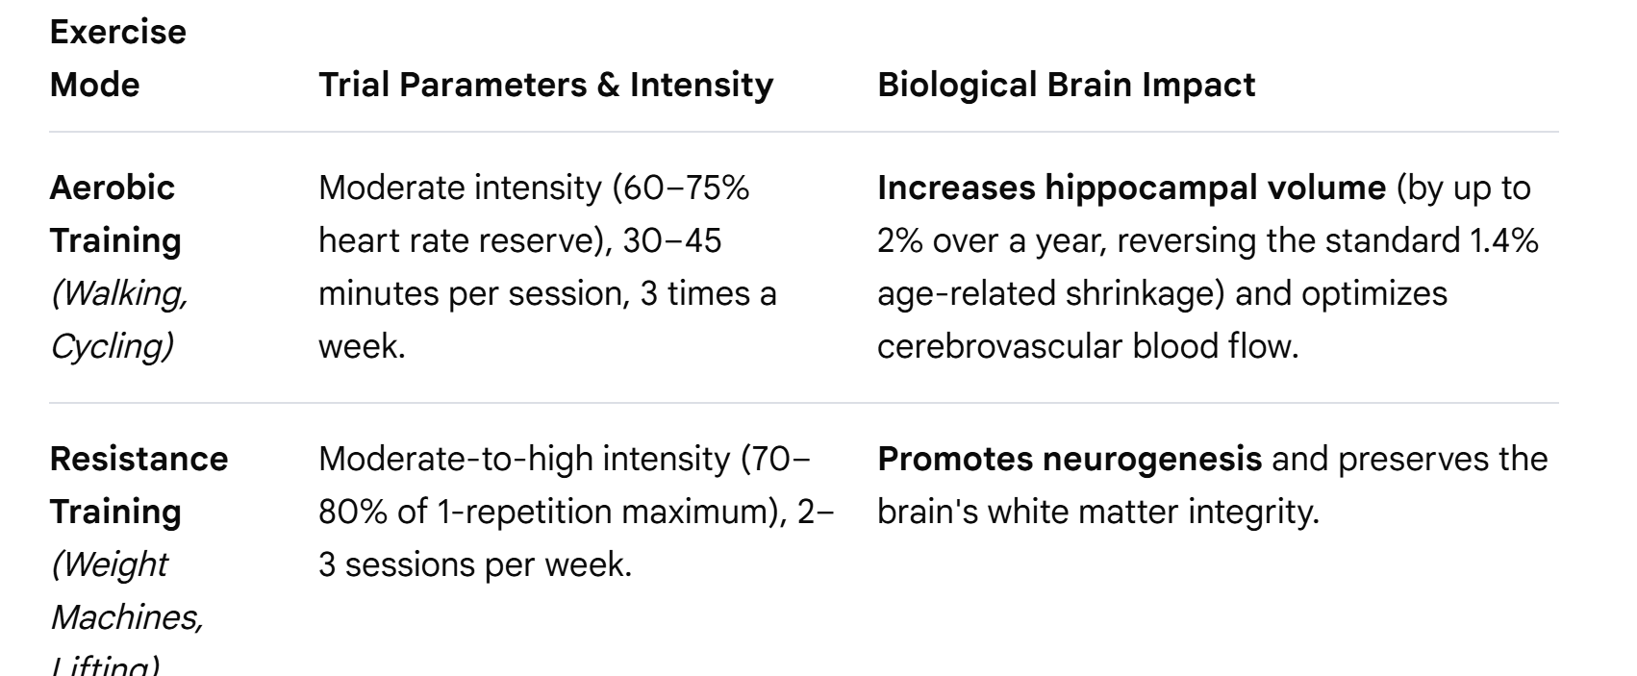
What the Exercise Looks Like

Slide 18
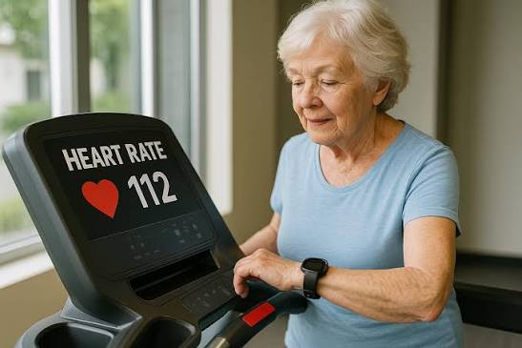
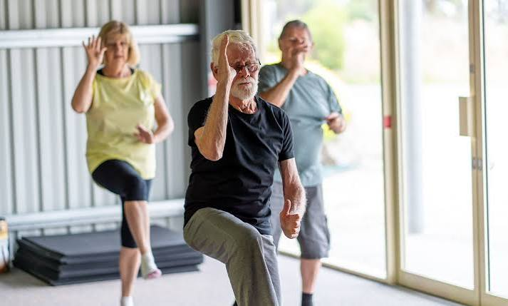
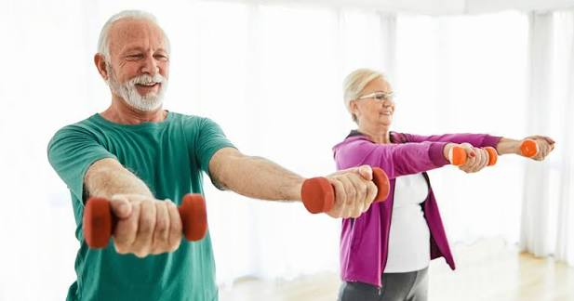
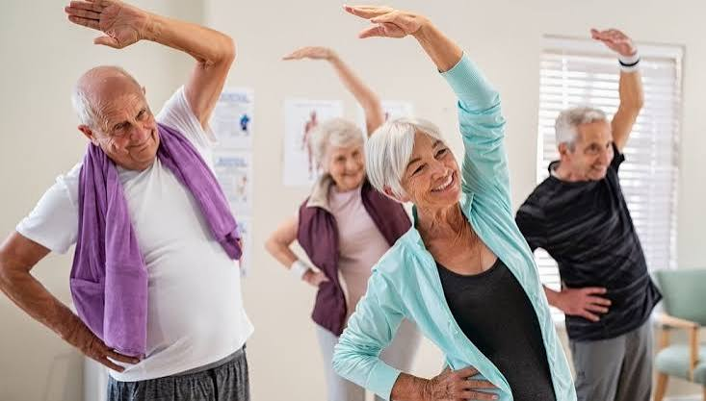
An Exercise Plan Includes 4 Components
Notes:
Aerobic
Strength
Balance
Flexibility

Slide 19
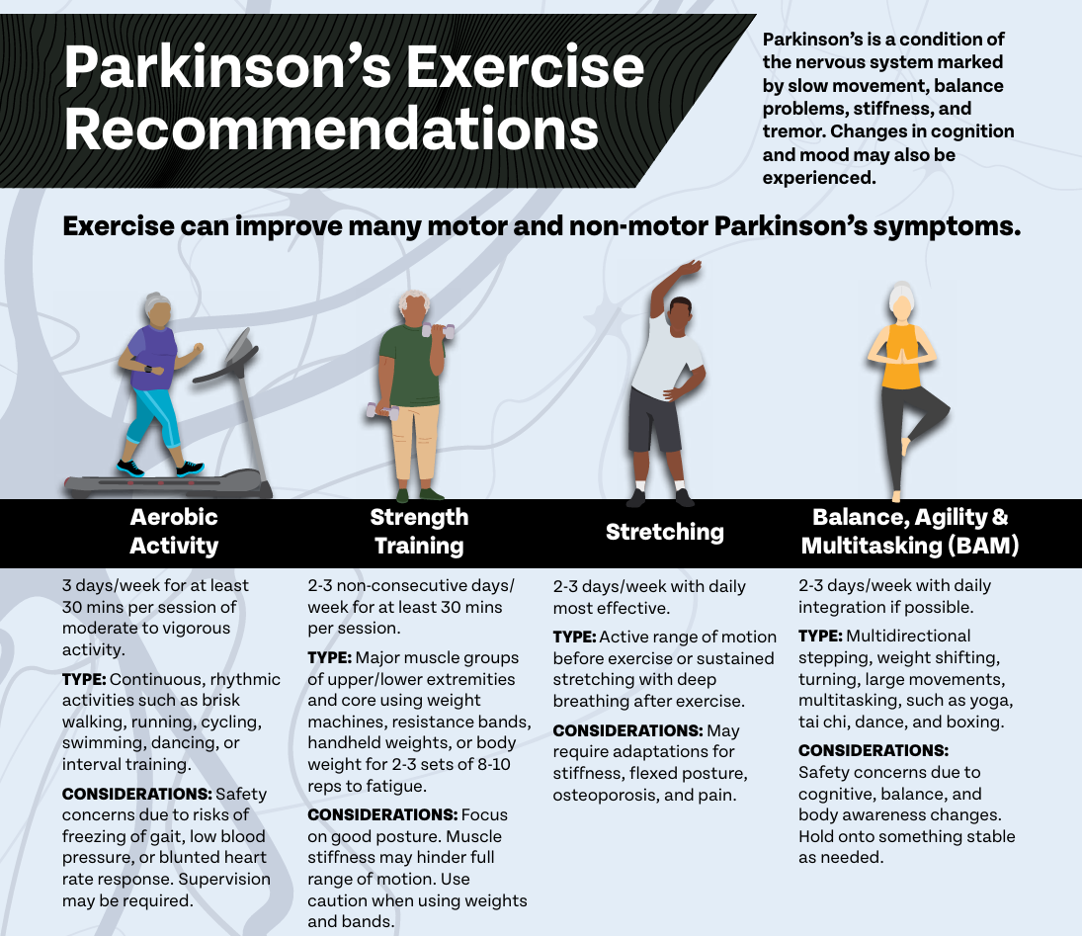
PD Foundation Exercise Guidelines

Slide 20
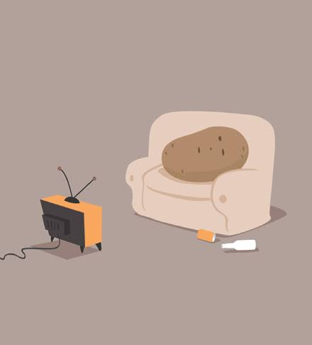
Research Gives us a Goal for Exercise
Aerobic exercise
  30 to 60 min 5-6 days a week (150 min a week)
Strength
  2-3 days a week
Balance
  2-3 days a week
Flexibility
  daily
Take away: AVOID inactivity
  Do what you can when you can
  It all counts and it all helps

Slide 21
Where do I Start?
Aerobic exercise
  2-5 min a day
Strength
  2-3 min a couple times a week
Balance
  2-3 min a couple times a week
Flexibility
  1 min daily
Keep it small and perceived as simple or easy to increase motivation and follow through

Slide 22
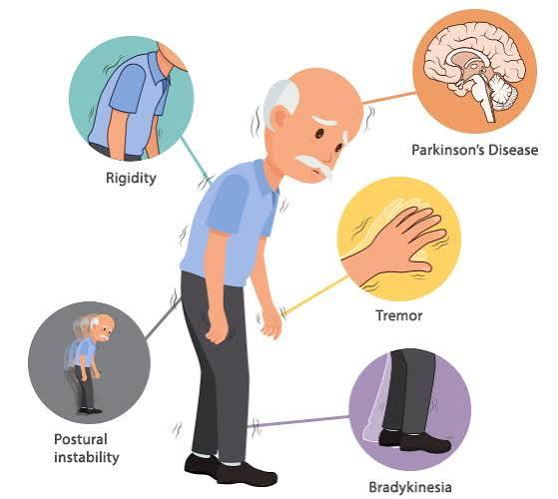
How to Choose an Exercise
What does my body and my health need?
Is it the right intensity for me?
Is it fun and social?
Does it fit my schedule and lifestyle?
Try it a few times to get an understanding of how the exercise answers these questions

Slide 23
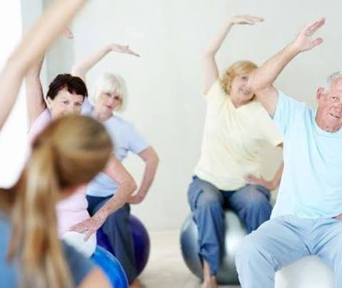
Ask Yourself: What do YOU Need to get started?
Do I have health conditions that require monitoring?
  Talk with your MD
  Work with a physical therapist
Every person is unique
  Where am I starting from?
We all need a different exercise plan

Slide 24
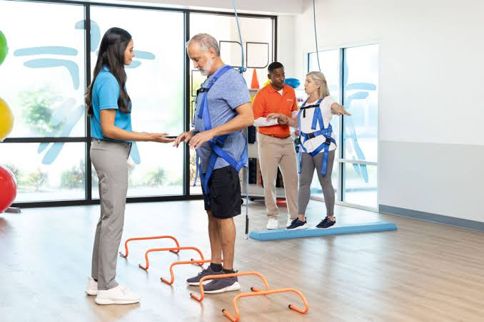
Physical Therapy and Exercise Plans
PTs can help you determine what aspects of your health to focus on
Help you tune up your movement and balance
Create a plan with you that works
Hold you accountable to help you get started
Continue to help you progress the plan
  And modify for illness and injuries
  Help you exercise safely

Slide 25
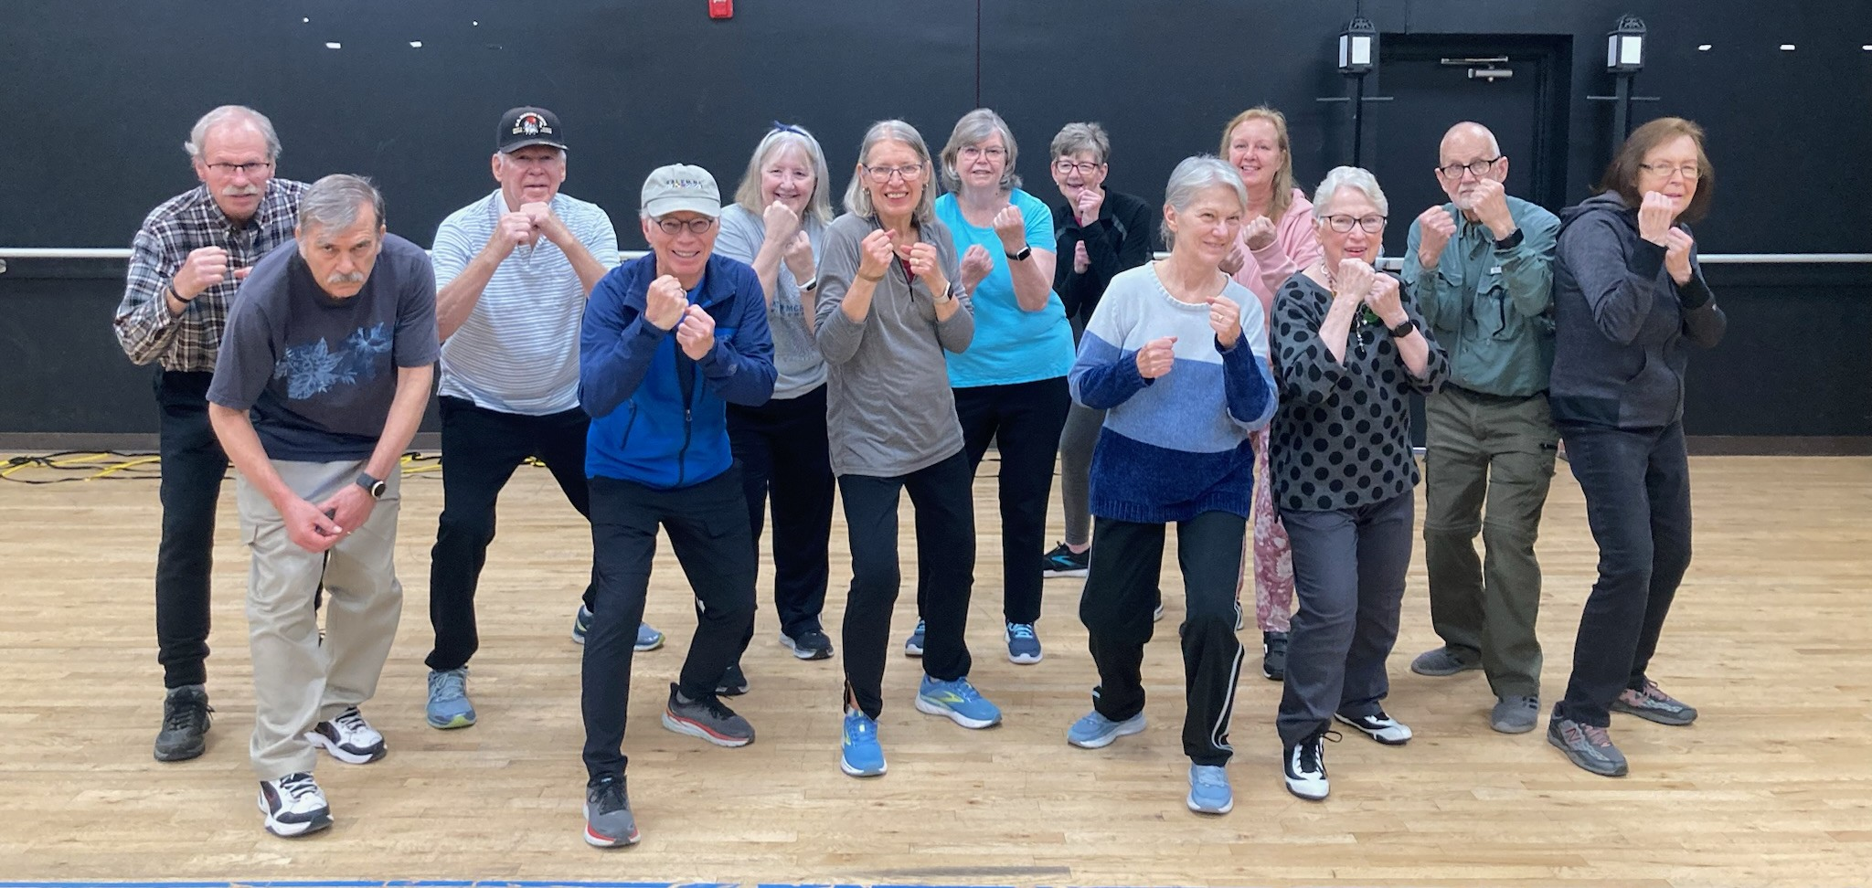
How to Keep it Going
Develop the belief that exercise is impactful on aging
Feel and notice the positive response your body has to exercise
Set goals for yourself and build your confidence, you can do it
Make it fun and social
Incorporate strategies that address physiology and behavior change theory

Slide 26
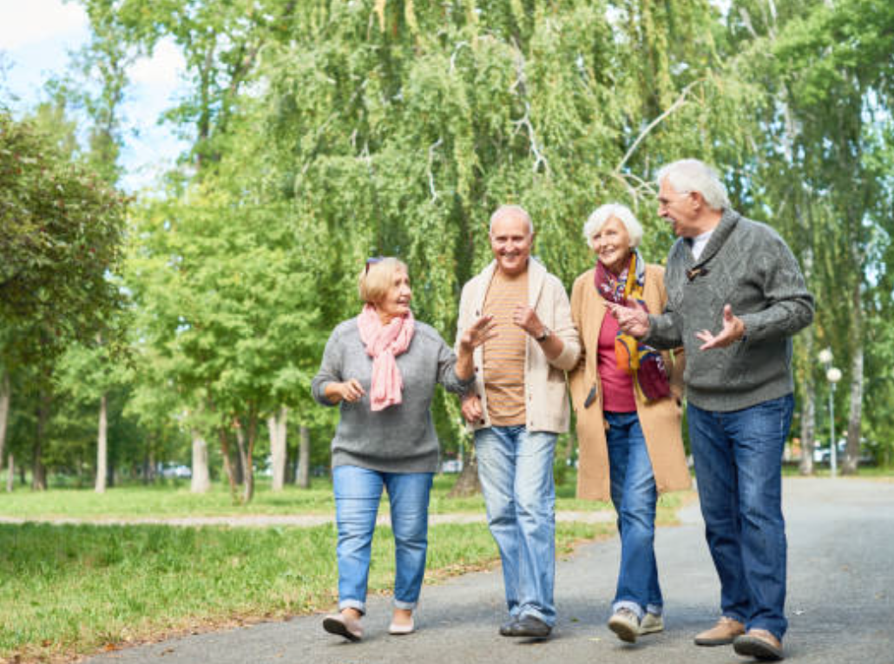
Exercise is One Piece of the Puzzle
Social connection over the age of 75 is a “stronger predictor of survival than baseline health”
Dietary diversity
  Minimally processed
  Plant forward
  Highly diverse (abundant in seasonal veggies, fruit, and legumes)
Metabolic Care
  Stable BMI
  Maintaining a health A1c
  Direct reduction in late life mortality

Slide 27
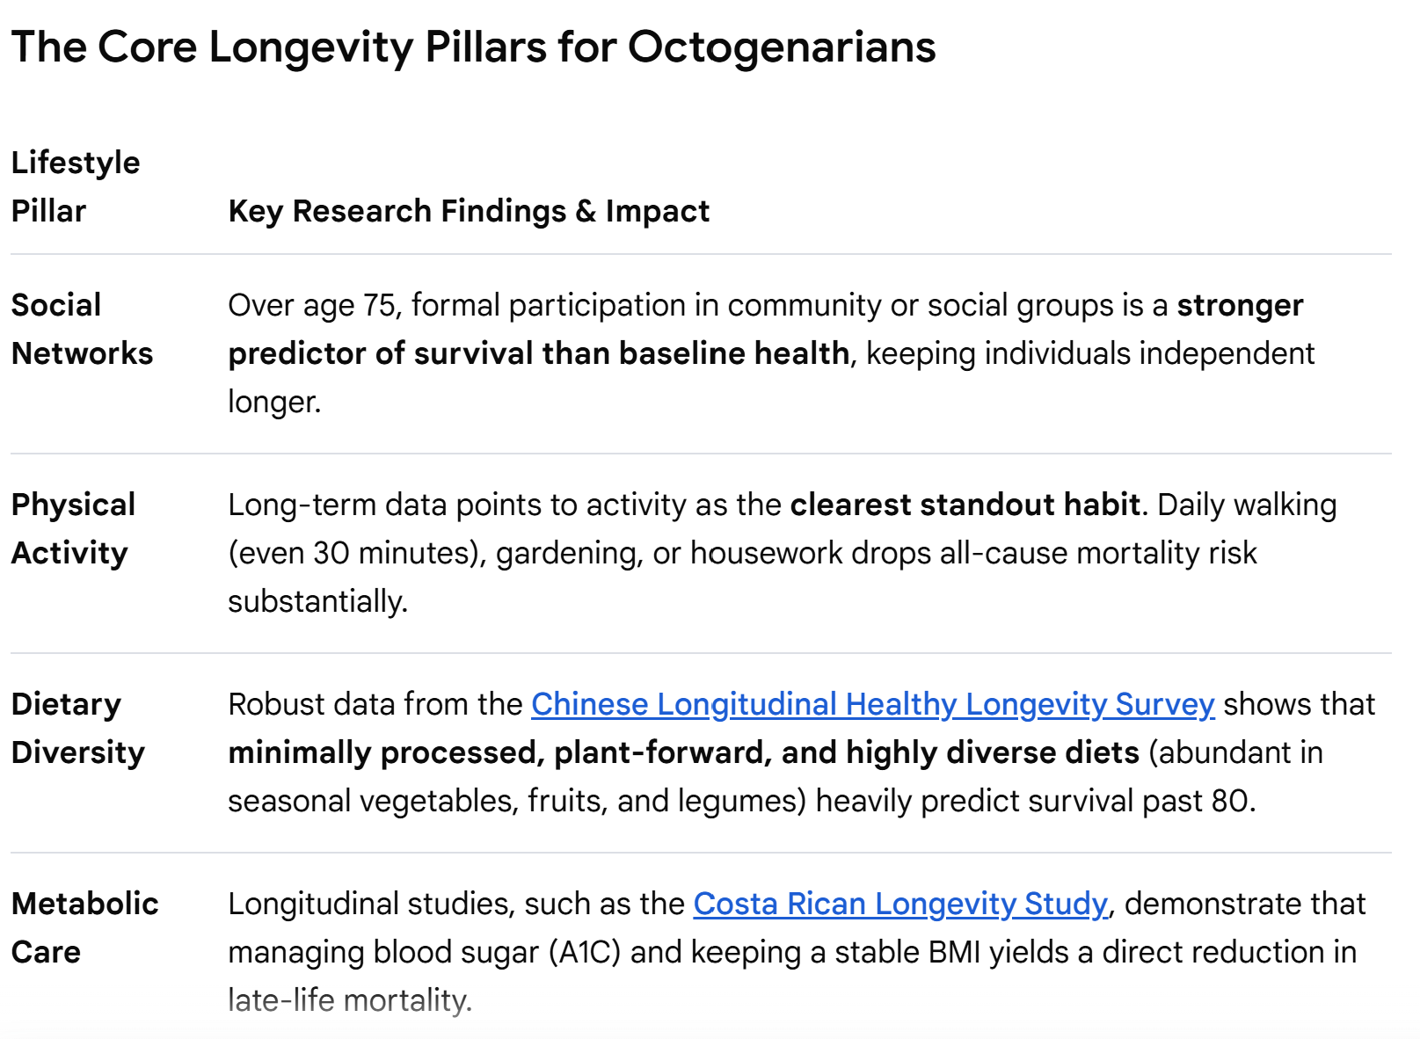
Exercise is One Piece of the Puzzle

Slide 28
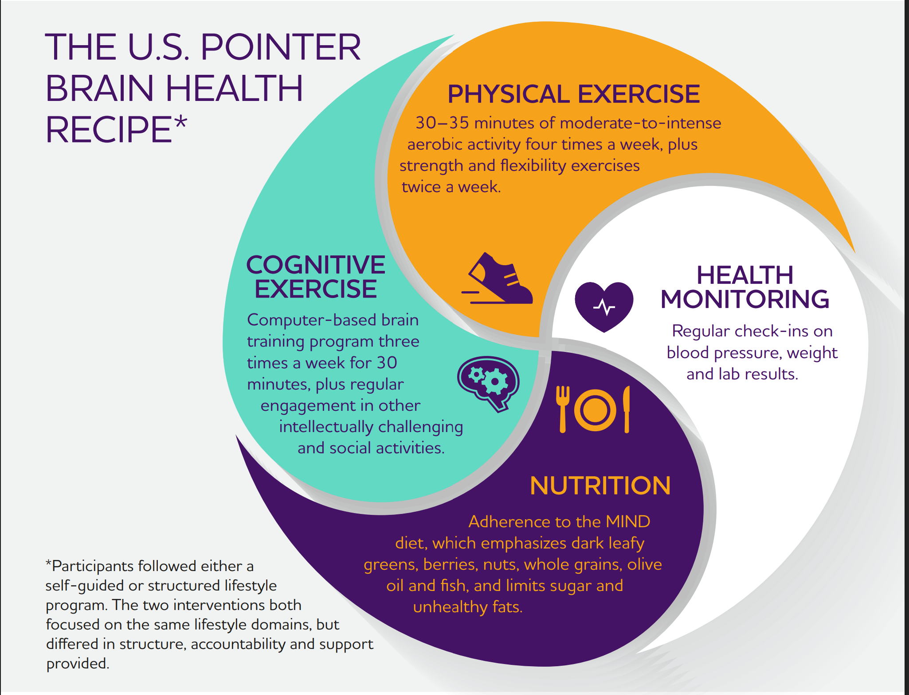
Alzheimer's Association Recommendations

Slide 29
How to Use These Important Habits to Encourage Exercise
Social connection releases oxytocin and serotonin
  Helps reinforce the habit and provides accountability
  Peer modeling increases self efficacy
Improved diet
  Supports muscle growth
  Provides fuel/energy for activity and exercise
  Reduces fatigue and soreness
Improved sleep and stress management
  Allows for the body to recover, heel and remove the “garbage”
  Provides us with the motivation to improve the next day
Huang, J., et al. (2025). "The influence of social support and empowerment on physical exercise behavior in university students: A self-determination theory perspective." Acta Psychologica 257: 105086.

Slide 30
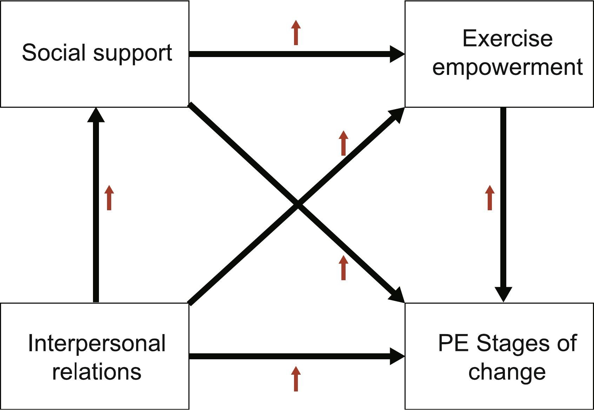
Overcoming Barriers
Huang, J., et al. (2025). "The influence of social support and empowerment on physical exercise behavior in university students: A self-determination theory perspective." Acta Psychologica 257: 105086.

Slide 31
Overcoming Barriers
Barriers
Dislike
Safety
Time commitment
No resources
Too expensive
Self-conscious/wants to exercise alone
Exercise Opportunities
In person community exercise classes
Remote personal training (1:1)
In person personal training (1:1)
Virtual community exercise classes
Rec center classes
Written exercise programs with a coach

Slide 32
The Importance of Social Connection
There is improved participation in the community-based exercise program compared with an individual-based program
Improved quality of life within community exercise programs compared to individual exercise
There may be some benefit to a community-based group exercise over individual exercise programs.

Slide 33
Social Connection
Can be found in community-based exercise programs
It can also be found in many other places
  Women’s or men’s groups
  Groups with a shared goal or struggle
  Neighborhood connections
  Religious groups
  Learning based groups
  Choir or other activity-based group
Goal to have face to face conversations most days of the week

Slide 34
An Exercise Plan Includes 4 Components
Notes:
Aerobic
Strength
Balance
Flexibility

Slide 35
Group Exercise Plan Example
TYPE OF EXERCISE | AEROBIC | STRENGTH | BALANCE | FLEXIBILITY
Boxing | x | X | X | x
Spin | x |  |  | x
Dance | x |  | X | x
Tai Chi |  |  | x | x
Walking | x
Yoga |  | x | x | x
Circuit class | x | x | x

Slide 36
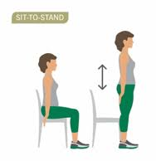
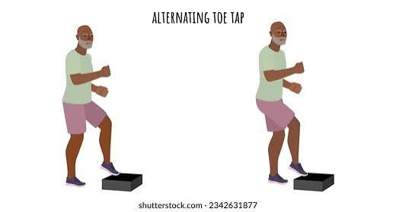
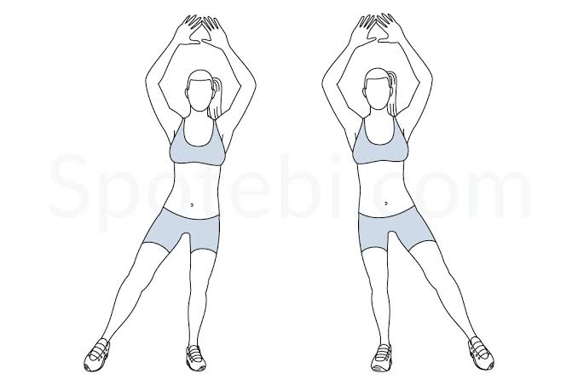
Individual Exercise Plan Example
Can be done for 20-30 sec each work up to 3 rounds over time.

Slide 37
Creating New Health Habits
Courtesy of Atomic Habits by James Clear
“Make it Obvious”
  Set a water bottle on the table or next to your chair.
  Leave your sneakers by the door or pin up your exercise sheet.
“Make it Easy”
  Drink one glass with each meal and medication time.
  Keep it to one min or 3 simple movements.
“Make it Attractive”
  Pick a fun, attractive bottle to drink from.
  Find a fun group or video.
“Make it Satisfying”
  Choose a liquid that feels special and enjoyable. Ex: pink drink
  Notice how you feel after in your body or pick a reward.

Slide 38
Think About an Action Plan
Those who create an action plan are 90% likely to complete the exercise than those who do not
  Who – I will …
  What – walk for 1 min
  Where – to my mailbox and back
  How – each day at noon (before my meal)
  Celebrate – give myself a high five or a gold star for the day

Slide 39
Action Plan Examples
I will do the 3 exercises from todays session after I make my morning coffee then give myself a pat on the back.
I will walk for 5 min to the corner and back after lunch and thank myself.
I will try a new class at my rec center in one week that is the same/similar time as my current schedule and be proud of myself.
I will get the fitness schedule for the center by my home by Monday of next week and give myself a high five.
I will ask a friend to walk with me one day a week by Monday of next week and give myself a gold star.

Slide 40
Action Steps – Your Challenge
Talk to MD
  What do you need to know about your health to exercise safely?
Know your body
  What does your body need to feel good?
  Where are you missing key components of the recommendations?
Discover what would be enjoyable and fun for you
  Try something new
Create an action plan
  Use a physical therapist for support as needed
GET MOVING AND BE SOCIAL

Slide 41
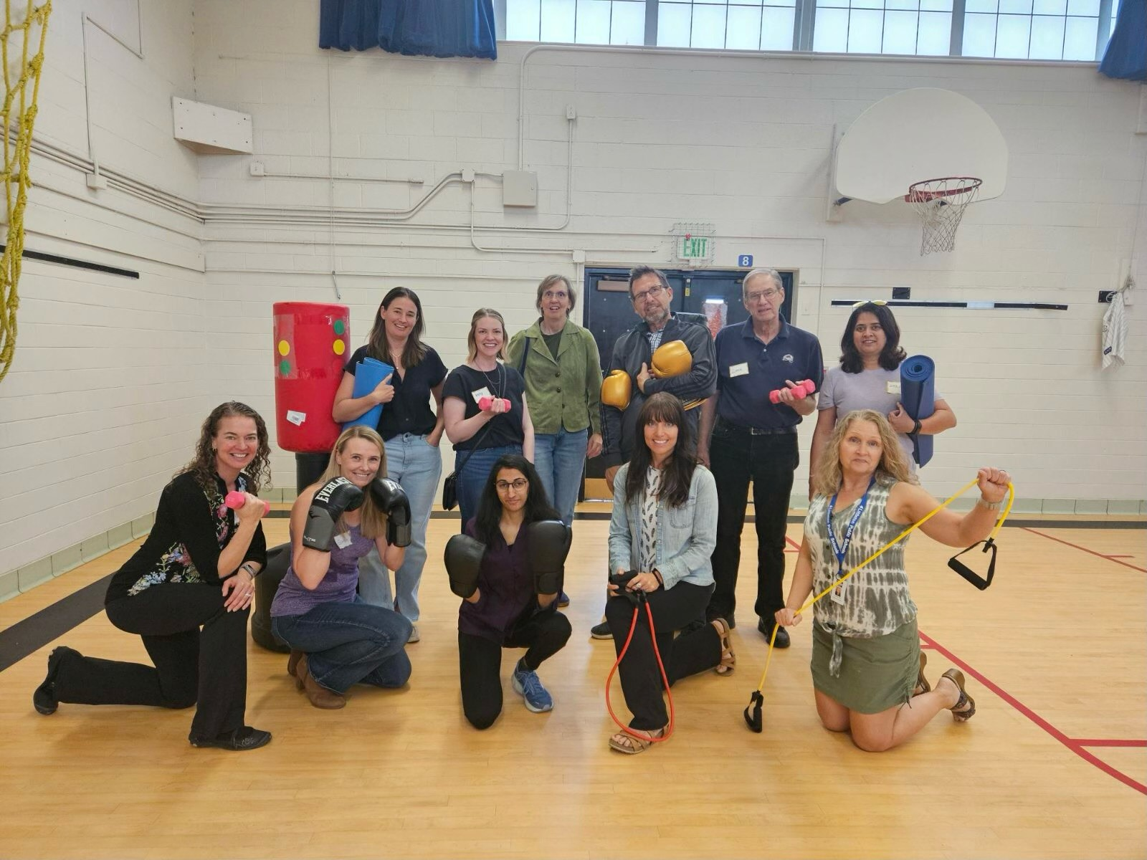
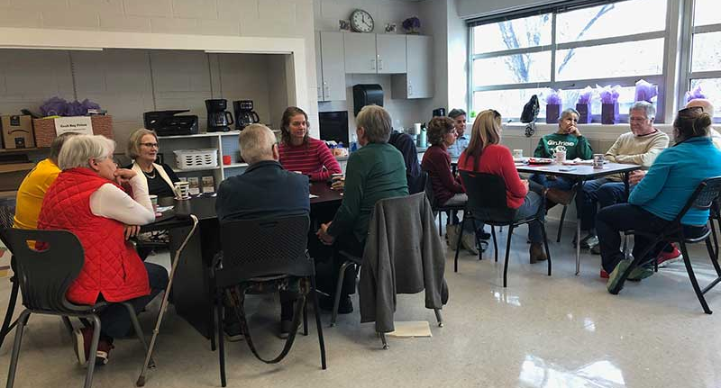
Parkinsons
Pointe
East Community Center, Littleton
Parkinsonspointe.org
720-468-4581

Slide 42
Parkinsons Pointe, a Place for Connection
Parkinson’s health promotion and wellness center offering
  Peer mentorship
  Community connection
  Group exercise classes for people with Parkinson’s
  Education and nutrition
501c3 nonprofit – all classes are donation based
  No mandatory cost to participate
Center is based in Littleton
www.ParkinsonsPointe.org or 720-468-4581

Slide 43
Resources
Parkinsons Pointe: www.ParkinsonsPointe.org
  Peer mentorship
  Carepartner health and wellness coaching
  Foundations class for those who are diagnosed within 3 years
  Variety of group exercise classes
  Coffee and connect between classes
  Emotional Wellbeing Symposium
  Lifestyle education classes
  Social activities

Slide 44
Thank you and Questions
Meredith Roberts Lo, DPT
  Meredith@ParkinsonsPointe.org
  720-468-4581
  www.ParkinsonsPointe.org

