Slide 1


Slide 2
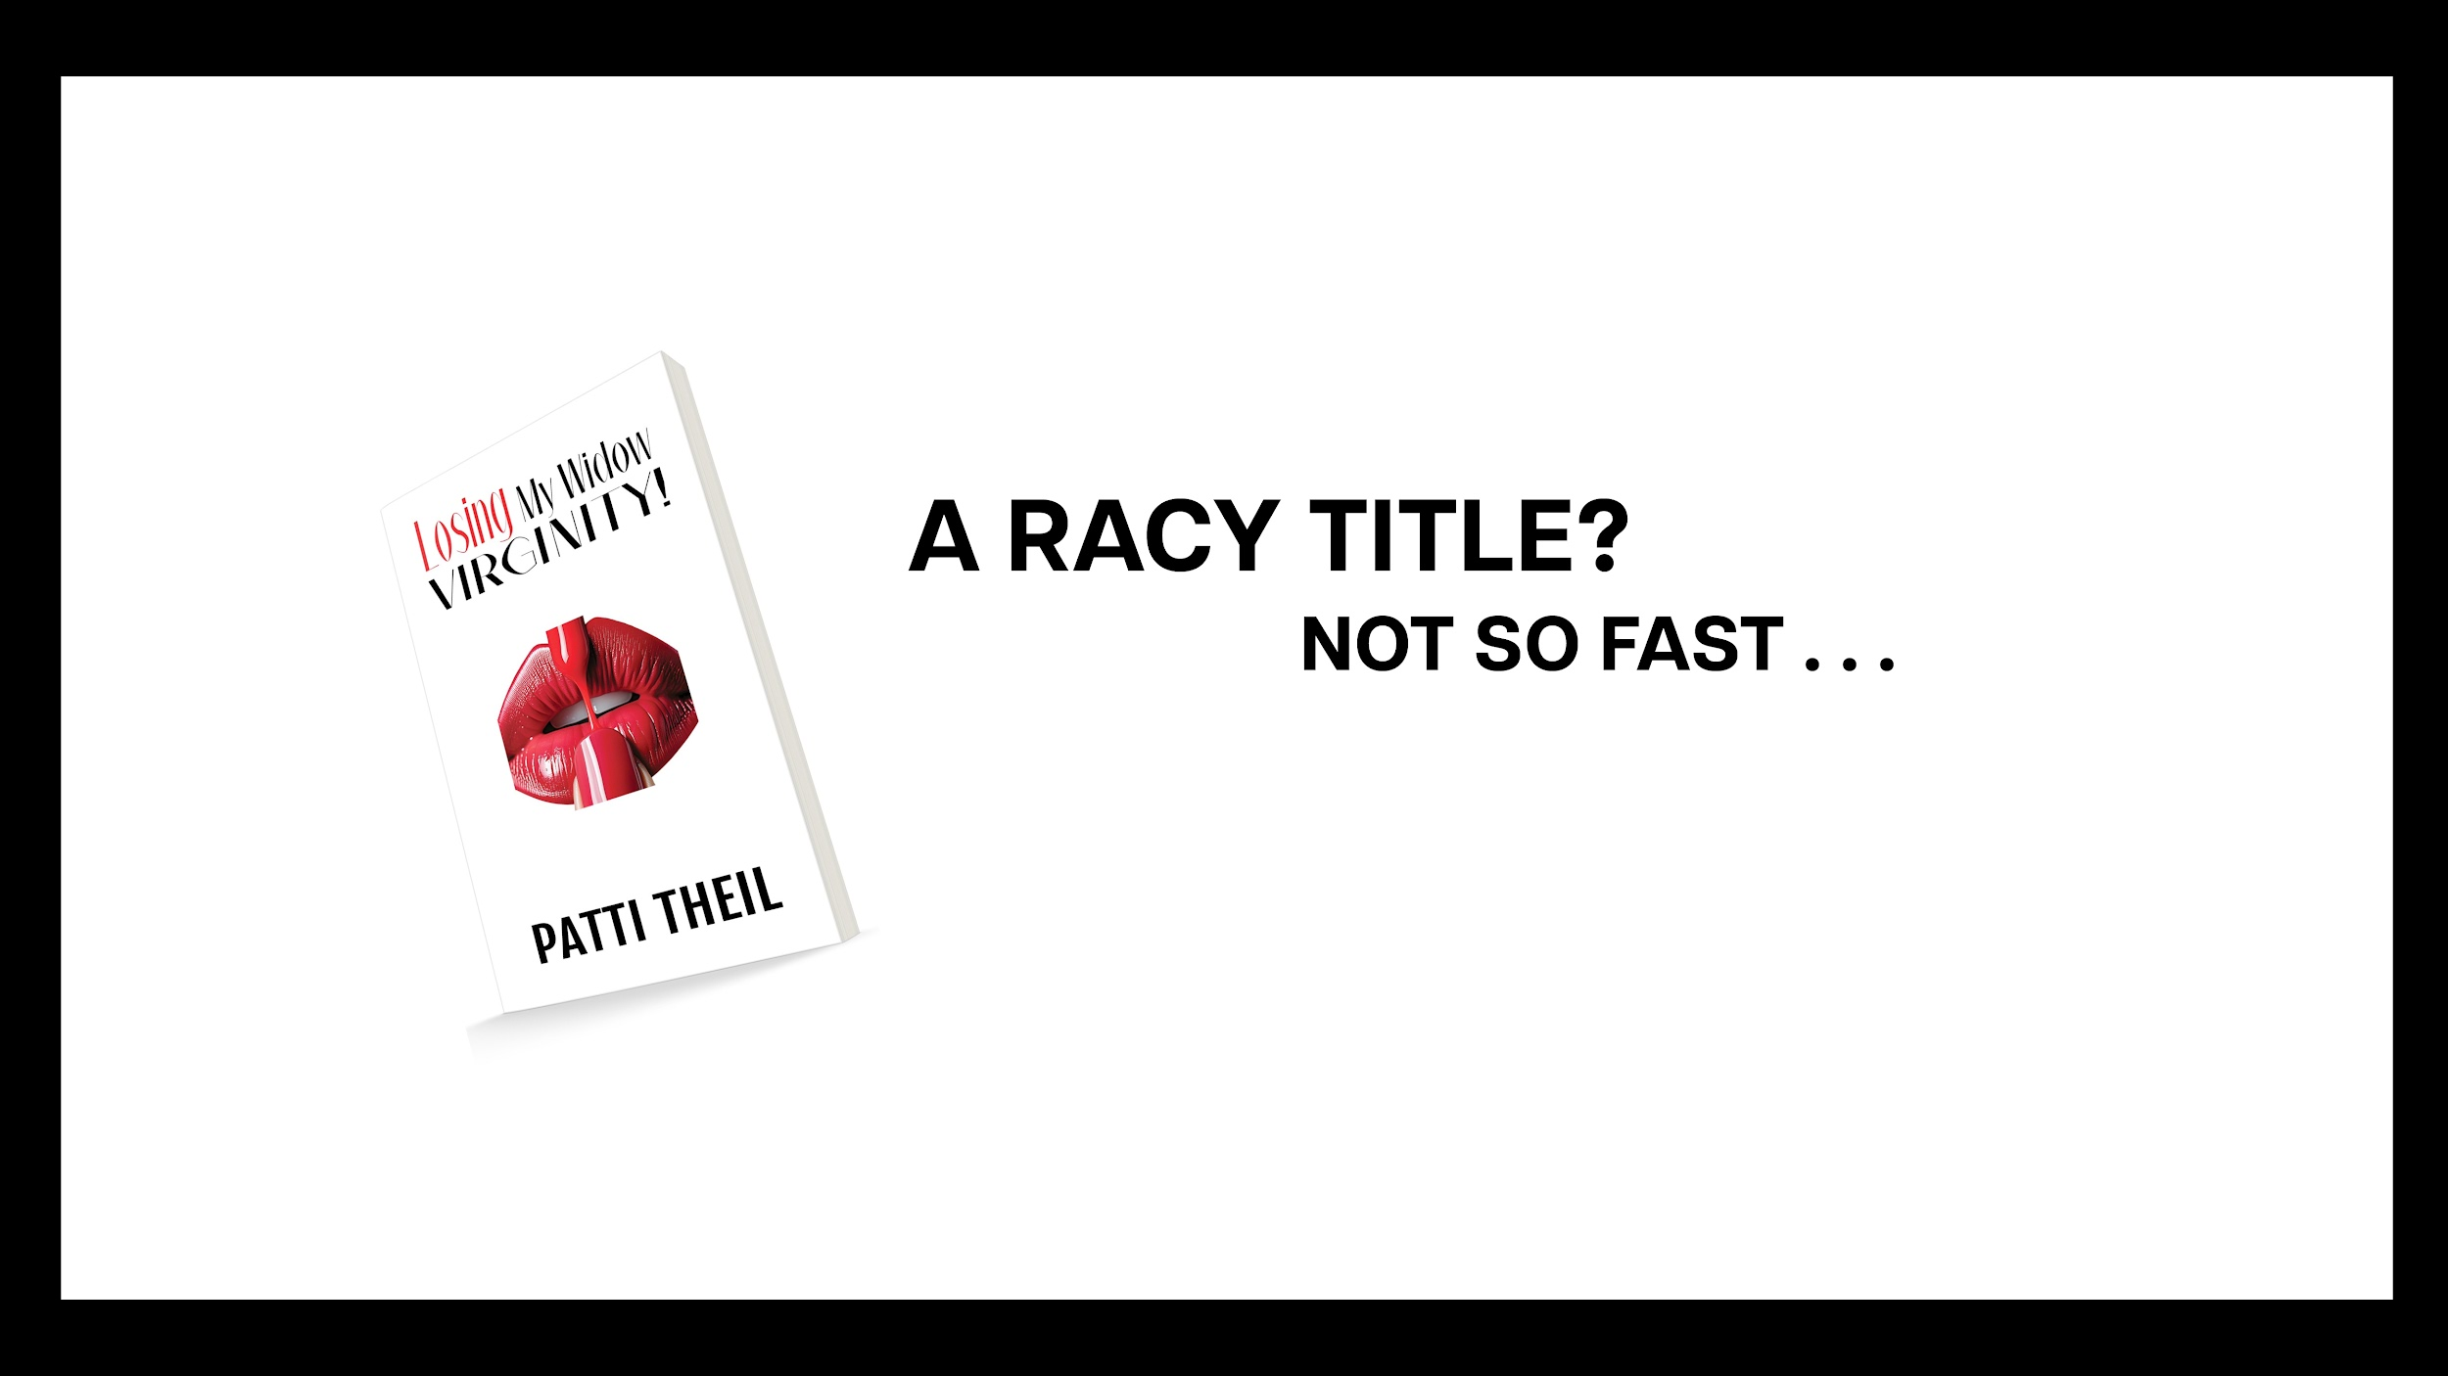

Slide 3
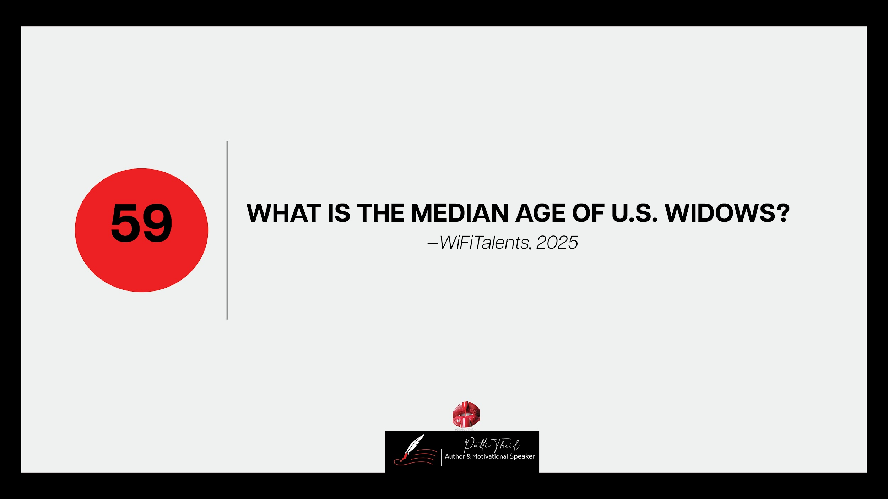

Slide 4
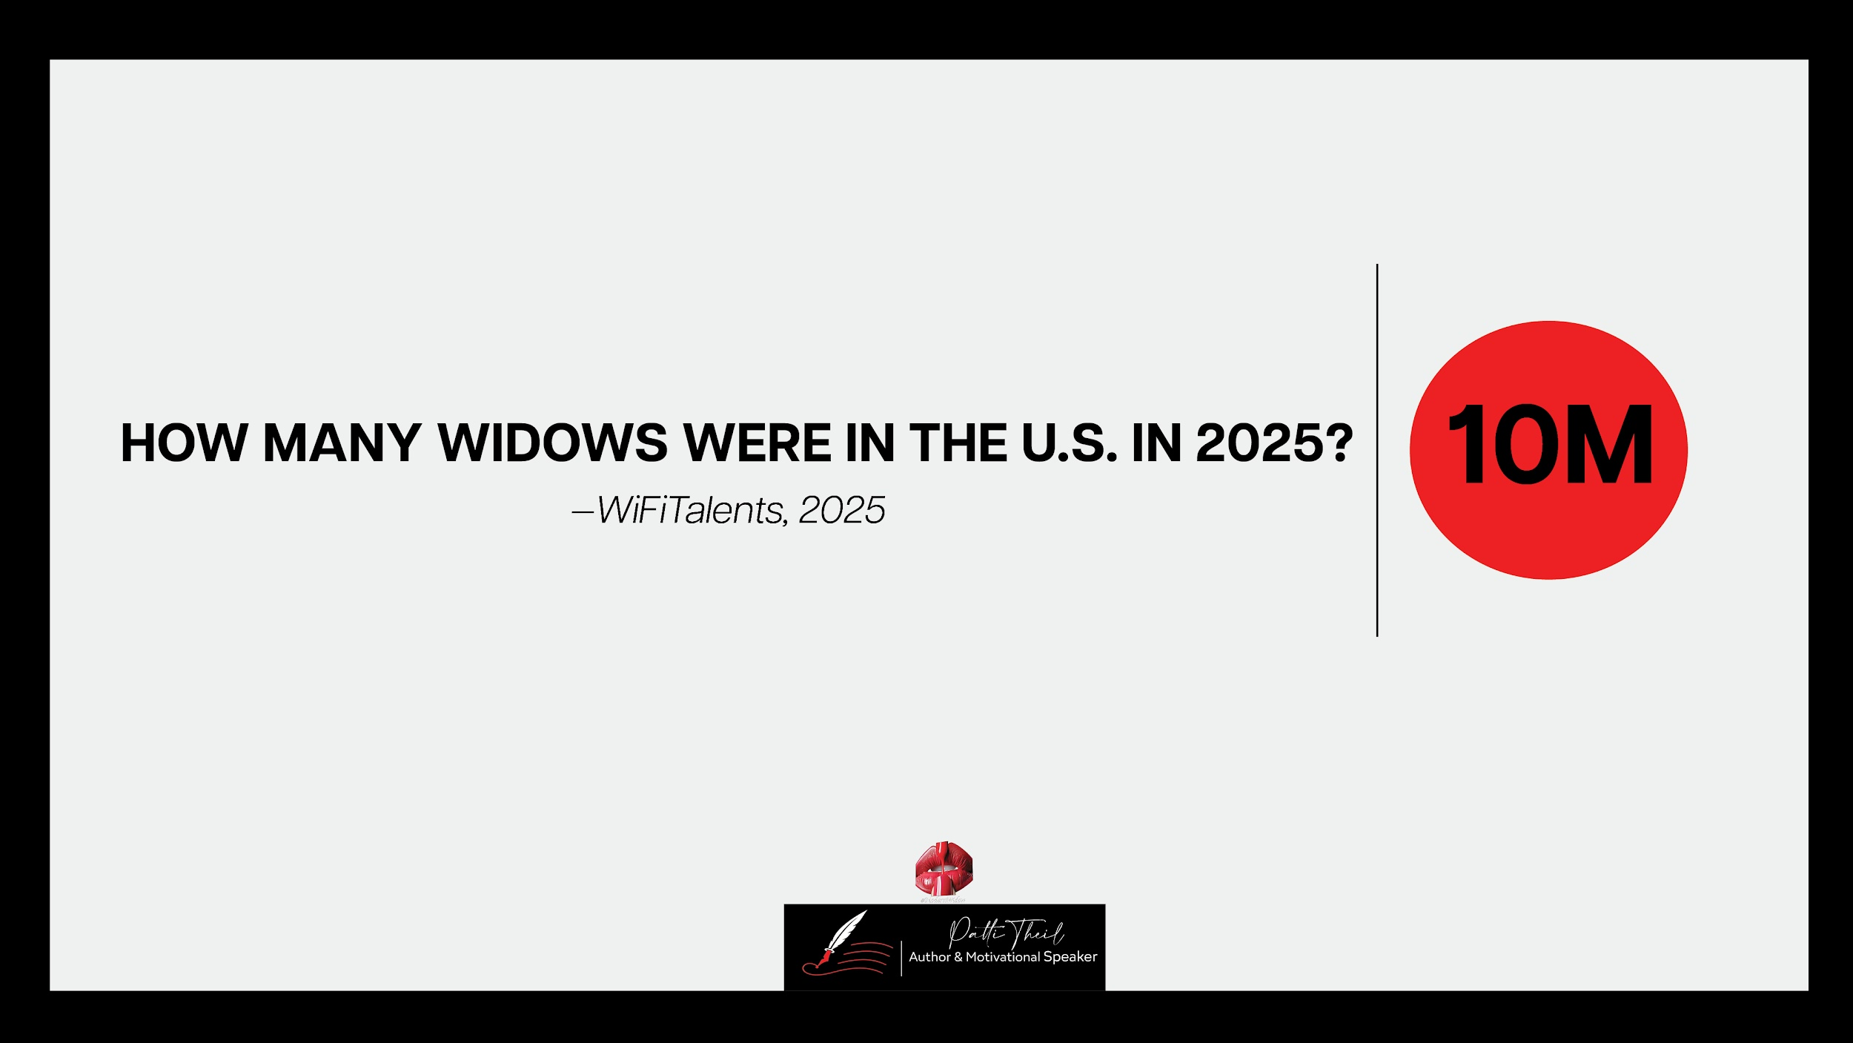

Slide 5
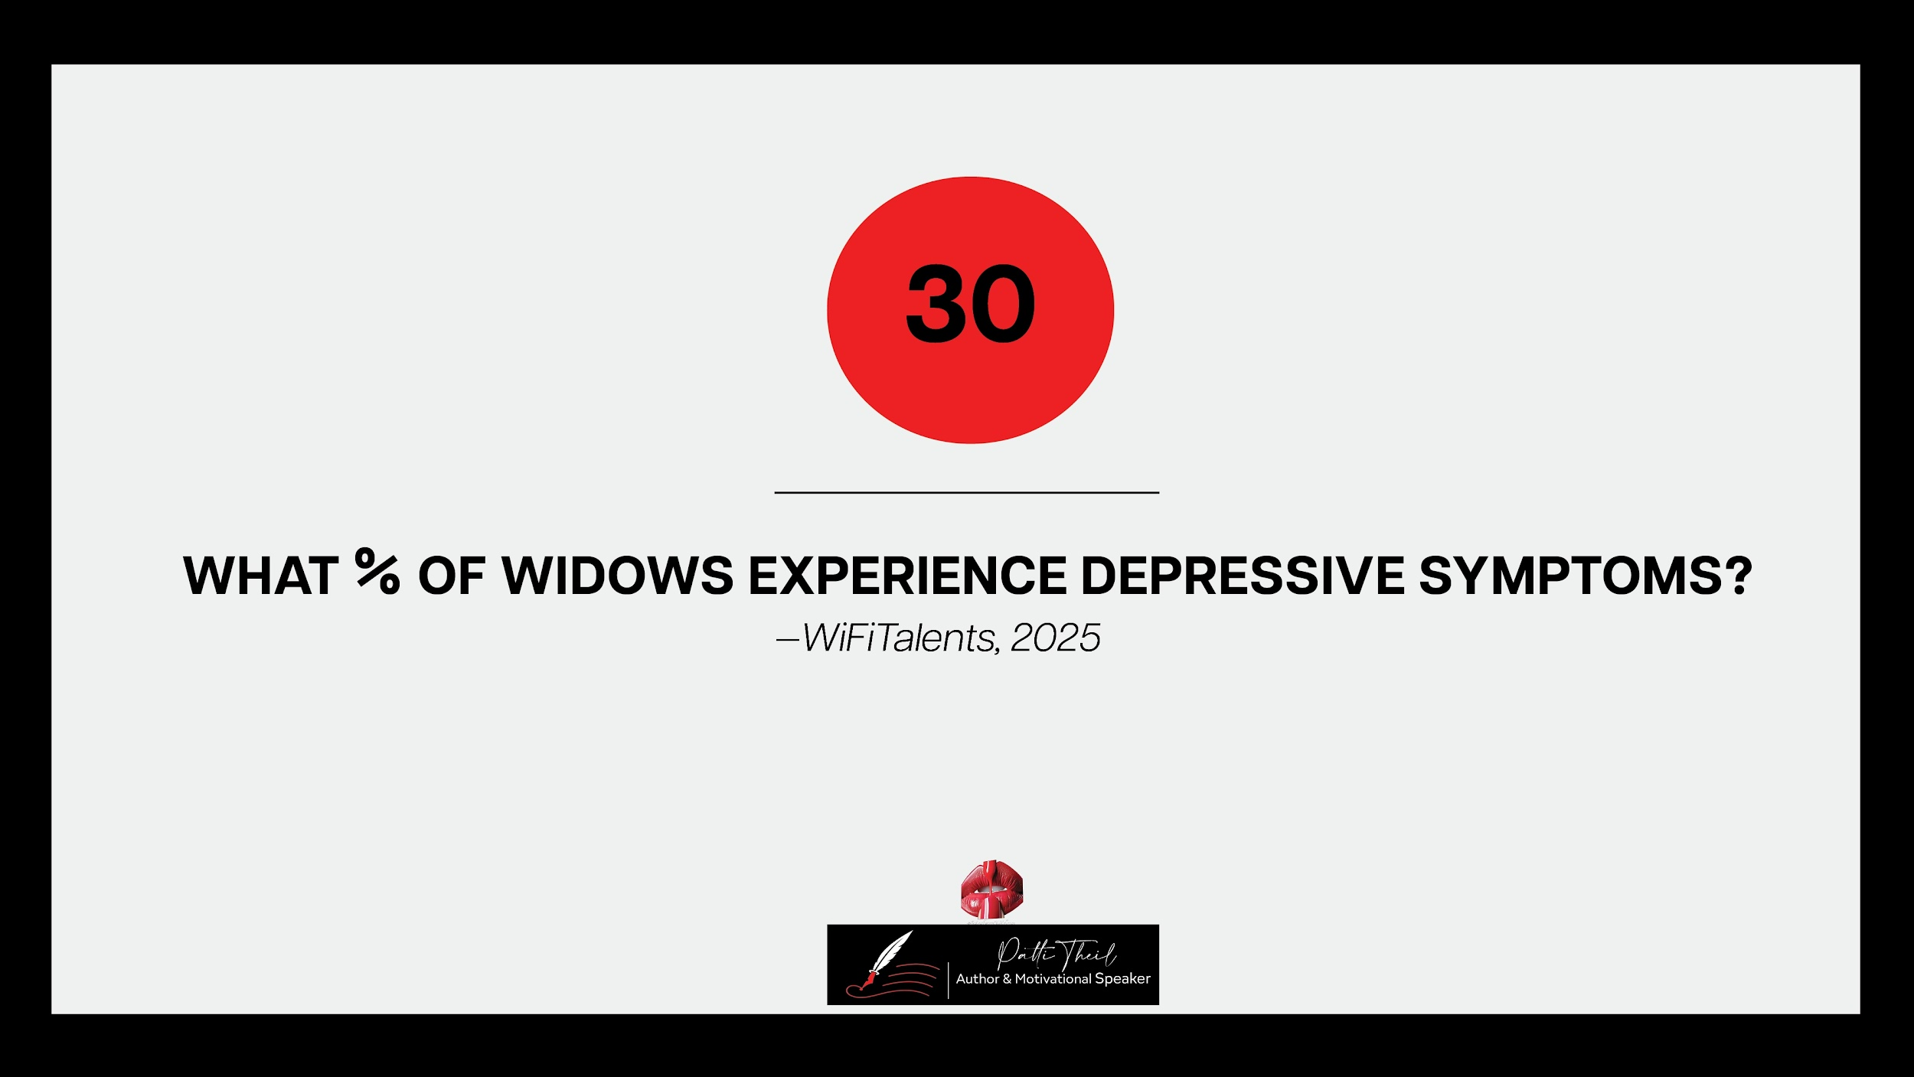

Slide 6
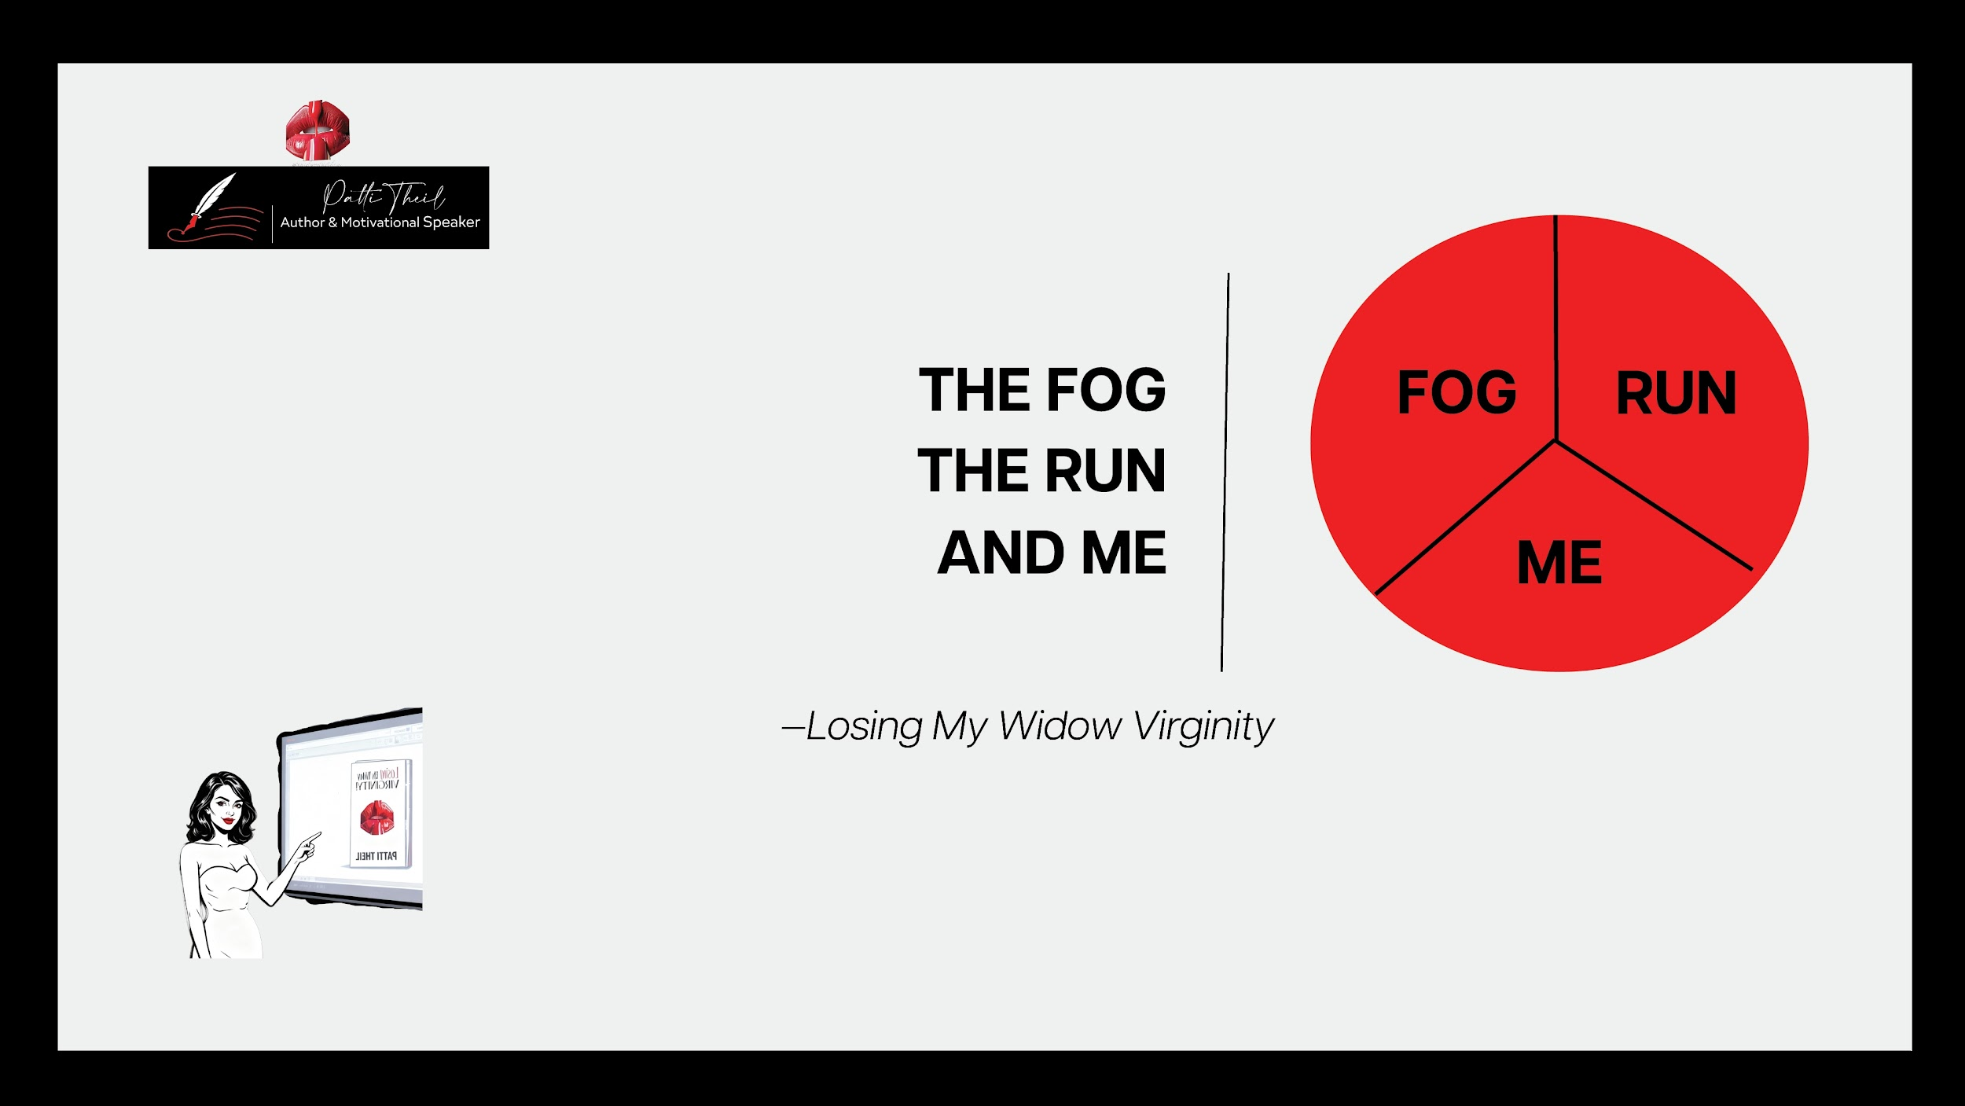

Slide 7
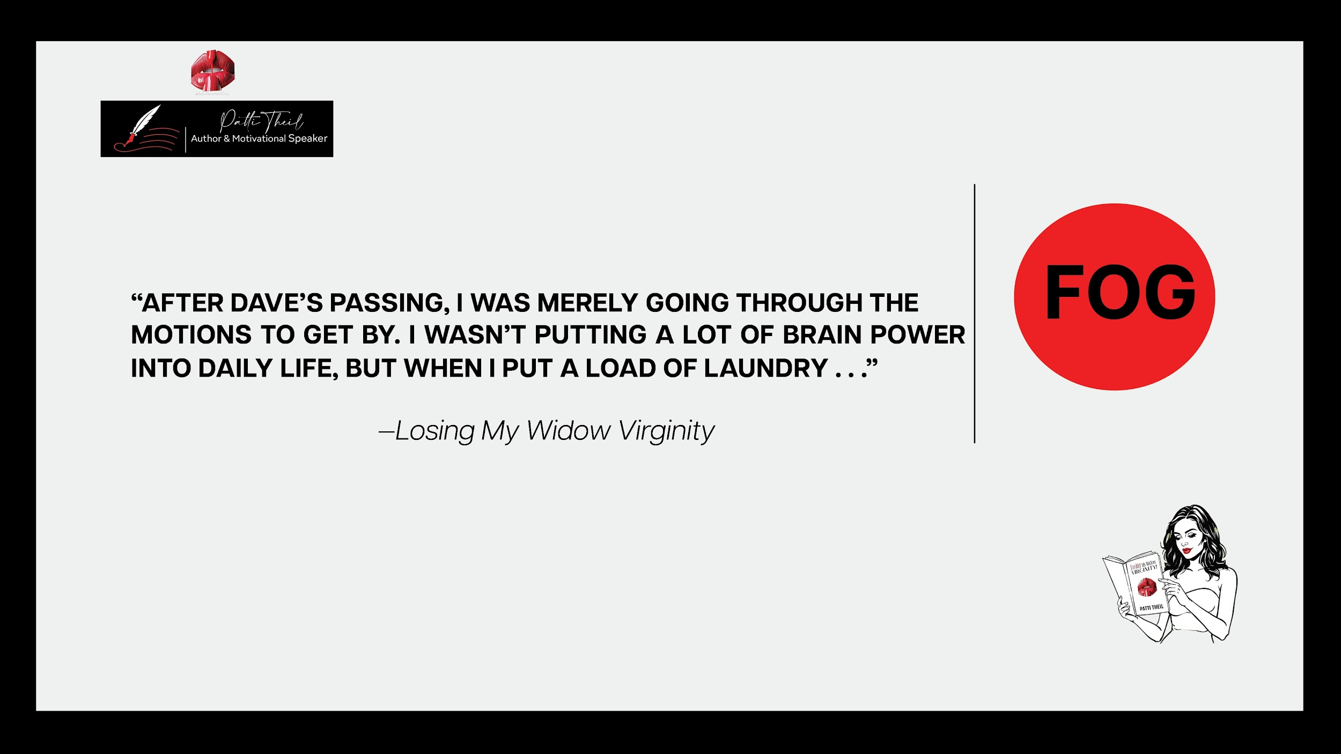

Slide 8
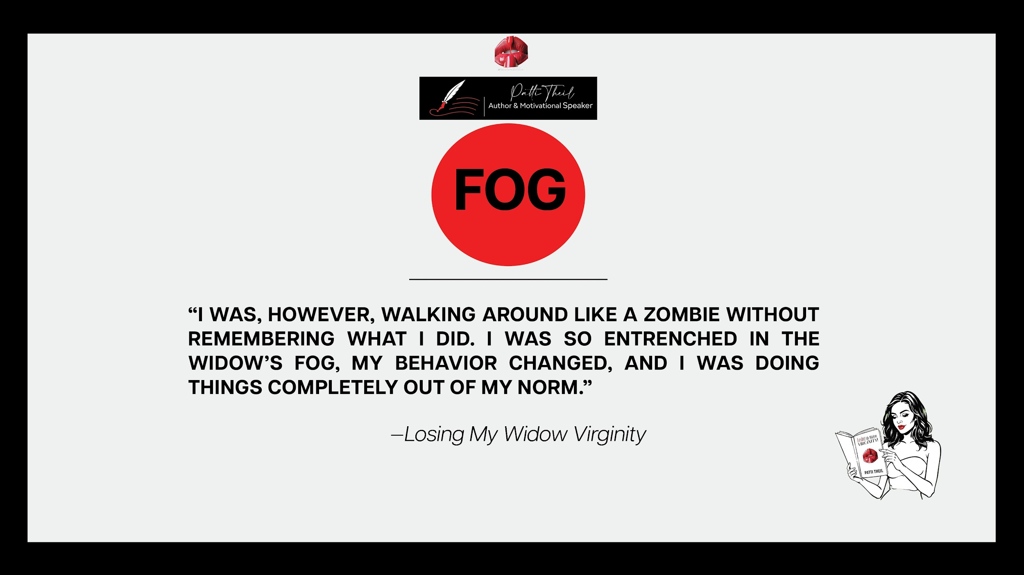

Slide 9
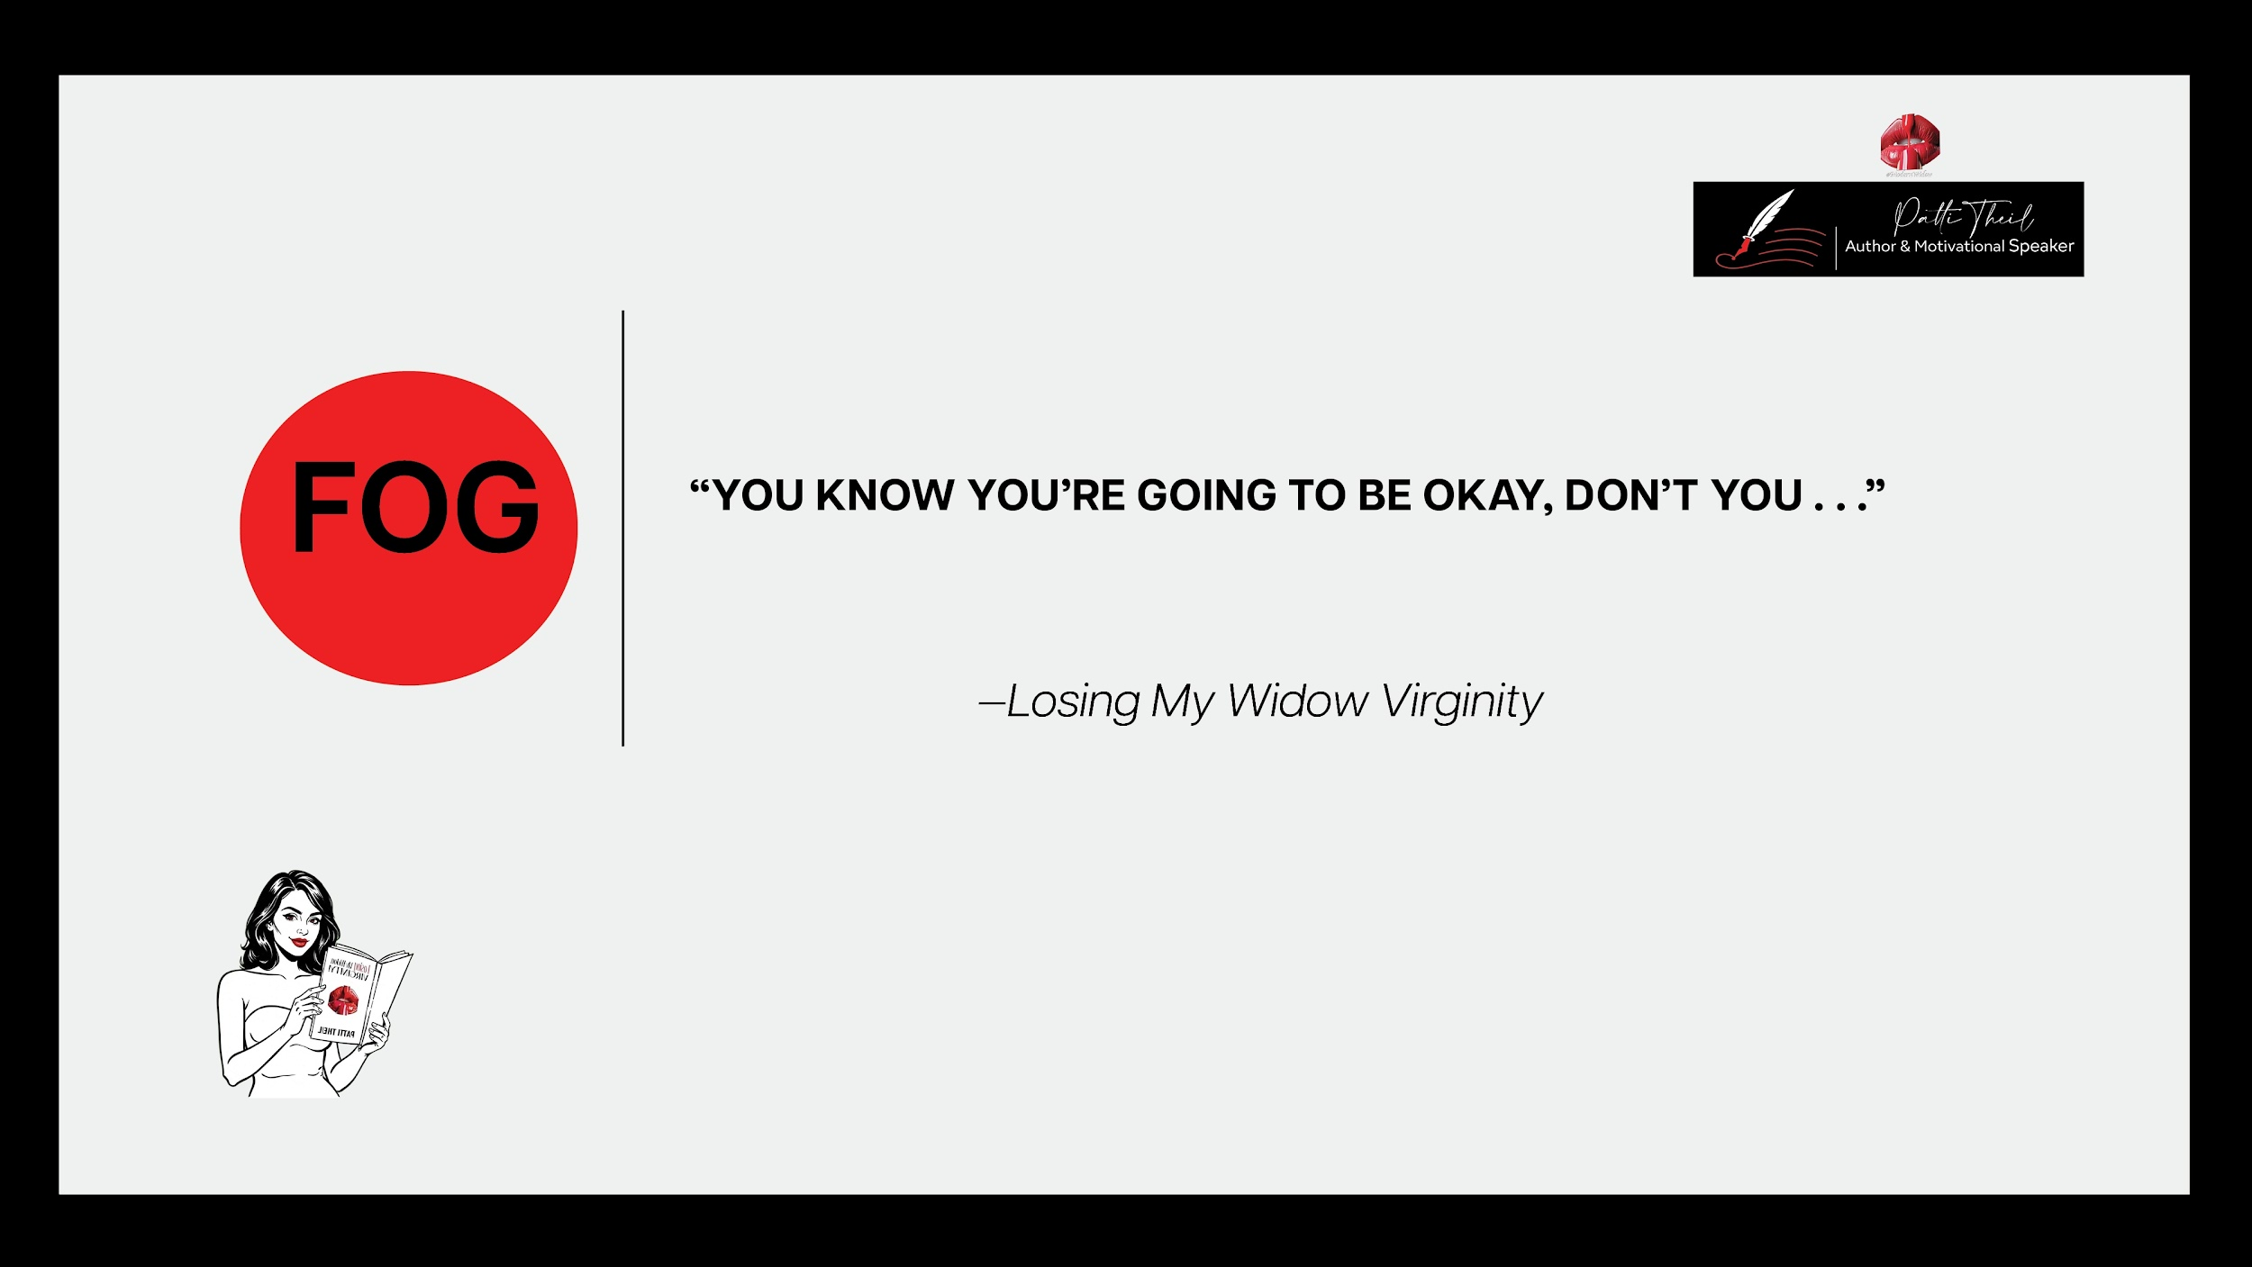

Slide 10
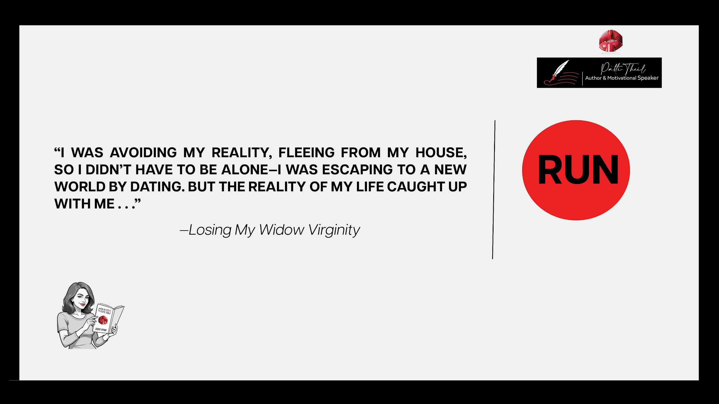

Slide 11
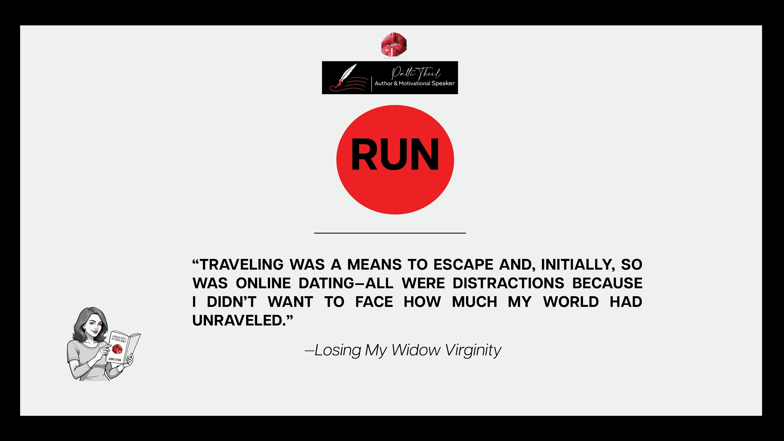

Slide 12
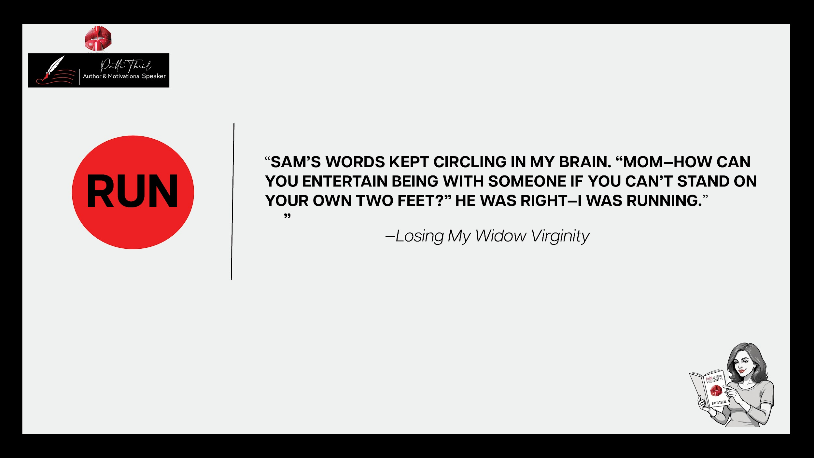

Slide 13
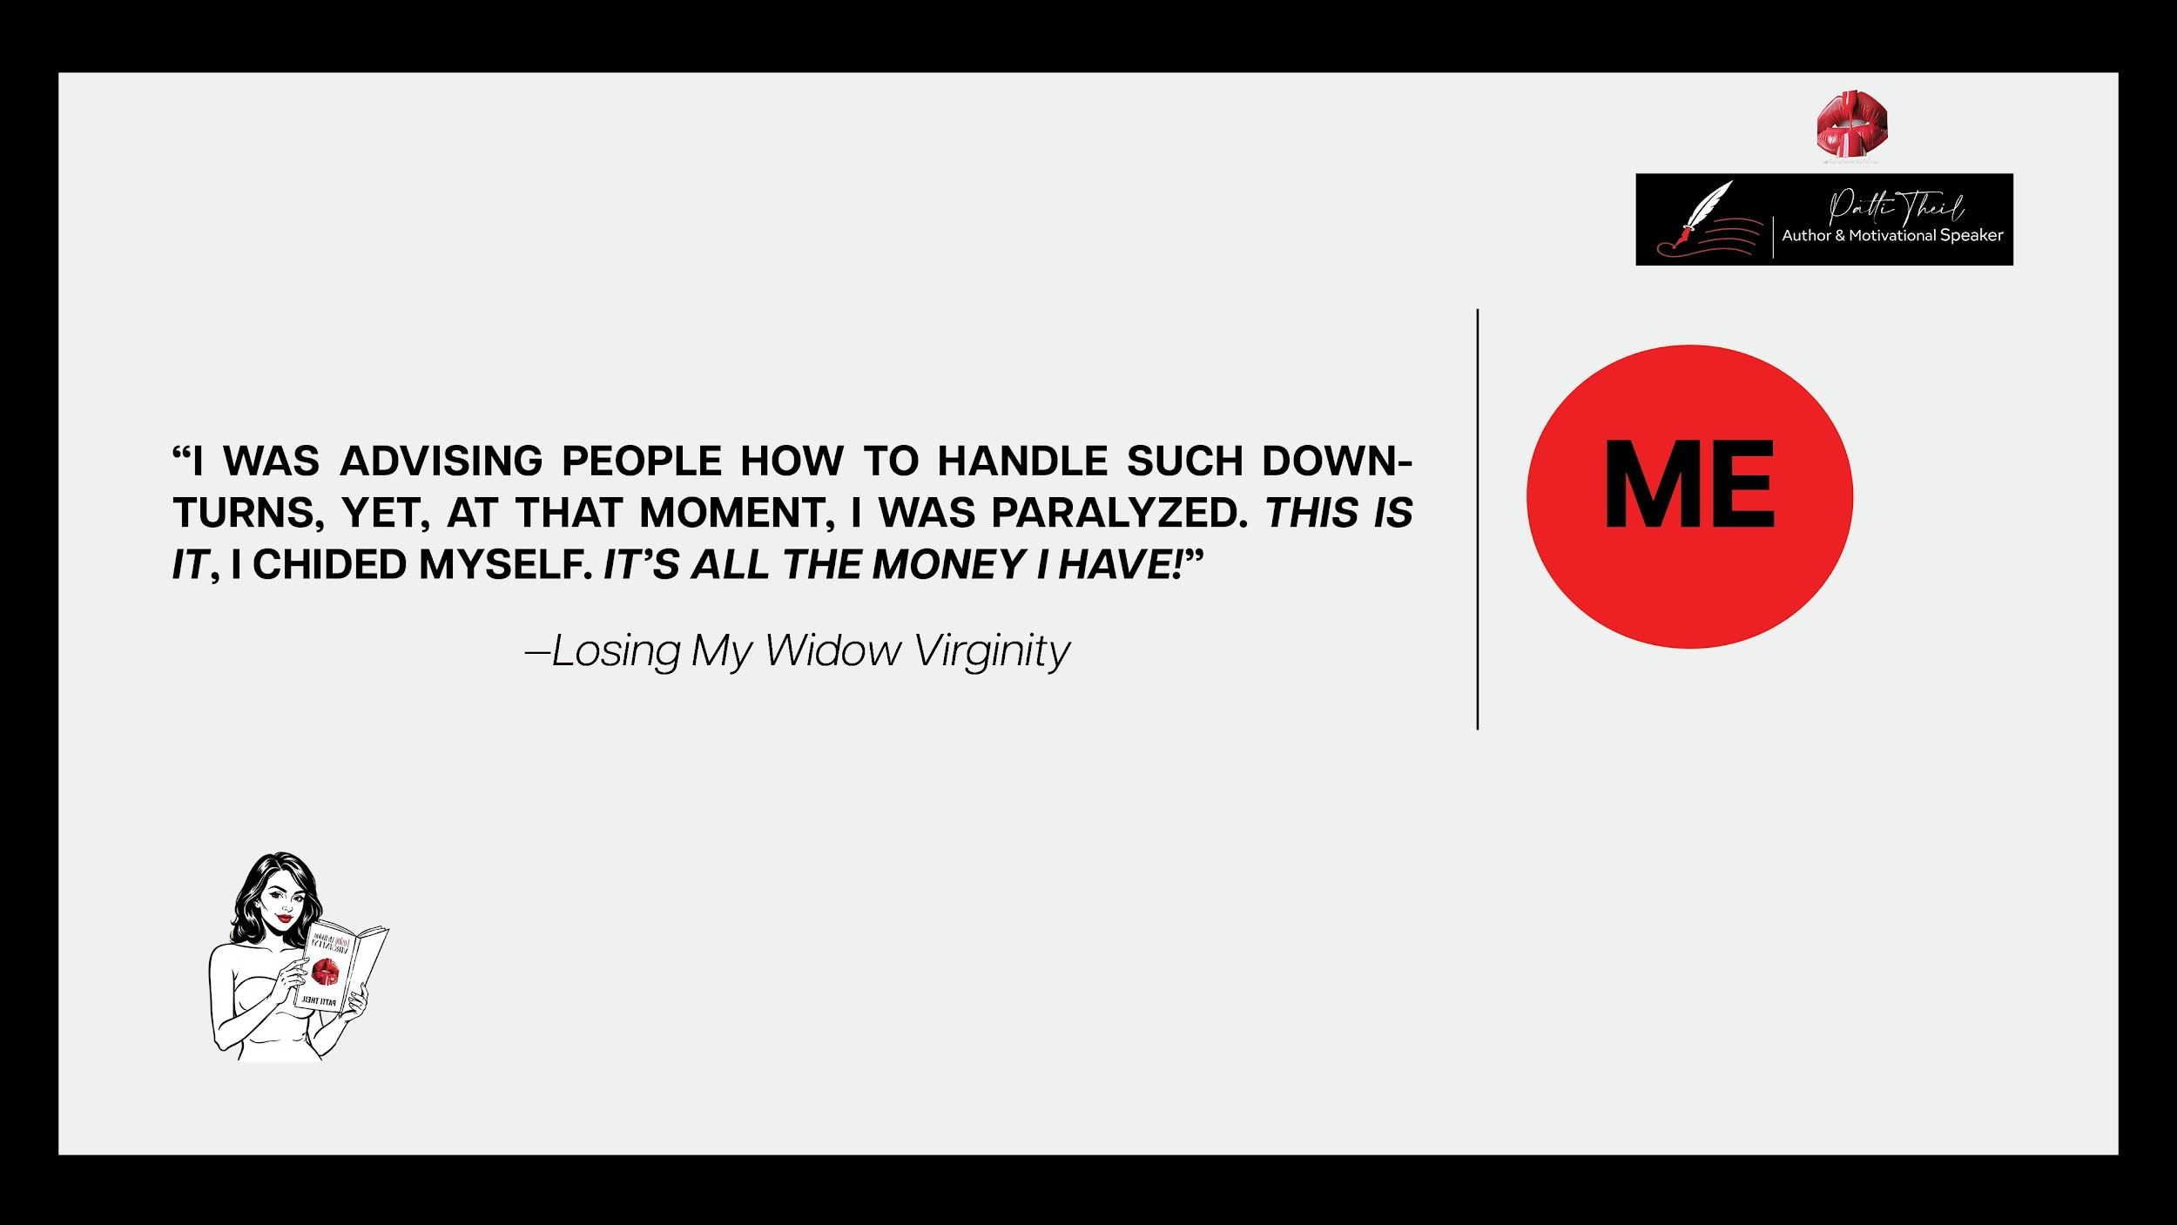

“HAVE YOU NOT WATCHED ANY PODCAST OR READ ANYTHING ABOUT EMOTIONALLY UNAVAILABLE MEN?
“NO…” I WAS STUNNED! I HAD NO IDEA SUCH A THING EXISTED–BUT I WAS ABOUT TO LEARN.”

Slide 14
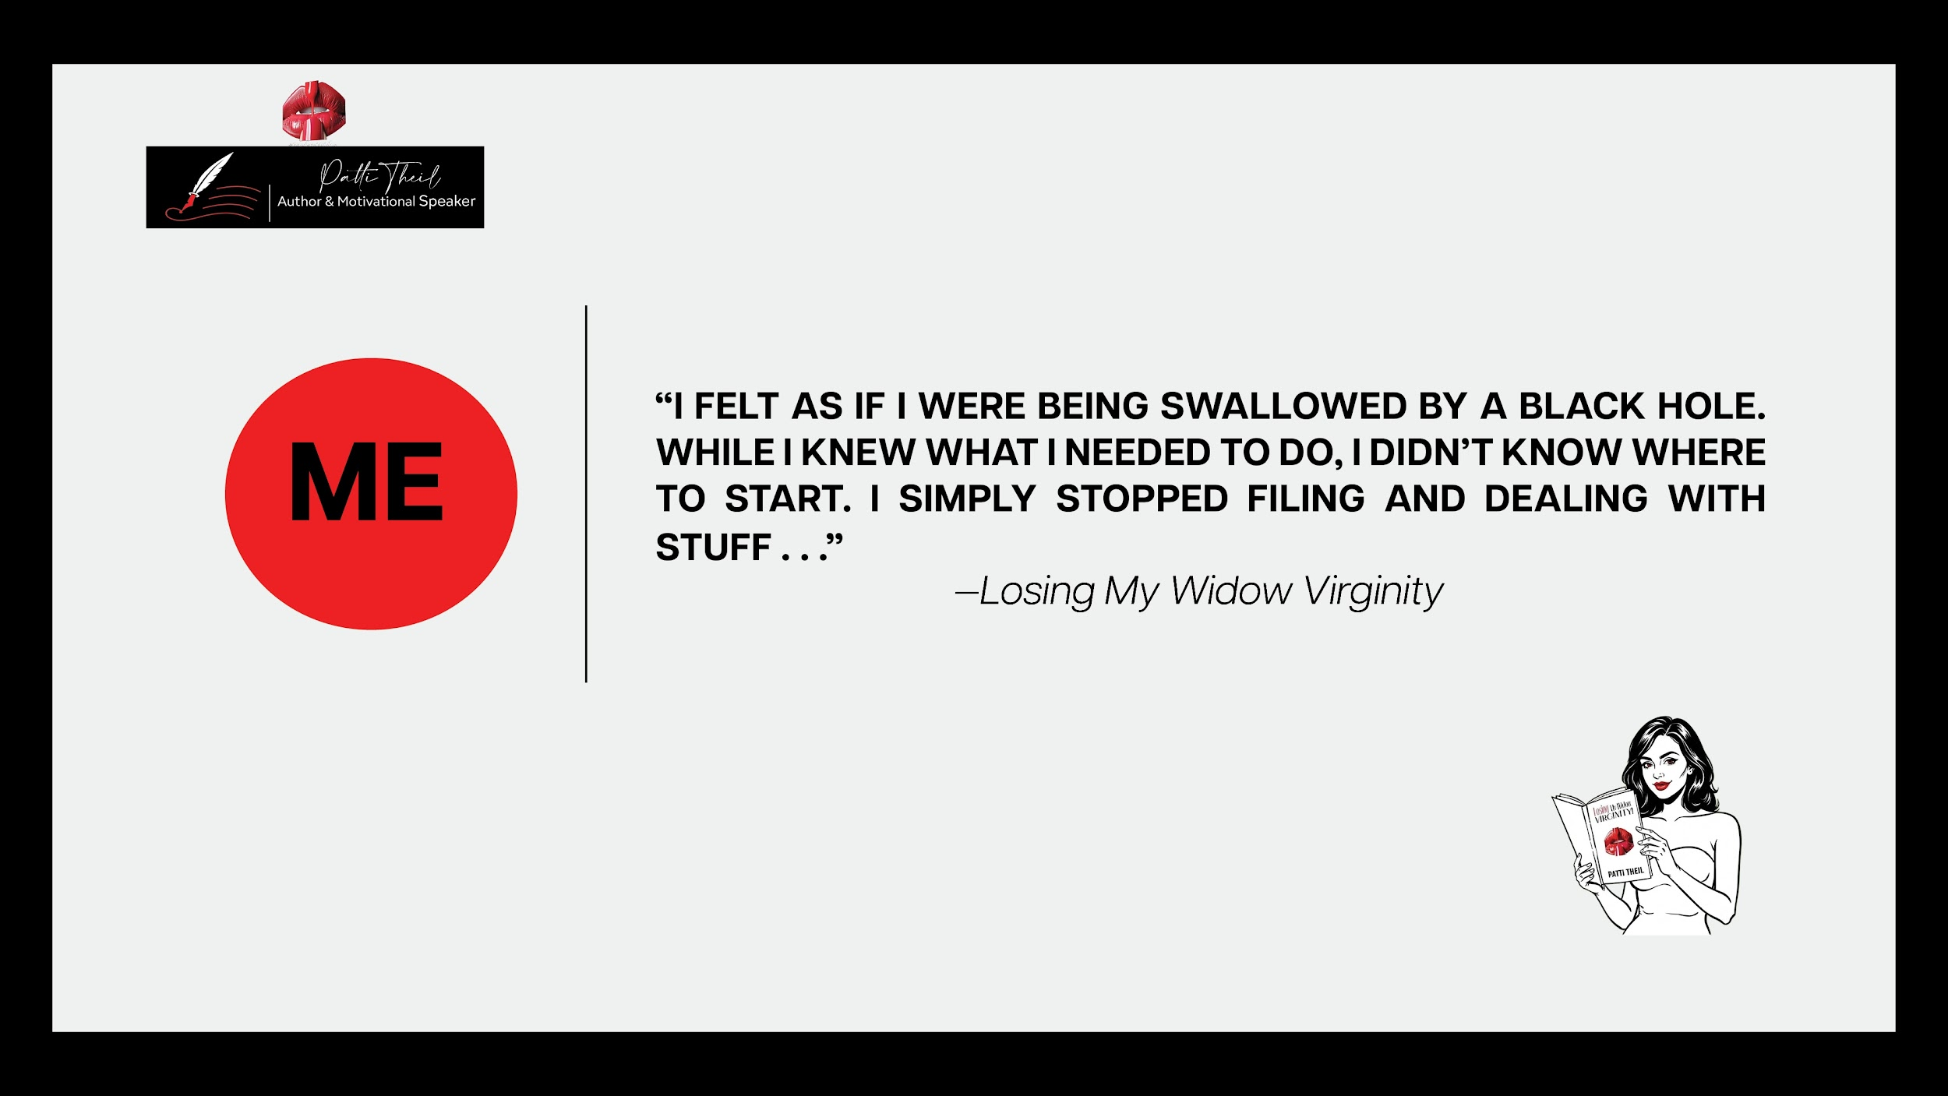

“WHEN HEARING UNTIL YOU CAN’T NOW, IT REMINDS ME OF THE DEEP LOVE DAVE AND I HAD FOR EACH OTHER–BUT IT ALSO RESONATES WITH ME, AS A SINGLE PERSON–THE ‘ME’ WHO HAS TWO FEET PLACED FIRMLY ON THE GROUND.
I’M A WOMAN WHO ISN’T TAKING TIME FOR GRANTED–THE KEY IS WHILE YOU HAVE YOUR HEALTH, FACILITIES, AND THE MEANS, LIFE IS SHORT REALLY SHORT. THERE’S NO GETTING AROUND TIME CONSTRAINTS, AND YOU JUST NEVER KNOW WHAT’S AROUND THE CORNER.
LIVE LIFE WHILE YOU CAN–UNTIL YOU CAN’T”

Slide 15
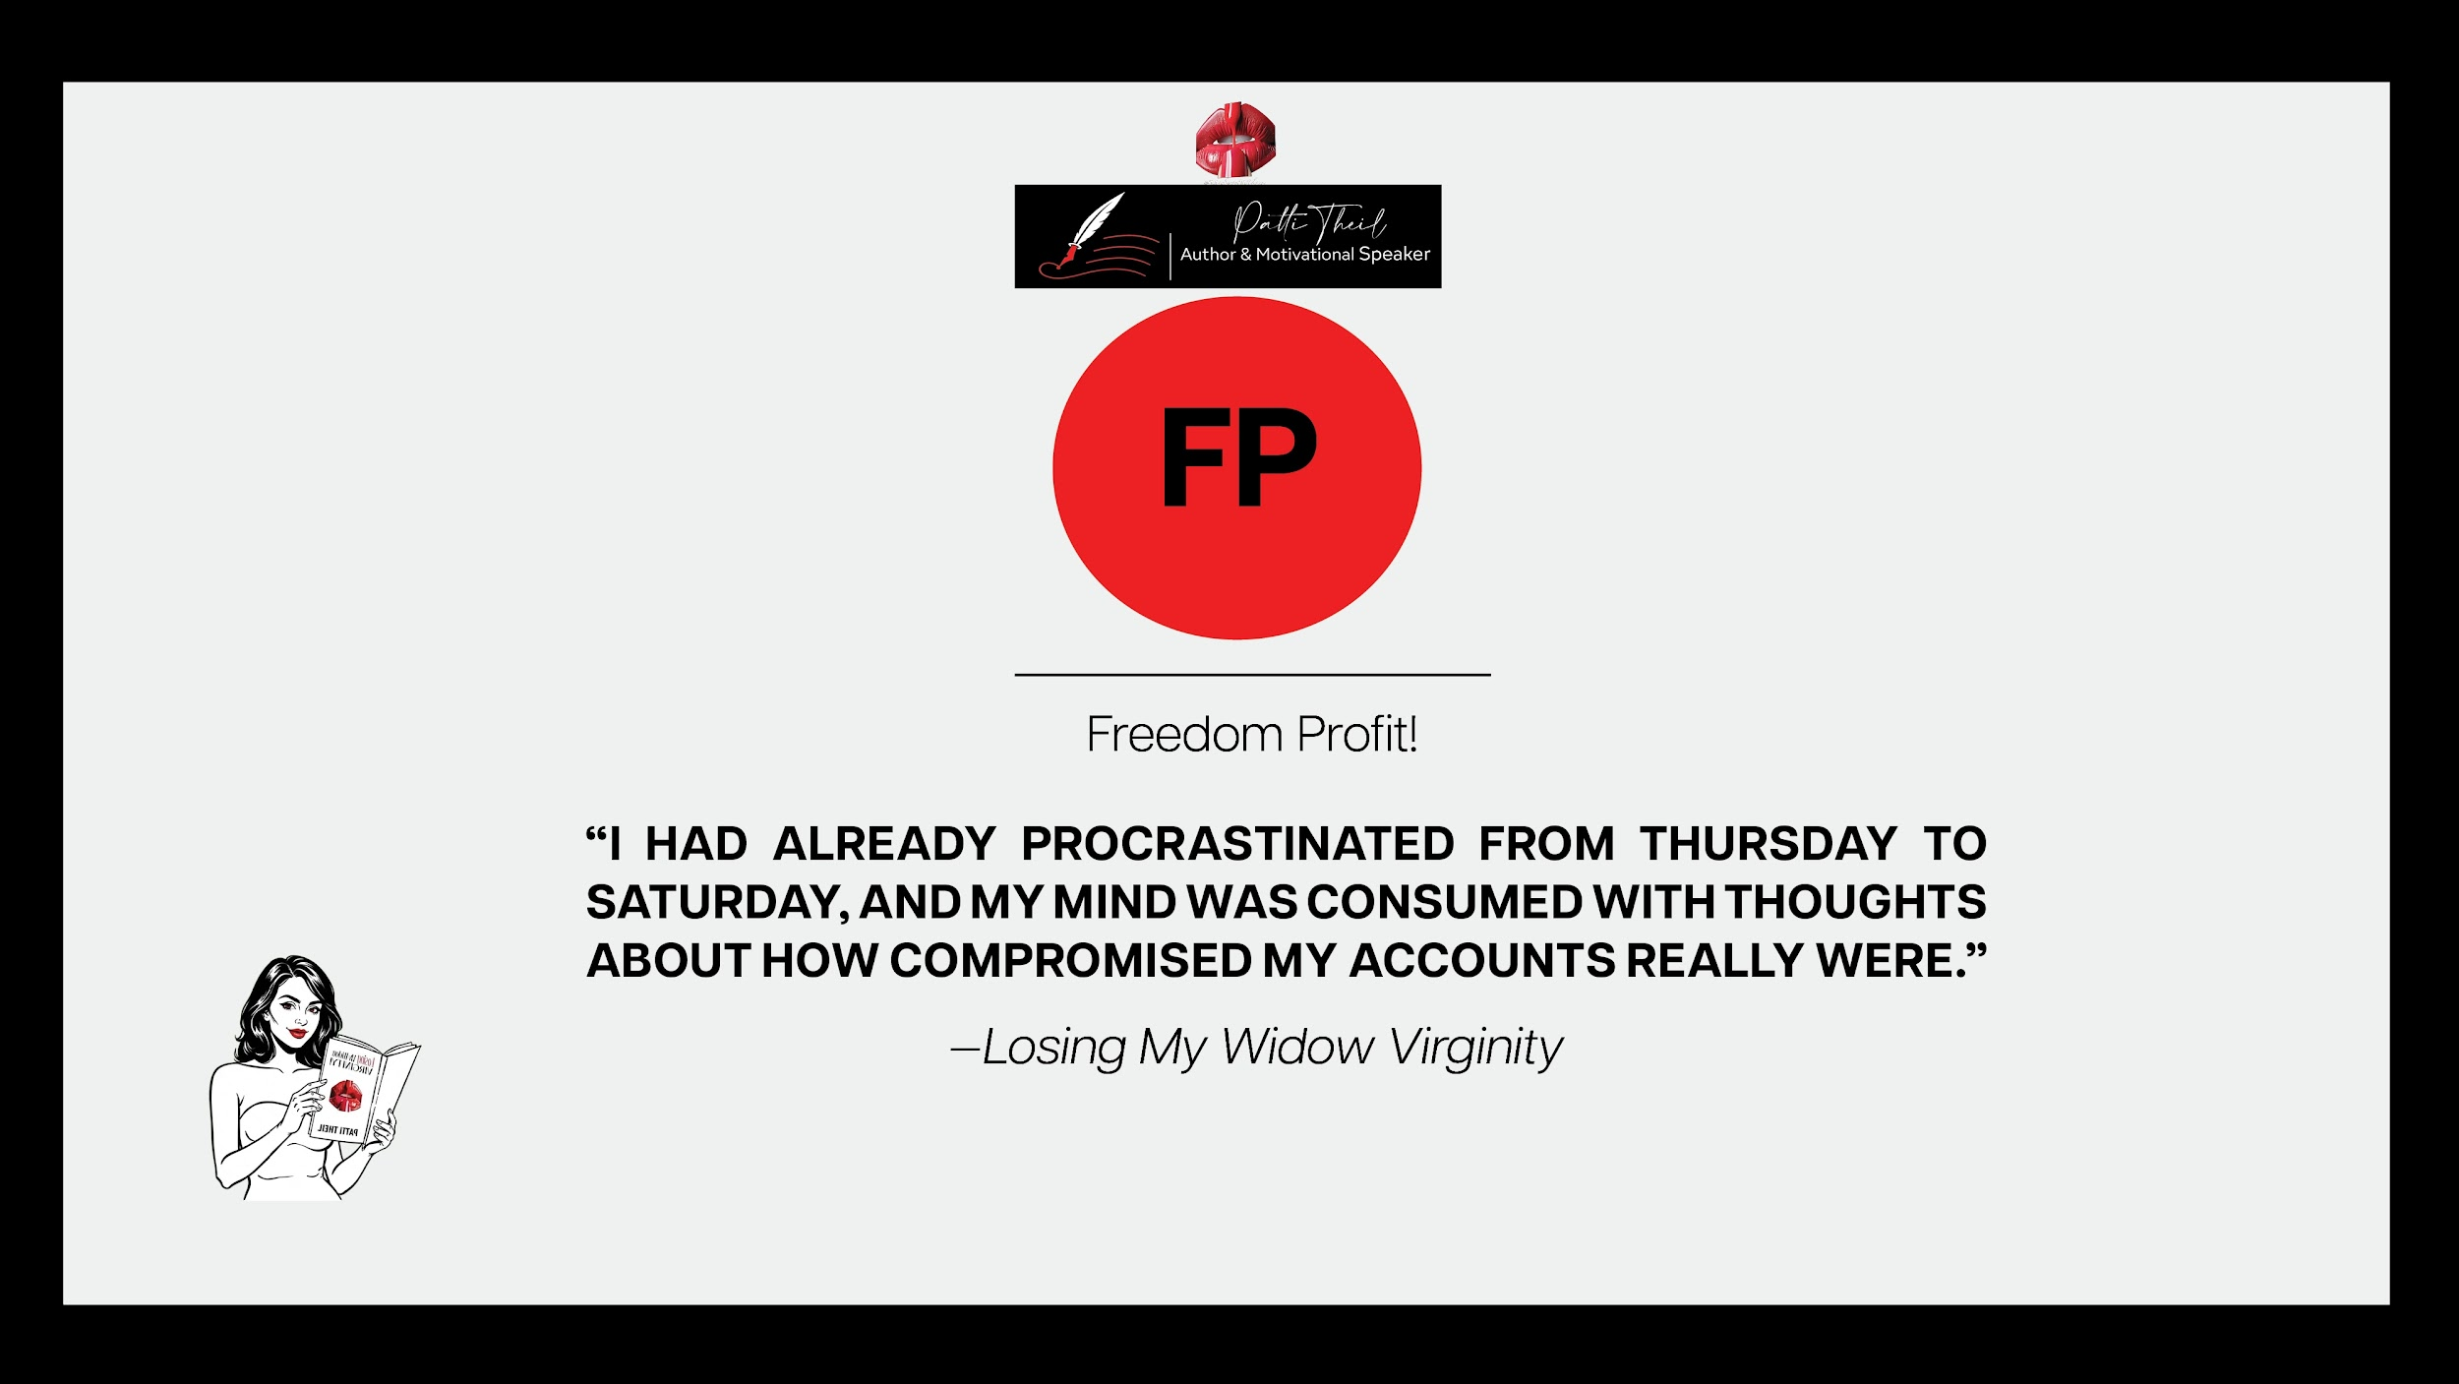
“SHE PRIORITIZED ME BECAUSE I WAS BROKEN, AND BETH WAS THE PERFECT PERSON TO REMIND ME I HAD FRIENDS. IT WAS BECAUSE OF HER, I KNEW I HADN'T BEEN FORGOTTEN, AND I COULD STILL HAVE FUN….”

Slide 16


