Slide 1
Wise Women Meeting
October 17, 2024
Barbara Kreisman, PhD

Slide 2
October Wise Women Agenda 10.17
Welcome of new participants (photo cover page)
Revisit the meaning of knowing oneself & unique characteristics
From Here poems (small groups of 4/5 each)
Highlight upcoming DU Retirement Reimagined course (January start)
Logo selection - Tree of Life & Enzo Circle
Website reveal Purposeful-Aging.org
Survey results
Next meeting dates – Nov. 14 or 21; Dec. 12 or 19th?
Facilitation/subject schedule (2025)

Slide 3
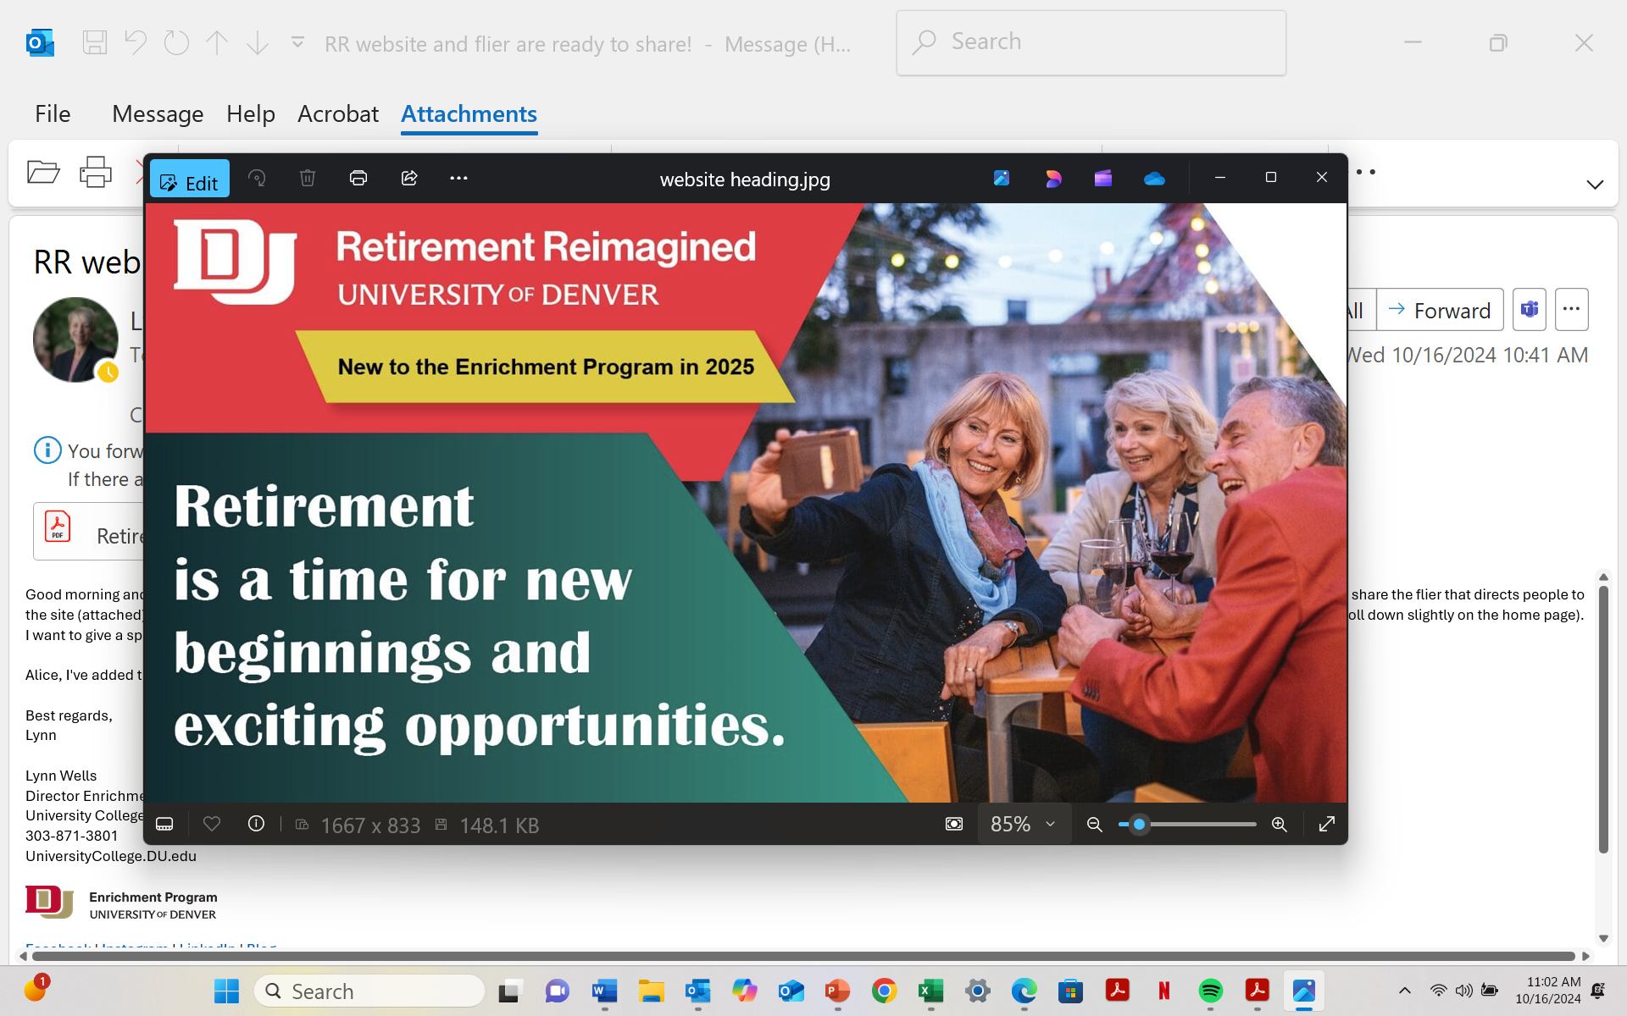
Course to Begin in January

Slide 4
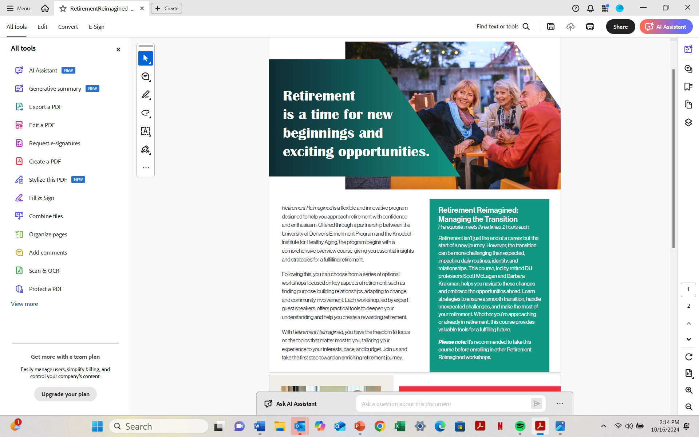
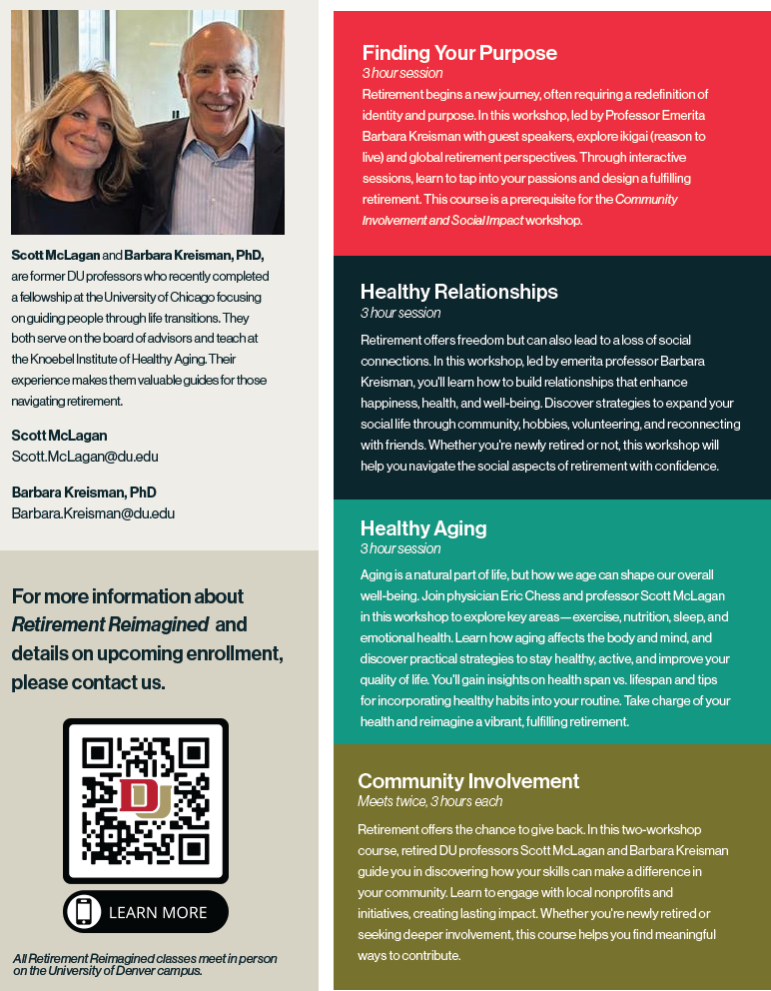
DU Course to Begin in January

Slide 5
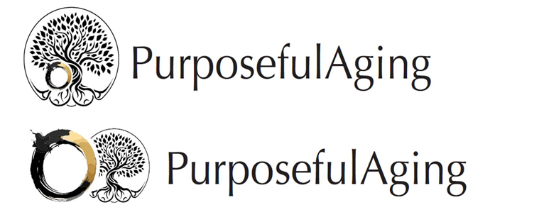


Slide 6
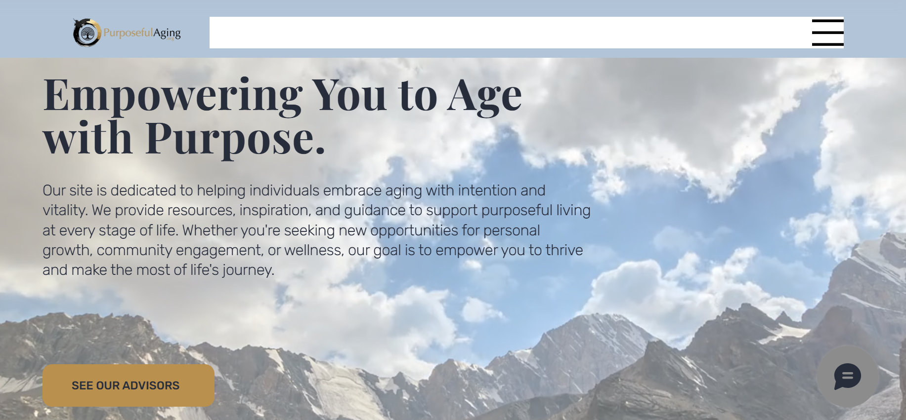

Slide 7



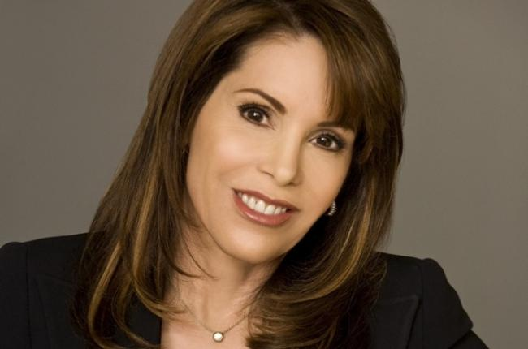
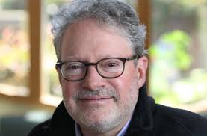
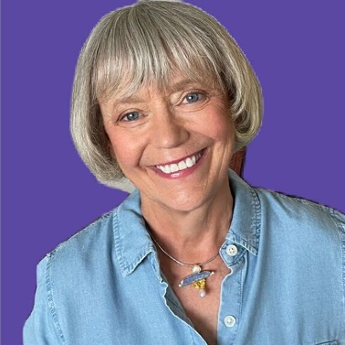

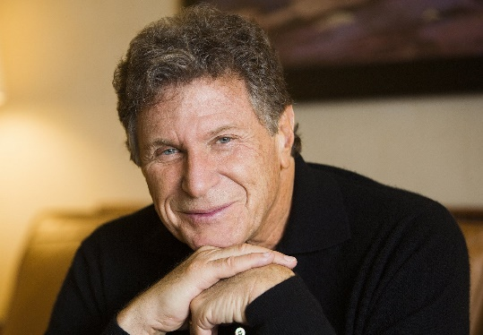


Board of Advisors/Thought Leaders
Our Advisory Board
The advisory board for the Purposeful Aging organization consists of experts from various fields, including healthcare, senior care, and wellness, providing valuable insights and guidance. Their combined expertise ensures that the website delivers accurate, up-to-date information and practical solutions to help individuals age gracefully and maintain a high quality of life. Through their support, the website stays at the forefront of aging wellness trends and best practices.
Rebecca Chop
Author of "Still Me" and expert on dementia.
Aaron Hurst
Author of "The Purpose Economy" and founder, Purpose Mindset
Chip Conley
CEO and founder of the Modern Elder Academy and noted author
Dr. Kent Bradley
Community Health Expert
Simon Chan
Co-Chair of The NEXEL Collaborative, education focus for those over 50
Marc Freedman
President of Encore.org
Chip Conley,
CEO and founder of the Modern Elder Academy; noted author, “Learning to Love Midlife”, “A Year of Wisdom” & others. Entrepreneur
Focus: Midlife Wisdom
,
Maddy Dychtwald,
Co-founder, AgeWave, Global Futurist
Author, “Ageless Aging”, etc.
Focus: Women’s Health & Aging,
Aaron Hurst,
Author, "The Purpose Economy“, etc.. Founder, Purpose Mindset
Focus: Purpose/Non-Profit Involvement, Social Entrepreneurship
Marc Freedman,
Founder, Co-Generate;; President of Encore.org; Author, “How to Live Forever”, “The Big Shift”, “Prime Time”, etc.
Focus: Intergenerational
Dr. Rebecca Chopp, Chancellor Emerita, Educator, Spirituality, Author,
“Still Me, Accepting Alzheimer's without Losing Yourself,”
Focus: Dementia Expert
Eleanor Mills, Founder Noon.Org., Author, “Much More to Come”, journalist, entrepreneur
Focus: Involvement & Community for Women over 50
London based
Dr. Ken Dychtwald,
Author (19 books on Aging), Noted Gerontologist & Psychologist, Founder of AgeWave
Focus: Healthy Aging, Community Involvement
Kent Bradley, MD, MBA.,MPH
Community Health Expert, Public Speaker
Focus: Health & Well Being
Simon Chan,
Co-Chair of The NEXEL Collaborative,
Longevity & Work Futurist
Focus: Mid-life Education

Slide 8
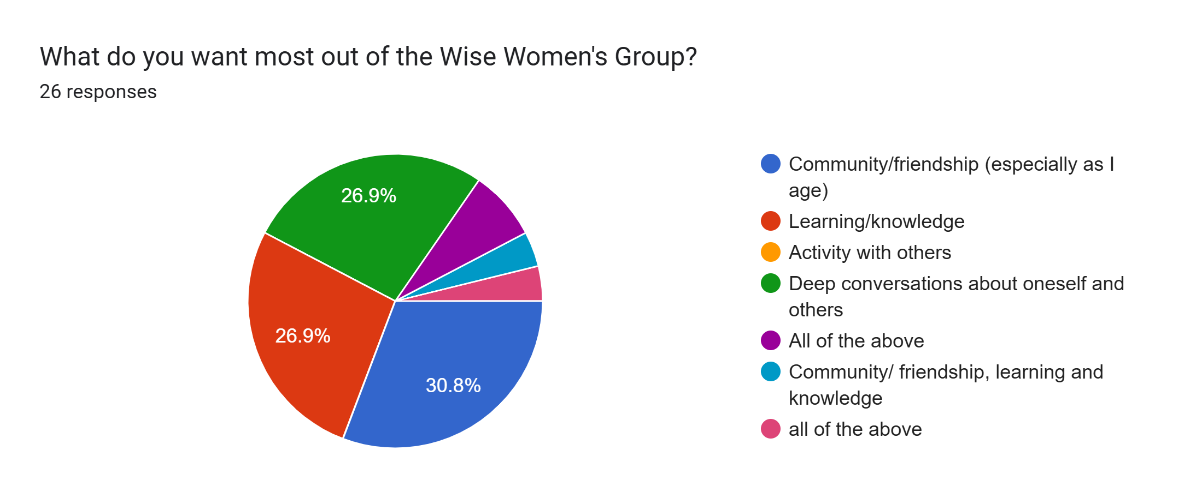
Desired Outcome
Desired Outcomes

Slide 9
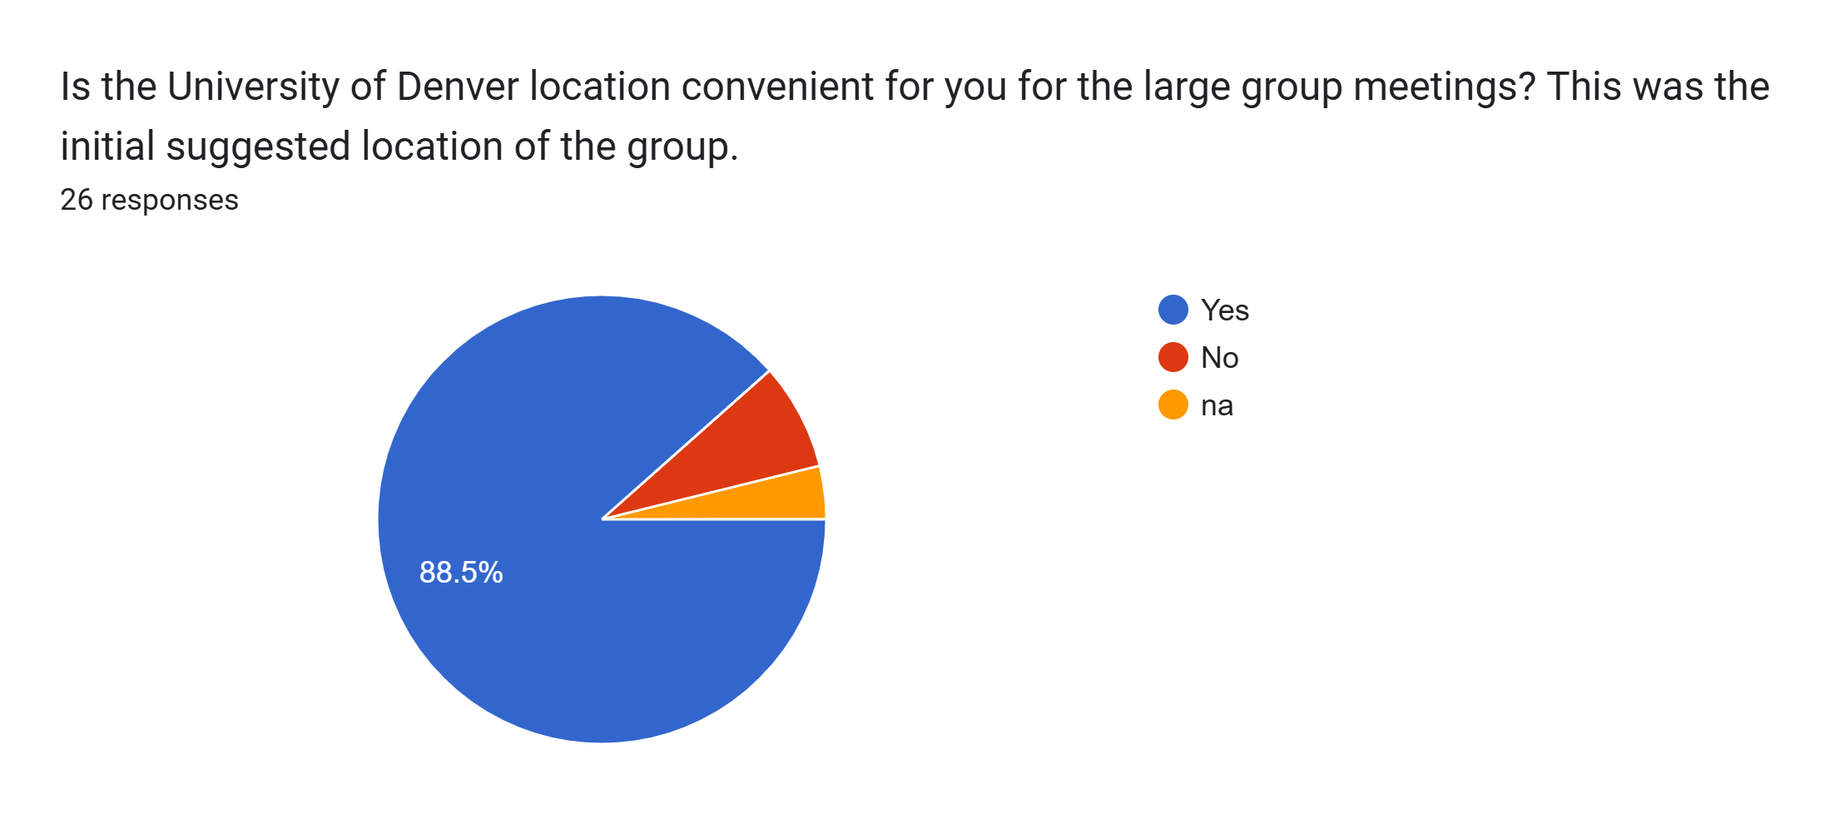
Is DU a Convenient Location?
Location Preference

Slide 10
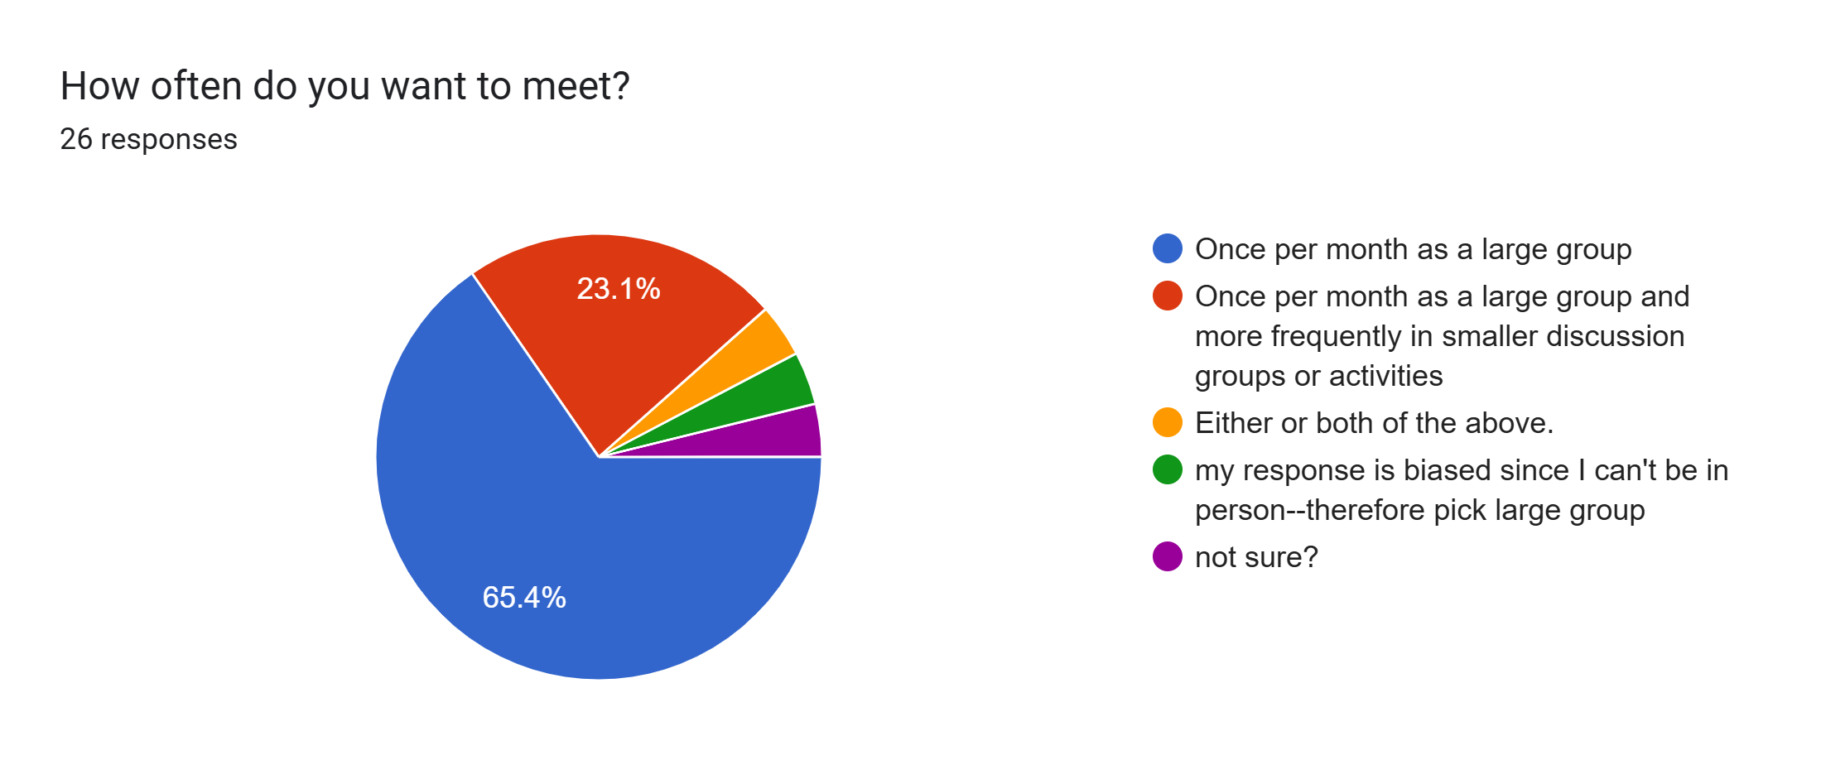
Meeting Frequency
Meeting Frequency

Slide 11
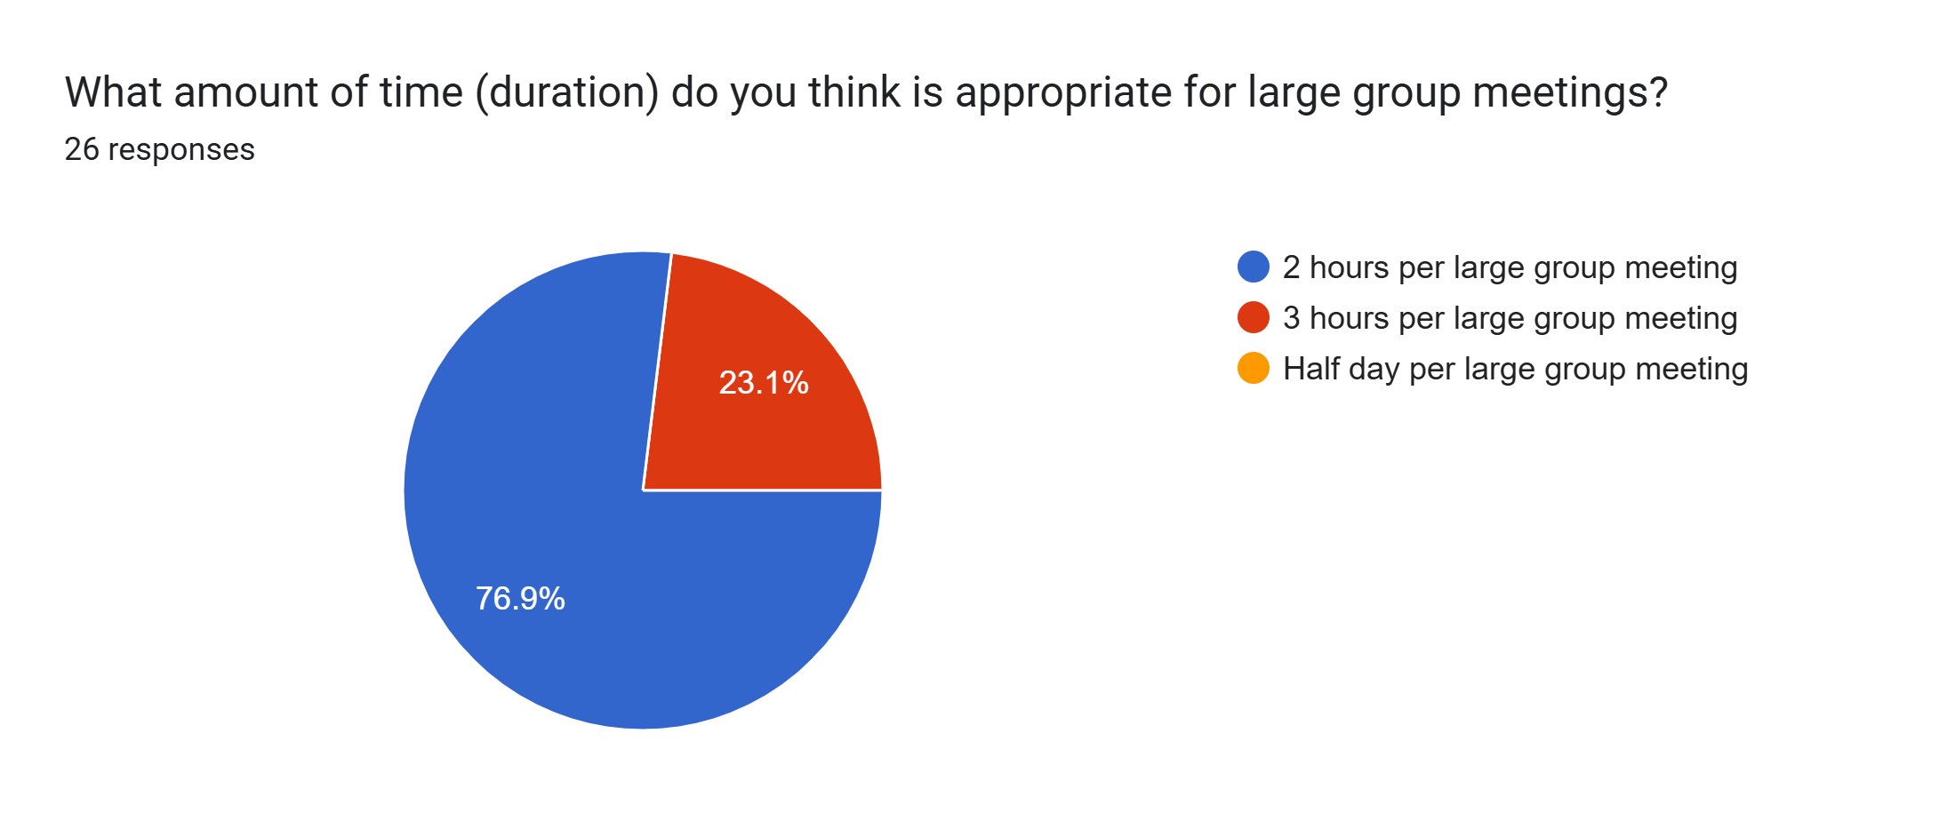
Duration of Meetings
Meeting Duration

Slide 12
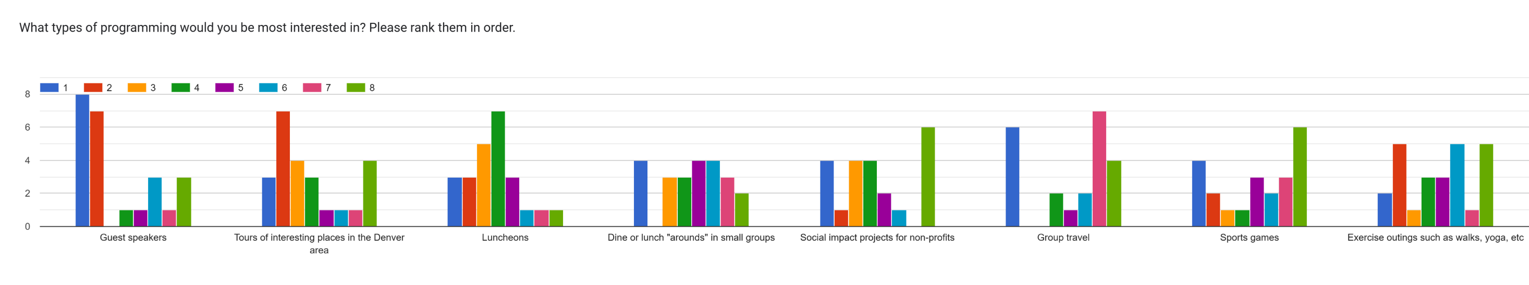
Programming
Program Interests

Slide 13
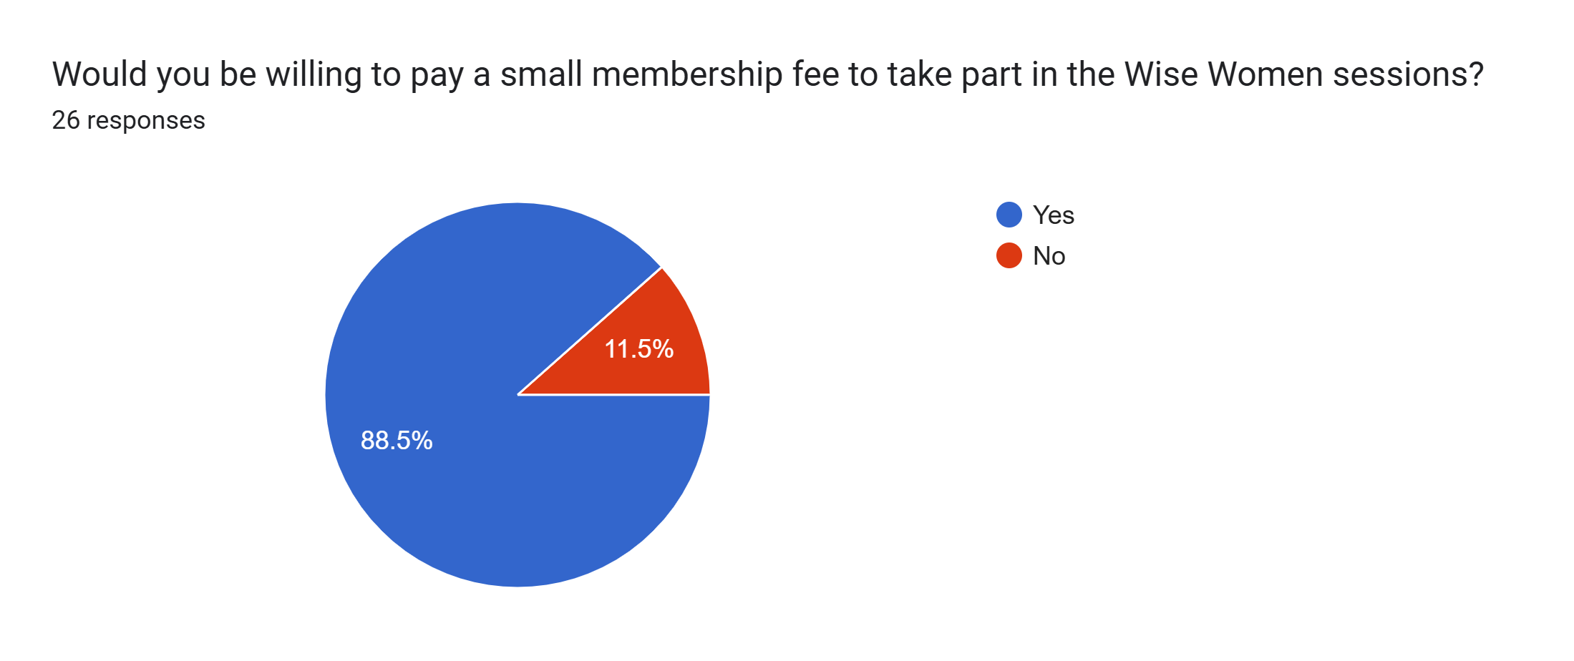
Would You Be willing to Pay a Small Fee?
Fee for Membership or Activities

Slide 14
Programming Suggestions #1
Latest research on healthy aging, e.g., supplements, activities, etc.; managing transition to third phase careers/switching careers later in life; financial/wealth management strategies
Human Animal Connection, music/art appreciation/health and well being
Perhaps each participant has some professional/personal expertise to share w/group.
Healthy aging, growth as a person
Healthy aging, practical tips on getting involved in volunteer opportunities, time management/organizing for post work schedule times
Life experiences in different professions
Understanding different religions

Slide 15
Programming Suggestions #2
I would like a better understanding the projects/passions/interests of the women in this group. It could be a nice way to get to know each other better, form tighter friendships with those of similar interests and create opportunities to learn from those that have different interests than my own.
The right to die; the culture of death in America, the social security system, women and finance, women’s aging and beauty, anything on woman poets or artists, various cultures and their notions of wisdom and women, family rituals and the role of aging especially of women. How to get people to take older women seriously or how to claim authority as an older woman I will keep thinking as the possibilities are endless
Health, science, finance
Art history of politics
Medical issues such as hormone use, bone density

Slide 16
Programming Suggestions #3
Wisdom from different cultures and traditions. Art and music composed by older artists - and their commentary.
Gardening/landscaping in light of climate change organizing my computer
Entrepreneurship and Innovation - and how our generation is embracing these opportunities.
Philosophy, current topics, art
Living with purpose, meaningful contribution
Hearing from others their intentional and/or serendipitous approach to finding meaning, fulfillment, & resilience in this "final" chapter of aging
Colorado history, Colorado geography, health in aging, Ancient history

Slide 17
Programming Suggestions #4
I would really like to hear a bit more from each woman.
Art classes A day in a life of ….(fill in blank) such as Governor Mayor Chancellor
Cultural events or classes
Woman’s Foundation of Colorado speaker
Things like art, music, collaring led as a process not of production but reflection and expression. I also think we could discuss some short you tube videos on a wide variety of topics
Cultural events
no, looks good
Current topics to make sure we stay engaged with the real world.
My responses are totally skewed by the fact I live out of town!

Slide 18
Knowledge Development #1
Latest research on healthy aging, e.g., supplements, activities, etc.; managing transition to third phase careers/switching careers later in life; financial/wealth management strategies
Human Animal Connection, music/art appreciation/health and well being
perhaps each participant has some professional/personal expertise to share w/group.
Healthy aging, growth as a person
Healthy aging, practical tips on getting involved in volunteer opportunities, time management/organizing for post work schedule times
Life experiences in different professions Understanding different religions
I would like a better understanding the projects/passions/interests of the women in this group. It could be a nice way to get to know each other better, form tighter friendships with those of similar interests and create opportunities to learn from those that have different interests than my own.

Slide 19
Knowledge Development #2
I would like a better understanding the projects/passions/interests of the women in this group. It could be a nice way to get to know each other better, form tighter friendships with those of similar interests and create opportunities to learn from those that have different interests than my own
The right to die; the culture of death in America, the social security system, women and finance, women’s aging and beauty, anything on woman poets or artists, various cultures and their notions of wisdom and women, family rituals and the role of aging especially of women. How to get people to take older women seriously or how to claim authority as an older woman I will keep thinking as the possibilities are endless

Slide 20
Volunteer Facilitation by Subject #1
Ayurveda for healthy aging; yin yoga for healthy muscles and bones; yoga nidra for meditation
Preparation for Death and Dying; Purpose; Social Impact
Our lives in times of change and transition, what, how to, best practices, sharing, etc.
Trips to museums or events
Aging topics and resources
Culture, finance, neuroscience, psychology
Guided Autobiography Workshop (1/2 day session)
I am not in Denver but I would be happy to present on Alzheimer’s, feminist theology, and any topics in theology I know Christian theology the best but I can also present on Jewish thought I am also happy to talk about higher ed in terms of its history or future.

Slide 21
Volunteer Facilitation by Subject #2
Writing of any kind (to leave a legacy, to process thoughts and feelings, to publish as blog or submit to editors, etc.)
Hero’s Journey exploration – maybe “Parts work”
Artificial Intelligence Opportunities and Risks
Wellness, mindfulness
Insight meditation, mindful communication
Art class

