Slide 1
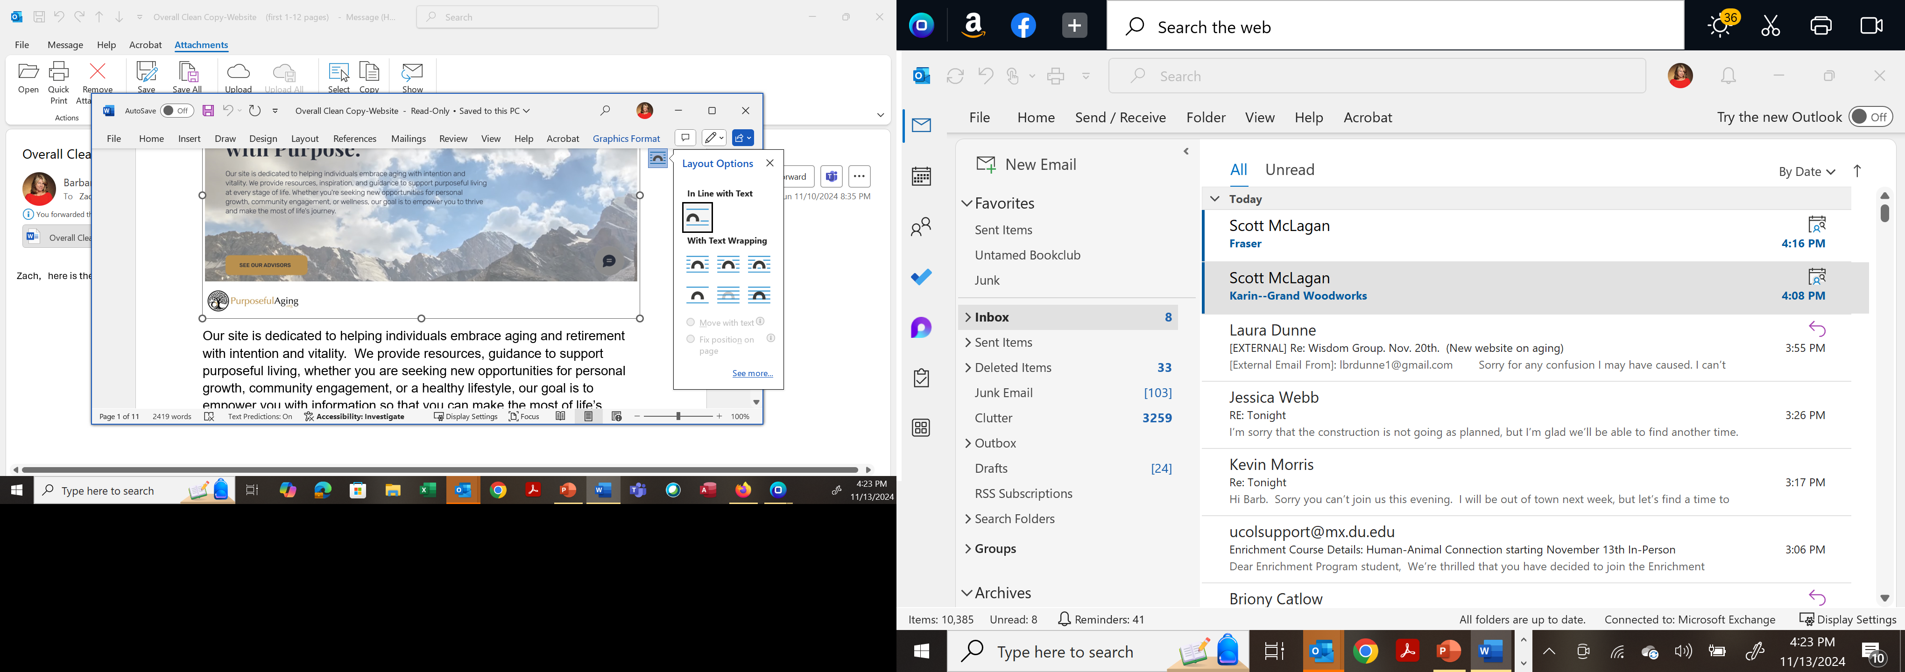
Wise Women Agenda
Introductions of New Participants
Dec. 13th Event – Wine Painting
Volunteers to Assist with 2025 Program Content
Revisit Mission and Pillars of Wisdom Group
Defining Reality
Drain the Swamp – Election & Emotion Debrief
Appreciative Inquiry – A Positive Process
“From Here” Poems
Directory Information Request

Slide 2
Wise Women Agenda
Introductions of New Participants
Dec. 13th Event – Wine Painting
Volunteers to Assist with 2025 Program Content
Revisit Mission and Pillars of Wisdom Group
Defining Reality
Drain the Swamp – Election & Emotion Debrief
Appreciative Inquiry – A Positive Process
“From Here” Poems
Directory Information Request

Slide 3

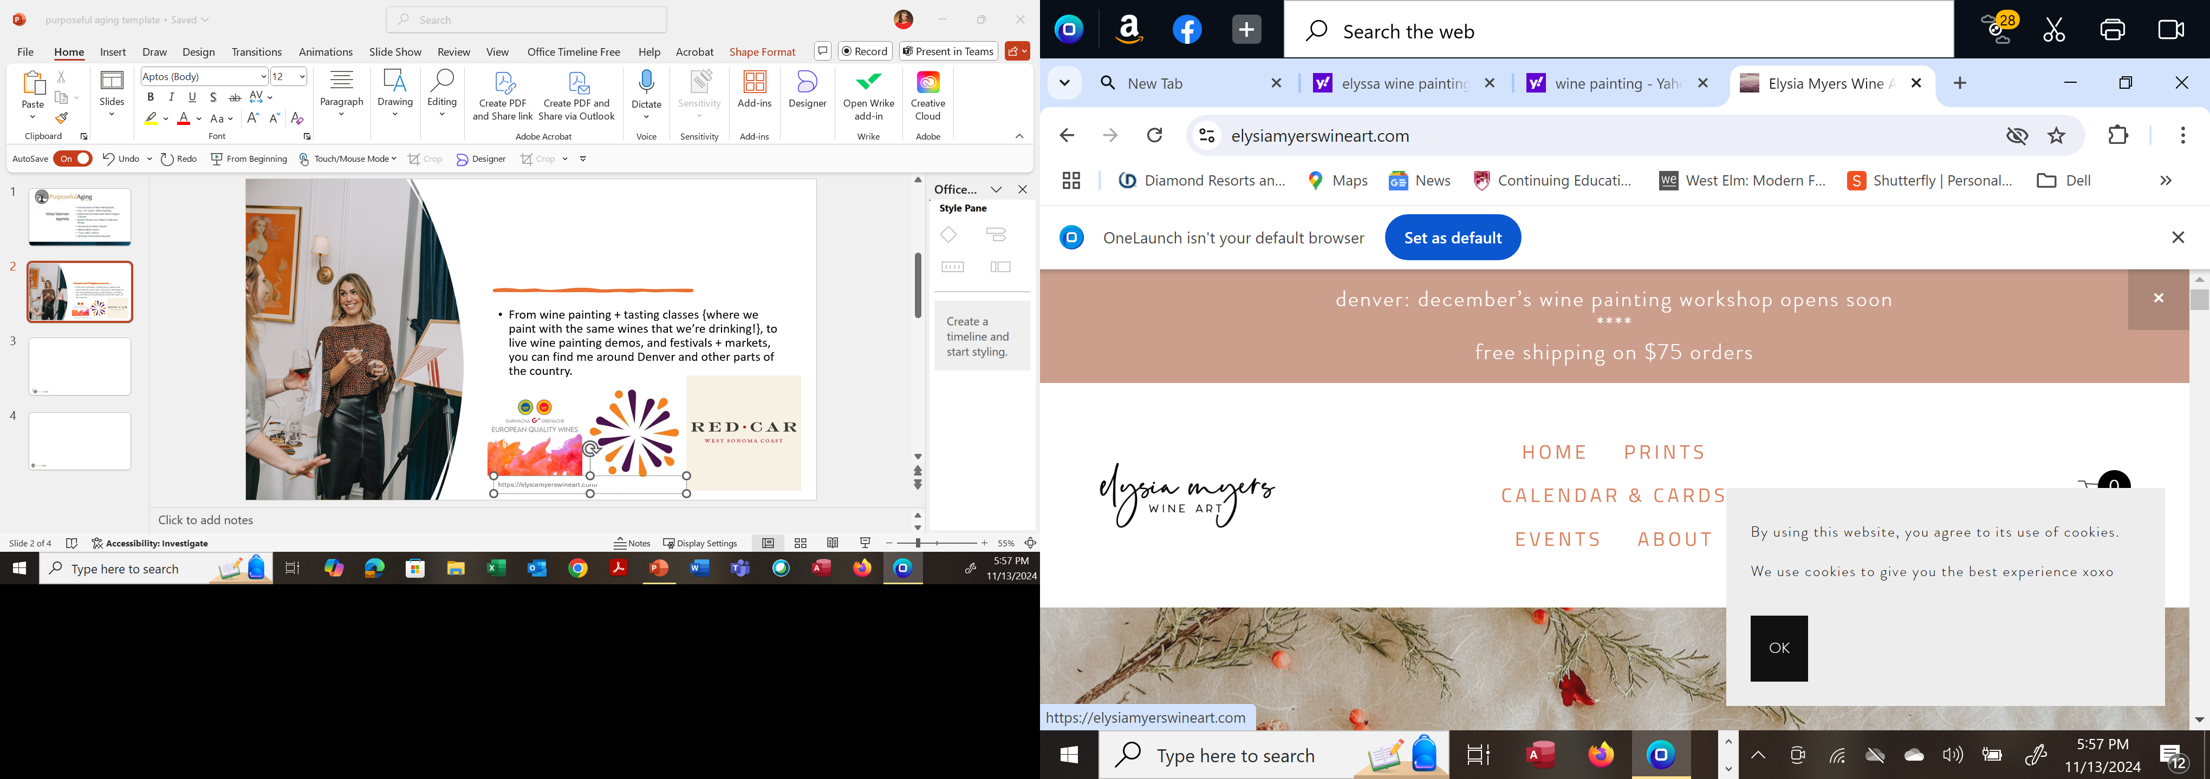



From wine painting + tasting classes {where we paint with the same wines that we’re drinking!}, to live wine painting demos, and festivals + markets, you can find me around Denver and other parts of the country.

Slide 4
Wise Women Agenda
Introductions of New Participants
Dec. 13th Event – Wine Painting
Volunteers to Assist with 2025 Program Content
Revisit Mission and Pillars of Wisdom Group
Defining Reality
Drain the Swamp – Election & Emotion Debrief
Appreciative Inquiry – A Positive Process
“From Here” Poems
Directory Information Request

Slide 5

Pressure versus Stress
“Pressure is the external demand in the environment. Everyone has pressure in their work and life: deadlines, projects, family demands. That is not stress. Stress is what people do with that pressure in their minds.”
Source: “Wake Up! The Surprising Truth about What Drives Stress and How Leaders Build Resilience; Nick Petrie

Slide 6
Reflection vs Rumination
REFLECTION
Reviewing (past)
Learning
Planning (future)
+ Positive
- Negative
Regrets (past)
Anxieties (future)
RUMINATION
Source: “Wake Up! The Surprising Truth about What Drives Stress and How Leaders Build Resilience; Nick Petrie
Notes:
The word ruminate comes from the noun ruminant. This is the term used to describe cows who chew on there cud. First they swallow their food. The they regurgitate it to chew it over again before swallowing it anew. Six times, the cycle of rumination repeats itself. Get the idea?

Slide 7
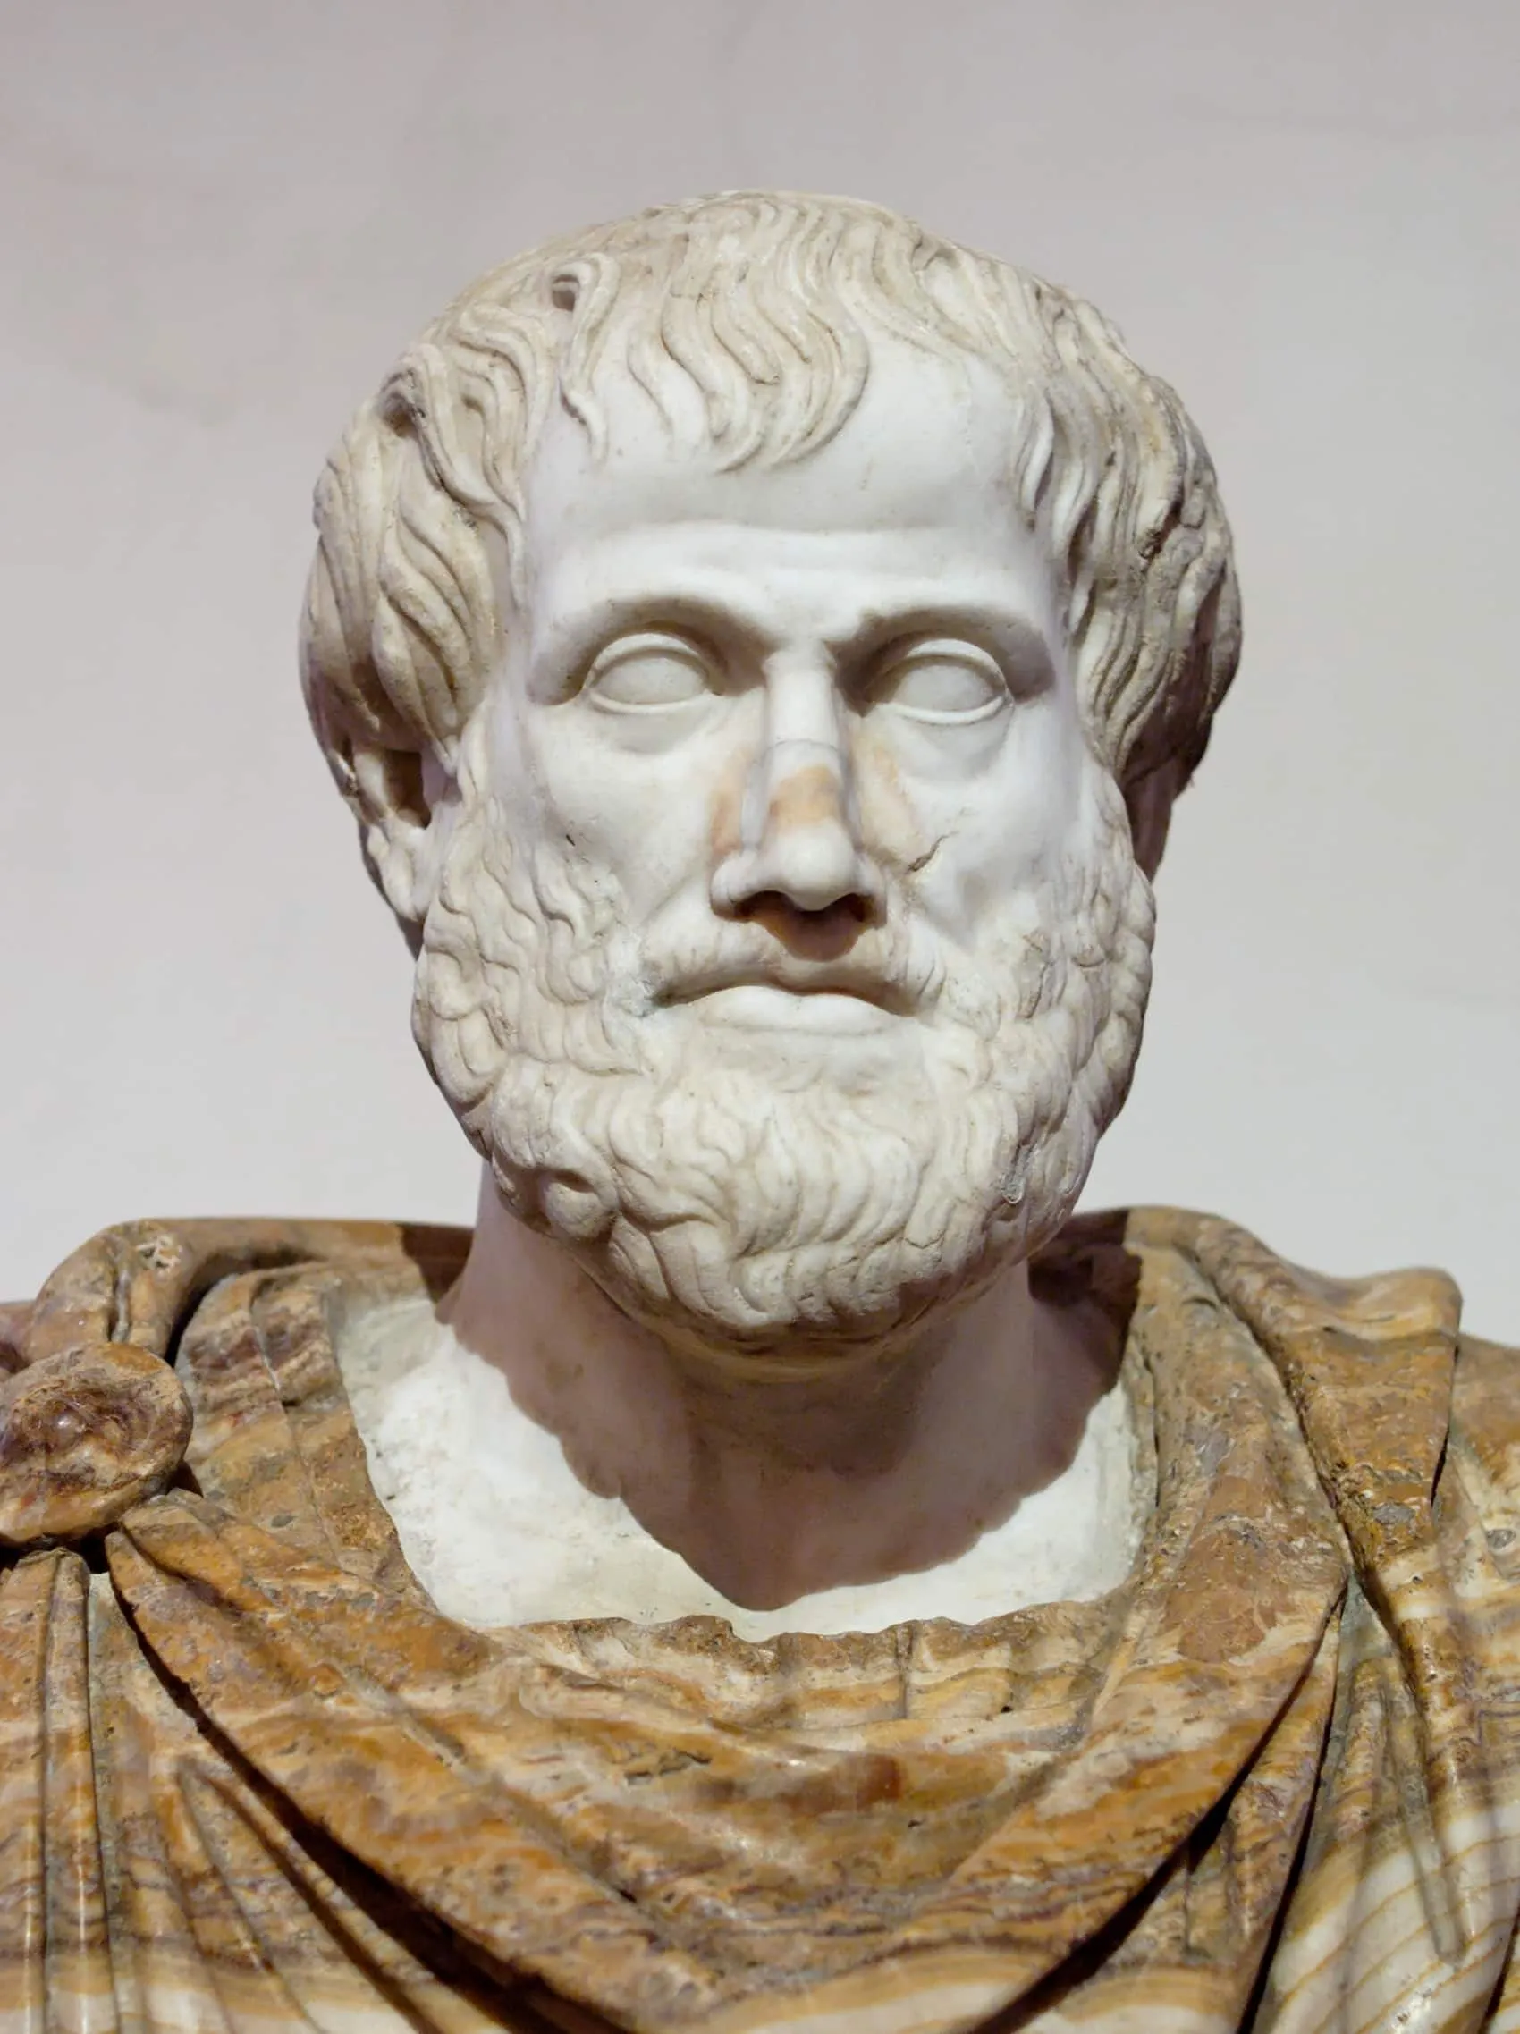

Wise Women’s Group – Pillars & Principles
Based Upon Aristotelian Wisdom & Virtues
  Knowing yourself is the beginning of all wisdom.”
  “At the intersection where your gifts, talents, and abilities meet a human need; therein you will discover your purpose.”
  “The more you know, the more you know you don't know.”
Epistemic Humility – “The more you know, the more you don’t know” There is no such thing as objective truth
Recognition and respect for each others’ milieu - culture, economic status, gender, race, early life influences, parental style, etc.

Slide 8
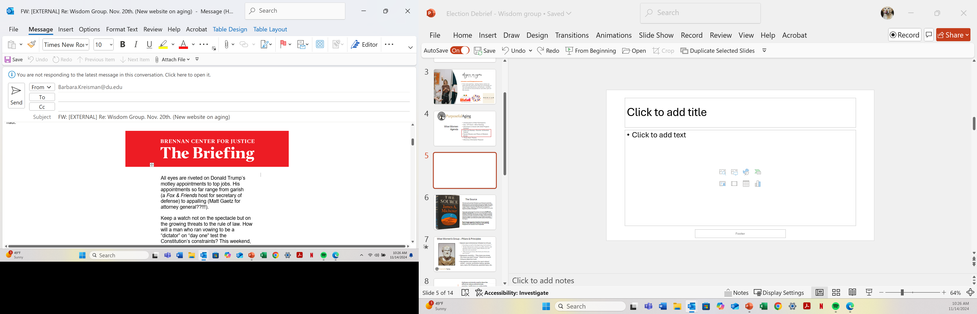
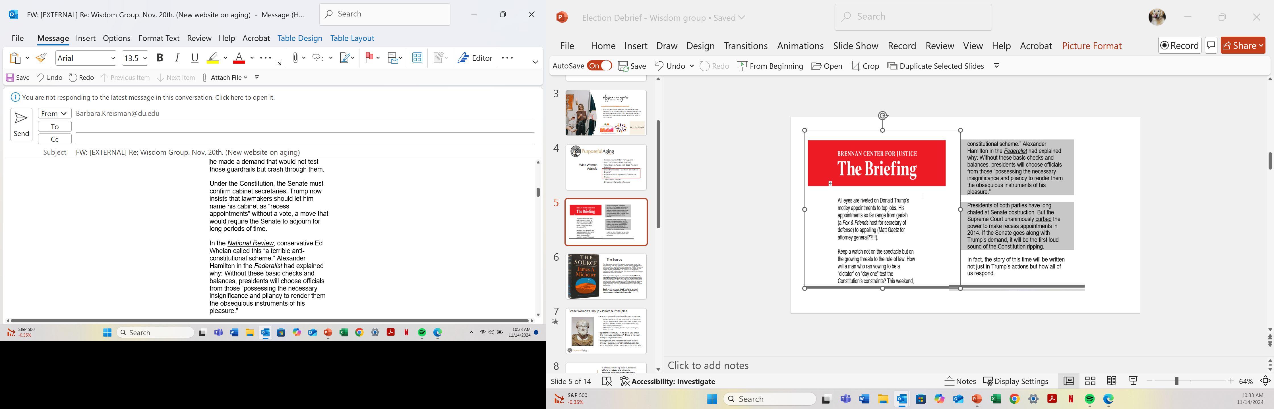
The Realities

Slide 9

The Source
The Source by James Michener is a historical novel that explores the rich and complex history of the land of Israel, stretching from ancient times through the 1960s. The story is framed around an archaeological dig at a fictional site called “Makor” (meaning “The Source” in Hebrew) in northern Israel, where a group of archaeologists excavates layers of ancient civilization.
Each layer at the dig site reveals remnants of different cultures and epochs, and as the archaeologists unearth artifacts, Michener introduces a series of interconnected narratives that span thousands of years. These individual stories bring to life characters from different time periods, allowing readers to experience major historical events, religious shifts, and cultural transformations that shaped the region.
Each level reveals itself to have lasted about 250-300 years before something happens to cause it to implode

Slide 10
Draining the Proverbial Swamp
A phrase commonly used to describe efforts to reduce and eliminate emotion, inefficiency or undesirable elements that harm the integrity of the whole
Originated from actual swamp draining practices aimed at improving land for development & reducing diseases but has evolved to symbolize deep, negative emotions that need to be addressed
What were/are your emotions as you consider Donald Trump to be our president for the next four years?

Slide 11
What Would Ari Do?
Aristotle, in his work Politics, would likely view the election of a controversial person through the lens of his theory on good and bad forms of government. He identified three ideal types of government—monarchy, aristocracy, and polity—and their corresponding corrupt forms.
In a democracy, for instance, where the majority’s decision should ideally reflect the interests of the whole community, Aristotle worried that demagogues (leaders who manipulate the masses) could exploit popular sentiment and lead people astray. In this case, the more controversial person winning could be a sign that the electorate was swayed by rhetoric rather than sound reasoning or virtue. If the person chosen was not genuinely wise or virtuous, but rather a person who appealed to base desires, Aristotle would see it as a failure of both the democratic system and the individual’s judgment.

Slide 12
Active Engagement and Civic Virtue: Aristotle would urge citizens not to disengage from politics, even if they believe the wrong person was chosen. but should continue to engage in public discourse & hold leaders accountable, He would encourage citizens to be involved in local affairs and to contribute to creating a virtuous society, rather than simply resigning themselves to the idea that one poor election outcome is irreversible
Promote Education: After an election outcome that is controversial, Aristotle believed the focus should shift to educating the public especially on how to make sound, virtuous decisions. Seasoned judgement, philosophical thinking and civic education could help mitigate the impact of bad leadership
Act in Accordance with the Common Good: Aristotle would encourage the public to work collectively toward the common good meaning that citizens should be prepared to oppose unjust actions by the elected leader, but also take steps to support policies that benefit society as a whole. The key would be keeping the broader goal of justice and the well-being of the community in mind, rather than merely reacting to individual leaders

Slide 13
Appreciative Inquiry-Key Principles
Positive, strengths-based encouraging discussion & shared a vision
AI is based upon asking positive questions
Participants seek to find and share positive stories; not problems
Intent is to inspire others through questioning
Change is more effective if it is collaborative
Future oriented attempting to imagine the best possible

Slide 14
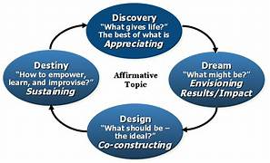
Appreciative Inquiry Design Model

Slide 15
Appreciative Inquiry Questions
What are some ways in which we can influence (educate) others in a positive manner during the next four years?
How do we seek to make a difference four years from now in support of the common good?
How can we minimize the negative rhetoric?
How can we better understand different individuals’positions political views?

Slide 16
Wise Women Agenda
Introductions of New Participants
Dec. 13th Event – Wine Painting
Volunteers to Assist with 2025 Program Content
Revisit Mission and Pillars of Wisdom Group
Defining Reality
Drain the Swamp – Election & Emotion Debrief
Appreciative Inquiry – A Positive Process
“From Here” Poems
Directory Information Request

